Slide 1
Fellowship Church Sunday School Jan – July 2022, Acts of the Apostles Today – Turn to Acts 26 A Complete Testimony Teacher: Bill Heath

Slide 2
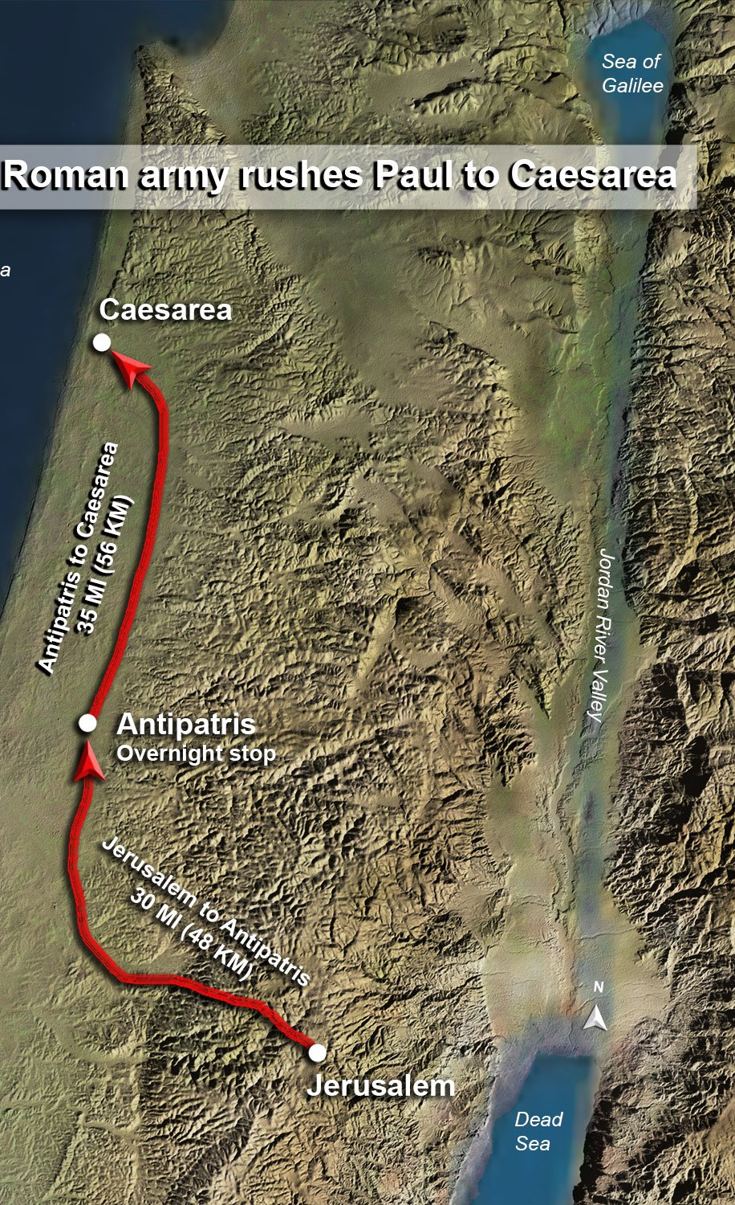
Acts 21:15-26:32, Paul’s 5 Trials
Acts At Jerusalem before Jews (12 days)
21:15-26 Vow at the Temple & false witness
1st 22:1-29 Testimony to angry mob & soldiers rescue
2nd 22:30-23:35 Witness to the Council & soldiers rescue
At Caesarea before Gentiles (>2 years)
3rd 24:1-27 Witness to Governor Felix (> 2 years)
4th 25:1-12 Witness to Governor Festus (> 14 days)
5th 25:13-26:32 Testimony to King Agrippa (near 30 days)
27-28 Trip to Rome (1st known in Acts 19:21)

Slide 3
My Testimony
“Witness Stand”
1st Against Jesus
2nd Experience Jesus
3rd For Jesus
Judge, Defense, Court Clerk, & Bailiff:
God, Jesus Christ, the Holy Spirit & Scripture
Prosecution: None
Audience: Fellowship Church (seen & heard – July 31), the angels (unseen)

Slide 4
Acts 26, Paul’s Testimony before Agrippa, the Military Captains, and the City Elite (Acts 25:23)
26:1-3 / Introduction – depends on the audience
26:4-12 Life against Jesus of Nazareth (LOST)
- Do many things contrary to the name of Jesus
- I gave my voice against followers of Jesus
26:13-18 Experience the Lord Jesus (SAVED)
- Now and in the future a minister and witness of Jesus
- Used to open eyes, turn from darkness to light & authority of Satan to God,
26:19-23 Life for Christ (CHANGED)
Repent & turn to God > works > help of God
Witness Christ’s death & resurrection to others
26:24-32 / Reaction of Others (my witness: fear or faith, survive or revive)
Questions?
Next Sunday: Acts 27 Free Escort & Ship Ride to Rome Teacher: Justin Olsen

