Slide 1
Fellowship Church Sunday School Jan – July 2022, Acts of the Apostles Today – Turn to Acts 28 Destination Rome, or Washington DC Teacher: Bill Heath

Slide 2
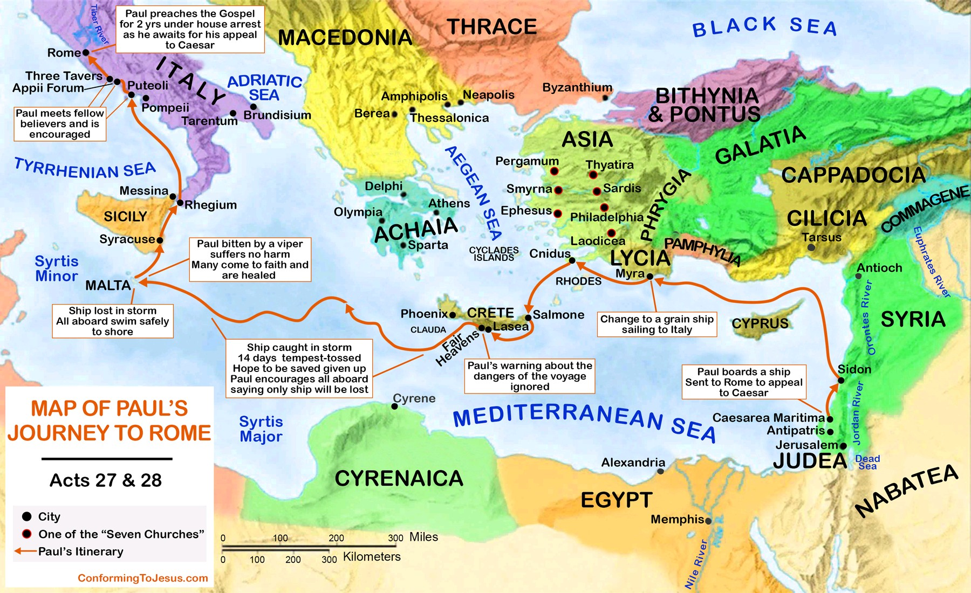

Slide 3
Acts 28 - Destination Rome, or Washington DC
28:1-10 Their Ship Wrecks at Malta (after 3 months)
1-2, 7 Hospitable barbarians to 273 souls non-Greek speakers
3-6 Miracle reveals superstition shake it off & from murderer to god
8-10 Healing all and blessings
28:11-16 Trip to Rome
11-14 Delays for compass & south wind found brethren at Puteoli (7 days)
15 Brethren travel to see Paul Appii Forum & Three Taverns /33 & 43 mi
16 Paul’s personal lodging and protection
28:17-31 At Rome (2 years)
17-22 Appointment with the chief Jews (after 3 days) Review of Acts 21:15 to present
23-29 Expound and testify the kingdom of God (9 hours) Left the Jews, Isaiah 6:9-10
30-31 Received ALL that CAME
Preaching the kingdom of God & Teaching the Lord Jesus Christ
Questions? Next Sunday: Acts 29 - Testimony Sunday

