Slide 1
Fellowship Church Sunday School Jan – July 2022, Acts of the Apostles Today – Turn to Acts 29 My Salvation Testimony Sunday Speaker: Several

Slide 2
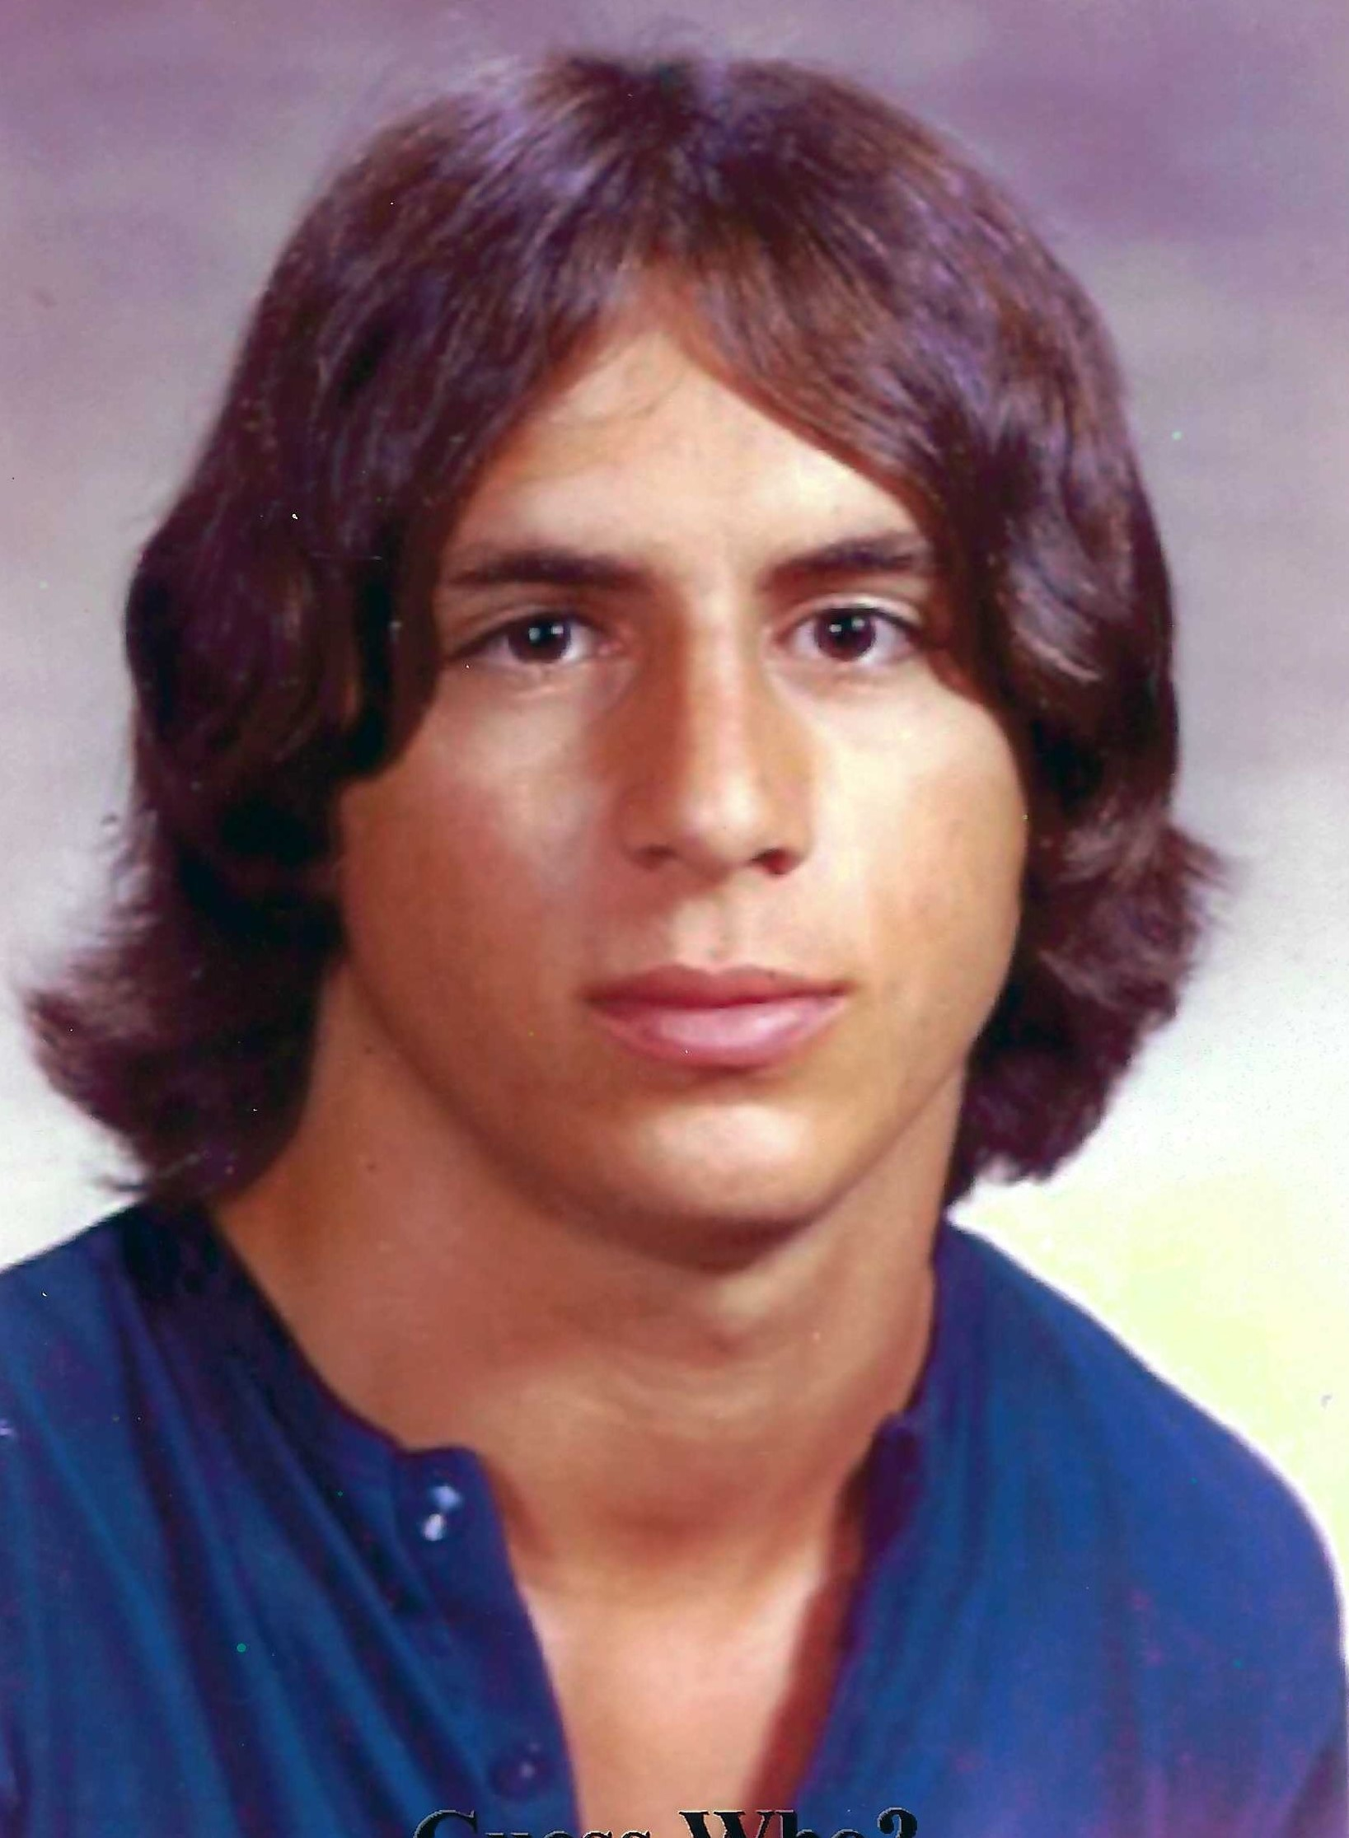
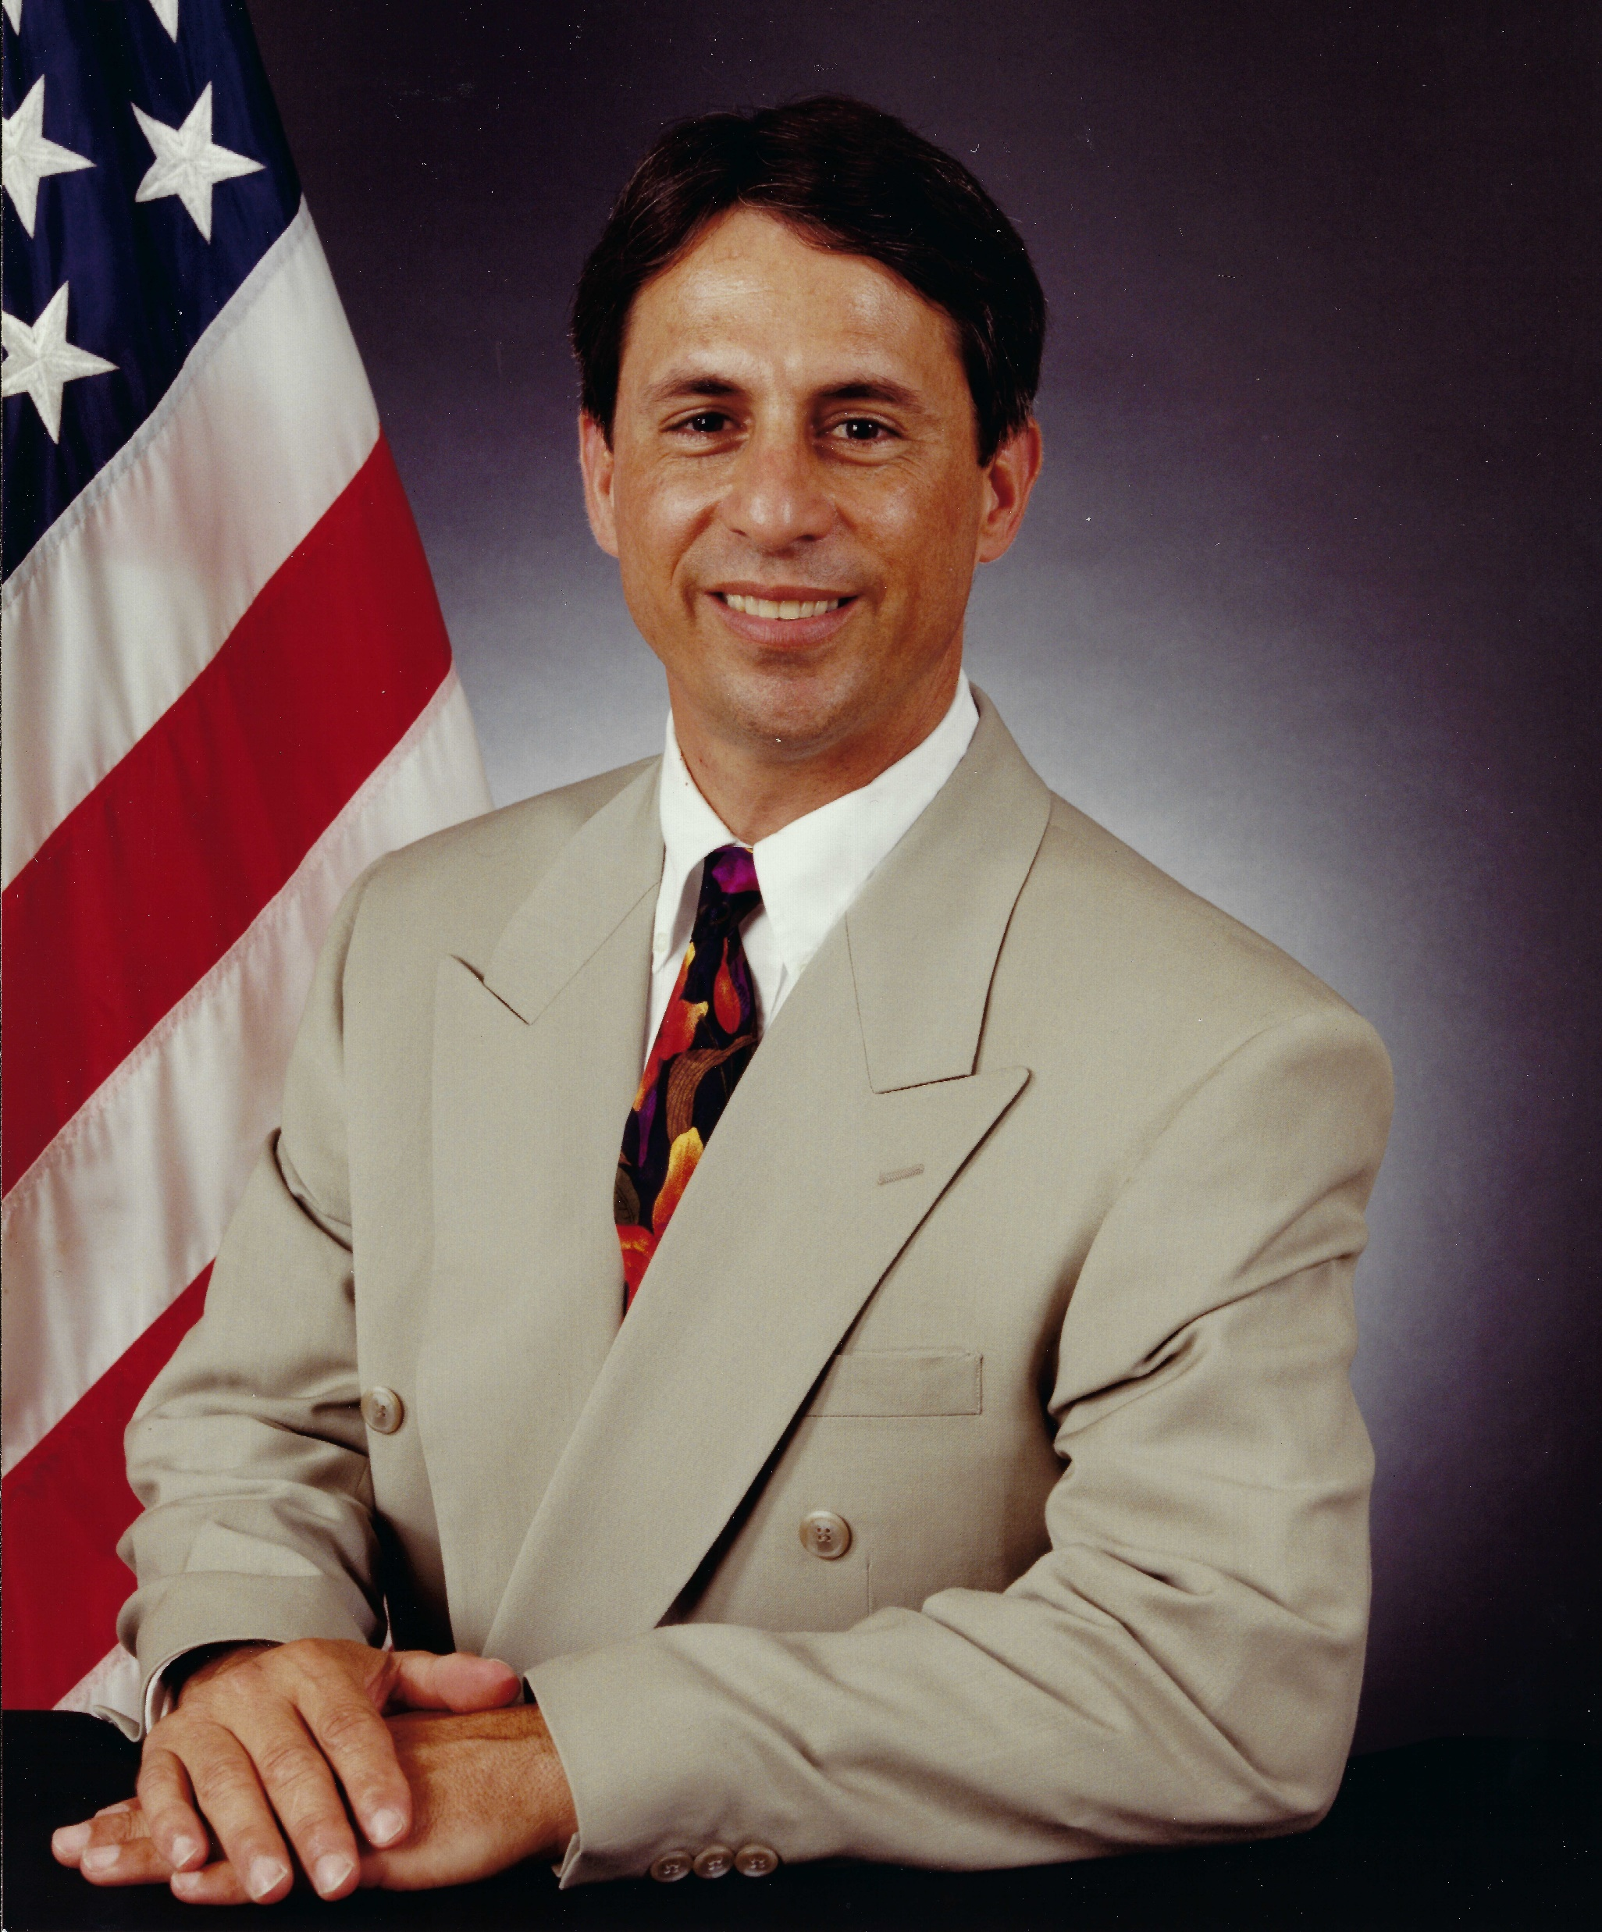
LOST
O-20 Years
SAVED
21 Years
July 7, 1976
CHANGED
21 + Years

Slide 3
My Salvation Testimony patterned after Paul in Acts 26:4-23 in less than 5 minutes
Before Salvation (Lost)
Salvation (Saved)
After Salvation (Changed)
We are living epistles (1 Cornithians 3)

