Slide 1
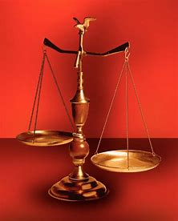
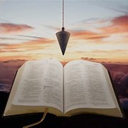
Perplexity to Praise, Trouble to Triumph, Grief to Glory
Fellowship Church, April 12, 2023 by Bill Heath
Following Christ in a
Balanced and Straight Way
Precept upon precept,
line upon line, here a little,
there a little (Isaiah 28:10,13)
#1 – Daily Scripture & Prayer Plan
#2 – Worldly Sin (Romans1:18-3)
#3 – God’s Salvation (Romans 4-5)
#4 – Who am I Connected to? (Ez 37)
#5 – Life ain’t what it use to be (1Cor 13:11)
#6 – Amos the Master Worker (Amos)
#7 – A Peculiar Relationship (Joab-David)
#8 – Habakkuk
OT: Deut 25:13-16
Daniel 5:25-28
NT: Hebrews12:1
1 Cor 3:11-15
OT: Ps 5:8, Pr 4:25-27
Amos 7:7-8
NT: Mt 3:3, Acts 9:11
Hebrews 12:13

Slide 2
Amos the Master Worker (1:1-2, 7:14-15)
Israel’s past suffering for sin and future glory
Sin: For 3 transgressions of ______, and for 4 (8x)
(3:3) Can 2 walk together, except they be
agreed?
(5:24) Let judgment run down as waters, and
righteousness as a mighty stream.
(7:8) I will set a plumb line in the midst of my
people Israel
(8:11) God sends a famine of hearing the
words of the LORD
Glory: (9:11) I will raise up the Tabernacle of
David (1000-year reign of Christ on earth)
Believer’s suffering for Christ and future glory
Sin: (1 Peter 4:17) Judgment must begin at the
house of God (sin)
Glory: (1 Peter 5:1-11) Suffering then glory in
due time
The God Squad or 9 Commanding Officers (CO)
Leader: in front, Jesus Christ with binoculars & pistol
Fire Team #1: Doctrine (by faith, from the heart)
1st: COntent
2nd: COntext
3rd: COncise
4th: COncept
Fire Team #2: Application (obey or disobey)
1st: COmfort or COnvict or Challenge
2nd: COnfirm or COnfess
3rd: COnverse or COnsult
4th: COnduit and COnduit
Help as needed from behind: Medic & grenadier
Goal: COnsistently, COnsumed for the glory of God
Inductive Bible Study
(passage-based)
Observations
Interpretations
What? What?
Application
WWJD
WDJD
WMID

