Slide 1
Fellowship Church Sunday School Nov-Dec 2022 Daniel’s Miracles & Prophecies Today – Turn to Daniel 1 The 100% Uncompromised Heart taught by: Bill Heath

Slide 2
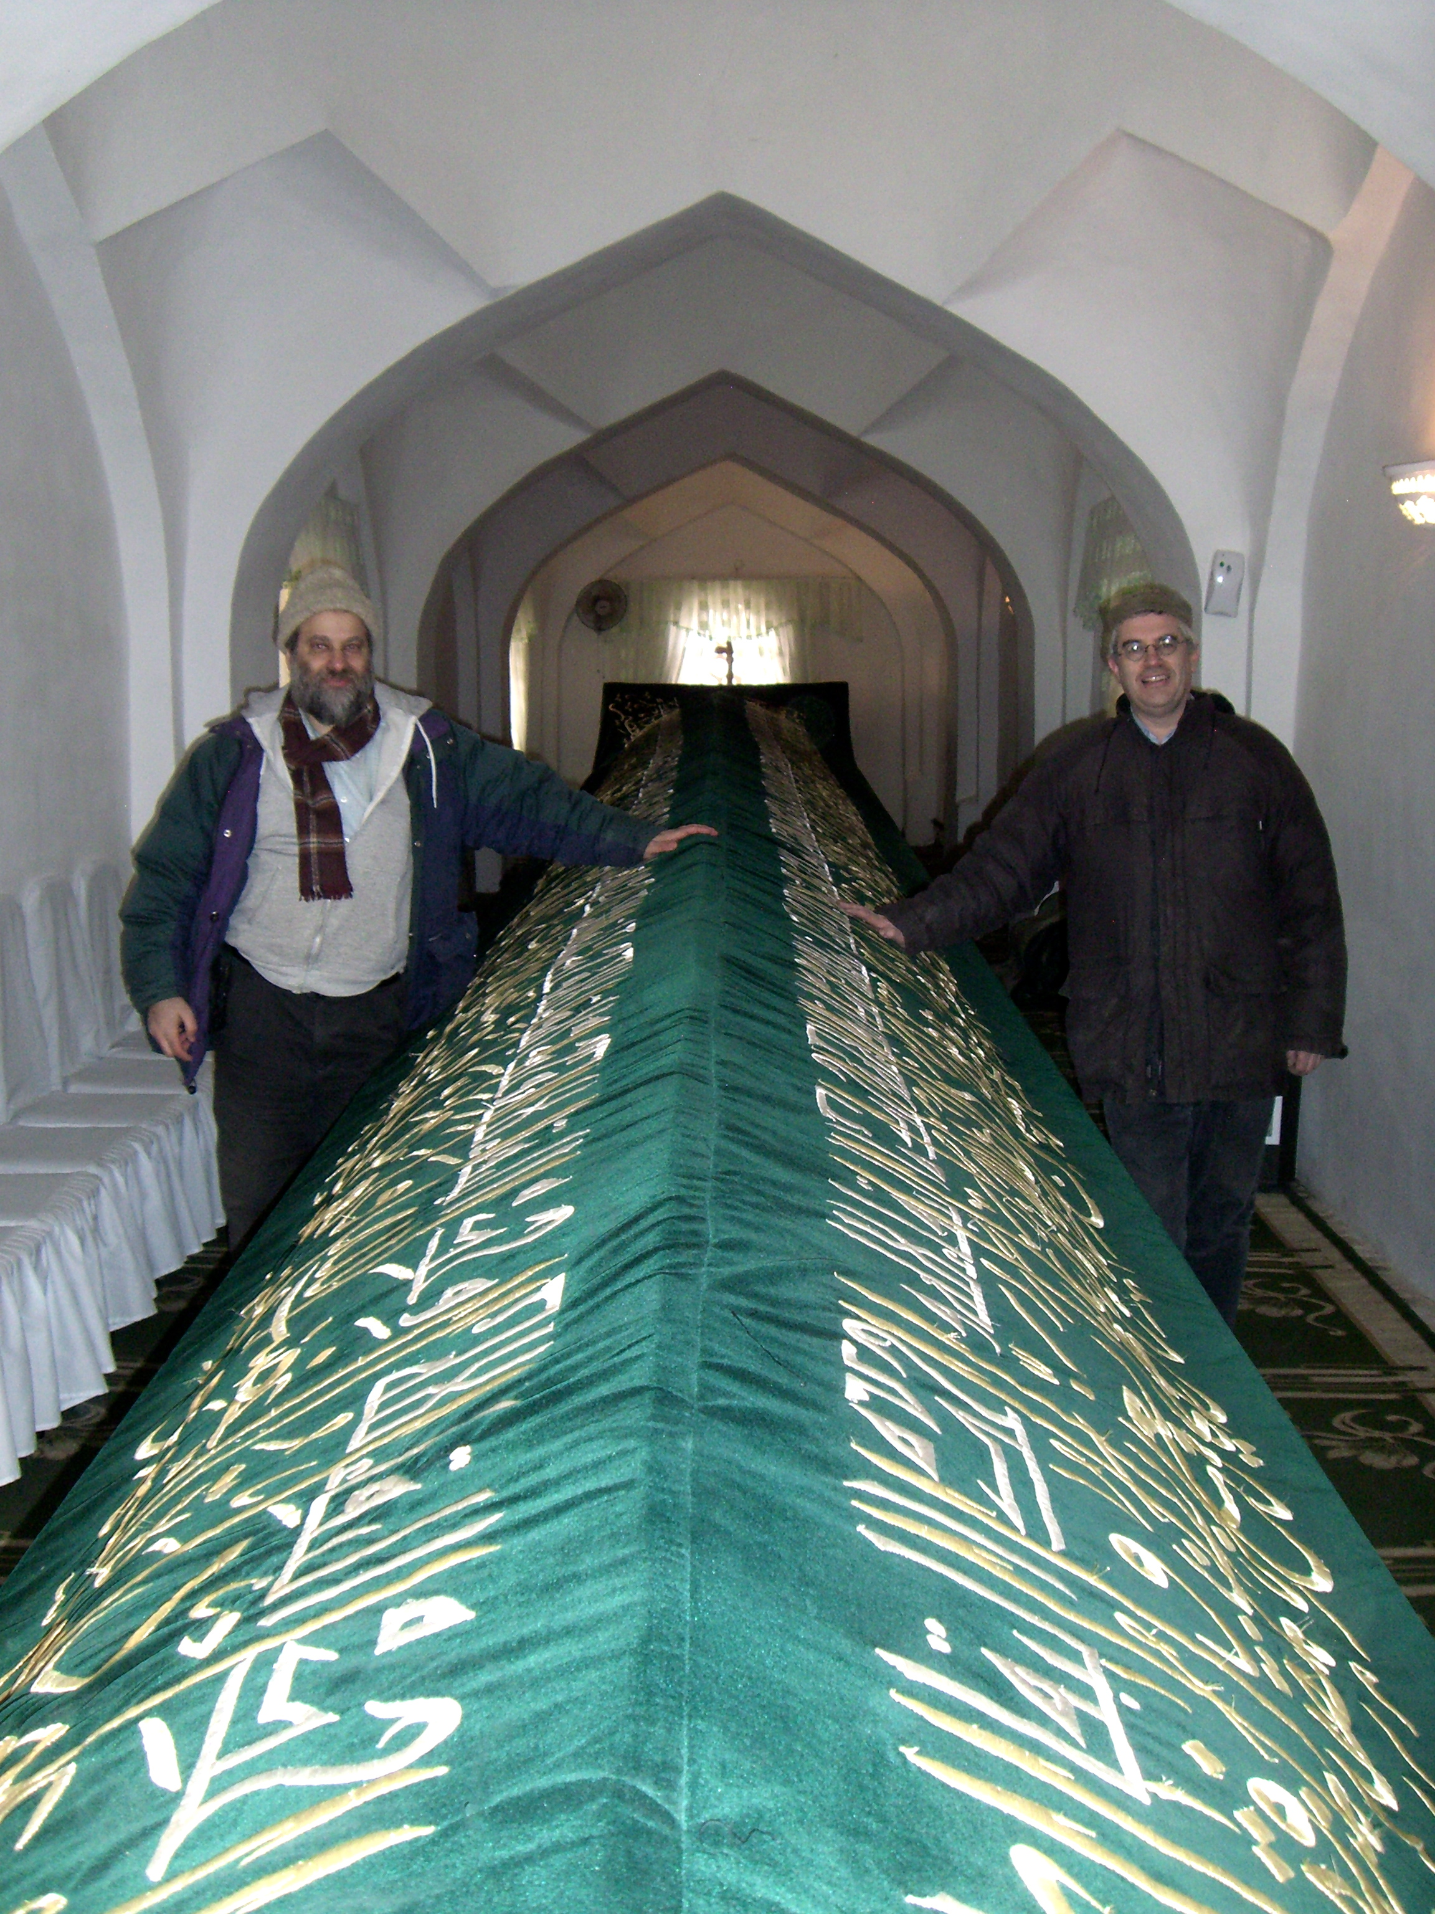
A Time and a Place (Daniel 1)
Daniel 1:1, 1:5. 1st exile. 3 + years. Daniel is 15-18 years old, 605 to 602 BC,
King Nebuchadnezzar.
Daniel 1:21. 70 years later Daniel is 85 years old. Jeremiah’s 70-year prophecy,
King Cyrus.
Notes: Ezra 1:1, 1st return (538), altar rebuilt (537), temple reconstruction began (536)
Jeremiah 25:11-12, 2 Chronicles 36:21-23
(605 – 536 = 70 years)

Slide 3
The 100% Uncompromised Heart
Old Testament
Ezekiel 14:14, 18 Noah, Daniel, & Job; 28:3 (1-19)
Daniel 10:11 a man greatly loved
Daniel
1:1-7 Excellence and brain-washing
- Danger of culture mixed with holiness
1:8-17 Refused the king’s meat and wine
- Wisdom from above
1:18-21 Ten Times Better & Ending Well
- 70 years later
Daniel 2 Next Sunday with Bill Heath
New Testament
Matthew 11:11-15, John the baptizer
John 13:23, disciple Jesus loved
Matthew 24:15 Daniel the prophet
1 Corinthians 1:16-31, simple things
1 John 2:15, Love not the world
1 Corinthians 10:31, 1:30 Jesus our
wisdom
2 Corinthians 4:7 we have this treasure
in earthen vessels, that the excellency
of the power may be of God, and not
of us.

