Slide 1
Fellowship Church Sunday School Jan-Feb 2023 Daniel’s Miracles & Prophecies Today – Daniel 12 Angels in Spiritual Warfare (time of the end) Teaching Pastor Bill Heath

Slide 2
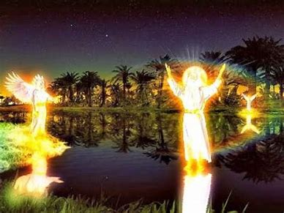
A Time and a Place (Daniel 12)
Time: 535 B.C. 1 day
3rd year of king Cyrus, 538-530 B.C.
3 years after his vision in chapter 9
Daniel is around 90 years old
Place: At the Tigris River, near Shushan
Guidelines for our understanding today
The Antichrist is revealed in
Daniel 7-12
and 1 John 2:18
Prophecy of the 2nd Coming of the Lord Jesus Christ
Key roles: Daniel, Michael, good & evil angels, Jesus Christ
Michael fights with fallen angels/ princes.
Why? PROPHECY
Key words:
Time (7x), end (5x)
Daniel 10-12 are one vision. The most detailed of Daniel’s visions.

Slide 3
Daniel 12 – Angels in Spiritual Warfare (time of the end)
Old Testament
12:1-3 Michael Stands Up (11:35, 40)
Time of trouble, your people delivered,
the book, everlasting life or everlasting contempt
12:4-10 Seal the Book until Time of the End
4b many run to and from – knowledge increased
5-8 two angels, Man clothed in linen on water
times, times, and a half (3.5 x 360 = 1260 days)
9 words closed and sealed up
10 many purified, made white, tried (Zech 13:8)
wicked not understand - wise understand
12:11-13 1,290 days (+30) and 1,335 days (+45)
11 abomination 1,290 days time to judge
12 blessed 1,335 days time to prepare
13 OT and tribulation saints’ bodies resurrected
Next Sunday: Daniel review and application
New Testament
The Old Testament is “written for our learning”
Romans 15:4 and ”written for our admonition”
1 Cor 10:11, and “shadow-body“ Colossians 2:17.
Matthew 24-25.
24:15 When ye therefore shall see the abomination
of desolation, spoken of by Daniel the prophet,
stand in the holy place, (whoso readeth, let him
understand:) //ye and him are future Israel//
24:21 For then shall be great tribulation, such as
was not since the beginning of the world to this
time, no, nor ever shall be.
25:1 Then shall the kingdom of heaven be likened
unto ten virgins, which took their lamps, and went
forth to meet the bridegroom.
25:46 And these shall go away into everlasting
punishment: but the righteous into life eternal.
Rev 5:1-5 who is worthy to open the book? Rev 20.

