Slide 1
Fellowship Church Sunday School Nov-Dec 2022 Daniel’s Miracles & Prophecies Today – Turn to Daniel 3 Pride and Persecution, or Purity, Protection and Promotion taught by: Bill Heath

Slide 2
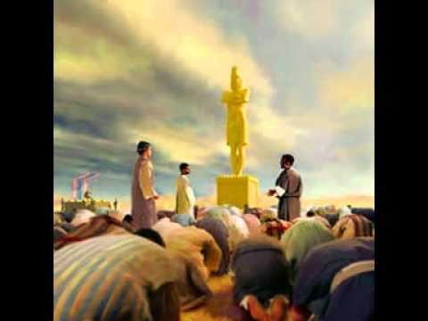
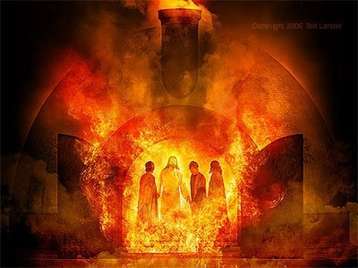
A Time and a Place (Daniel 3)
Time: Around 584 B.C. Daniel and his 3 friends are around 39 (20 years after chapter 2 ends.
Jerusalem and the temple are destroyed in 586 B.C.)
3:1-2, a few years. 3:3-30, one day.
Place: The plain of Dura in the province of Babylon.
(near Babylon, a huge idol, and very hot furnace)
Key words
Golden image, set up
Plan: sent, gathered, herald, music, fall down
No plan: (heart of worship)
Fast – then, now, therefore, & same hour
Dunghill, Fire, Son of God

Slide 3
Daniel 3 - 6 continue with “The 100% Uncompromised Heart”
Old Testament
Daniel Devil’s trial of fire (60x6 image)
3 :1-15 Pride (1-7) & Persecution (8-15)
evil - head of gold (Daniel 2: 37-38)
goes to Nebuchadnezzar’s head
- gathering, herald, and music are “set up”
- accusations, full of fury
3:16-30 Purity (16-18), Protection (19-25)
good & Promotion (26-30)
- Stand up, speak up, and trust God
- Strongest men are consumed
- Jesus frees and walks with us
- Promotion (Job 16:19, 31:2)
Q&A
Daniel 4, Pride Replaced by Humility
Next Sunday with Bill Heath
New Testament
God’s trial of fire
Romans 15:4 Old Testament (prophets)
are written for our learning
Jesus Matthew 5:12 Rejoice
Matthew 10:28 Fear not
Apostles Acts 5:29 Obey God or man
Acts 5:41 Rejoicing
Paul Philippians 4:4, 8 Rejoice, Praise
Peter 1 Peter 1:6-8 Rejoice
John 1 John 5:21 Keep from idols
Tribulation Rev 12:11 blood of the Lamb
Types: Fire – persecution in this world,
Nebuchadnezzar – antichrist, 3 Jews – Israel
Daniel – the rapture of the church

