Slide 1
Fellowship Church Sunday School Nov-Dec 2022 Daniel’s Miracles & Prophecies Today – Turn to Daniel 4 The King’s Conversion Testimony taught by: Bill Heath

Slide 2
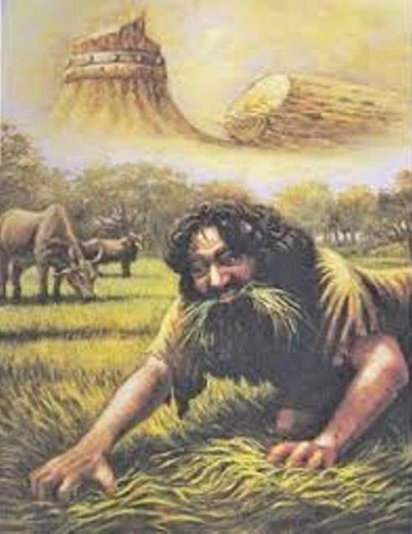
A Time and a Place (Daniel 4)
Time: Around 584 B.C.
Daniel is around 46 , 7 years after chapter 3.
Nebuchadnezzar after 1 plus 7 years continues to reign 14 years before a natural death in 562.
584 - (1+7) = 576, 576 – 562 = 14 years.
Grandson is king Belshazzar, Daniel 5.
Place: The city of Babylon, 225 square miles
Key words Pride - Abase
* Great Tree, stump of tree, heart of an animal, eat grass like an animal for 7 years
* King/kingdom-13x, heaven-15x, earth-10x * Sins replaced by righteousness, iniquities replaced by mercy to the poor

Slide 3
Daniel 4 - The King’s Conversion Testimony
Old Testament
Daniel Nebuchadnezzar’s Conversion Testimony
4:1-7 The Memo
Praise (1-3) & Background (4-7)
4:8-17 King Requests Daniel to Interpret
his Dream (8-12) & Angelic Vision (13-17)
4:18-27 Daniel Interprets the Dream (18-22)
& Angelic Vision (23-27)
4:28-33 After 1 Year the King is Humbled
for 7 Years
4:34-37 God Saves the King from His Pride
to Praise the King of Heaven
Q & A
Daniel 5 – The Writing on the Wall
Next Sunday with Bill Heath
New Testament
My Conversion Testimony
Romans 15:4 Old Testament (writings)
are written for our learning, 1 Cor 10:11
John Mt 3:10 the axe is laid unto the
root of the trees: therefore every tree
which bringeth not forth good fruit is
hewn down, and cast into the fire.
Jesus Luke 10:21-22 hid-revealed
Paul Acts 26 Paul’s conversion testimony
1 Corinthians 1:26-31 foolish-wise
James 4:7-10 pride-humility-exaltation
Peter 1 Peter 1:10-12 prophets-angels
Rev 2-3 The overcomers in each church

