Slide 1
Fellowship Church Sunday School Nov 2022 – Feb 2023 Daniel’s Miracles & Prophecies Today – Turn to Daniel 5 The Writing on the Wall taught by: Bill Heath

Slide 2
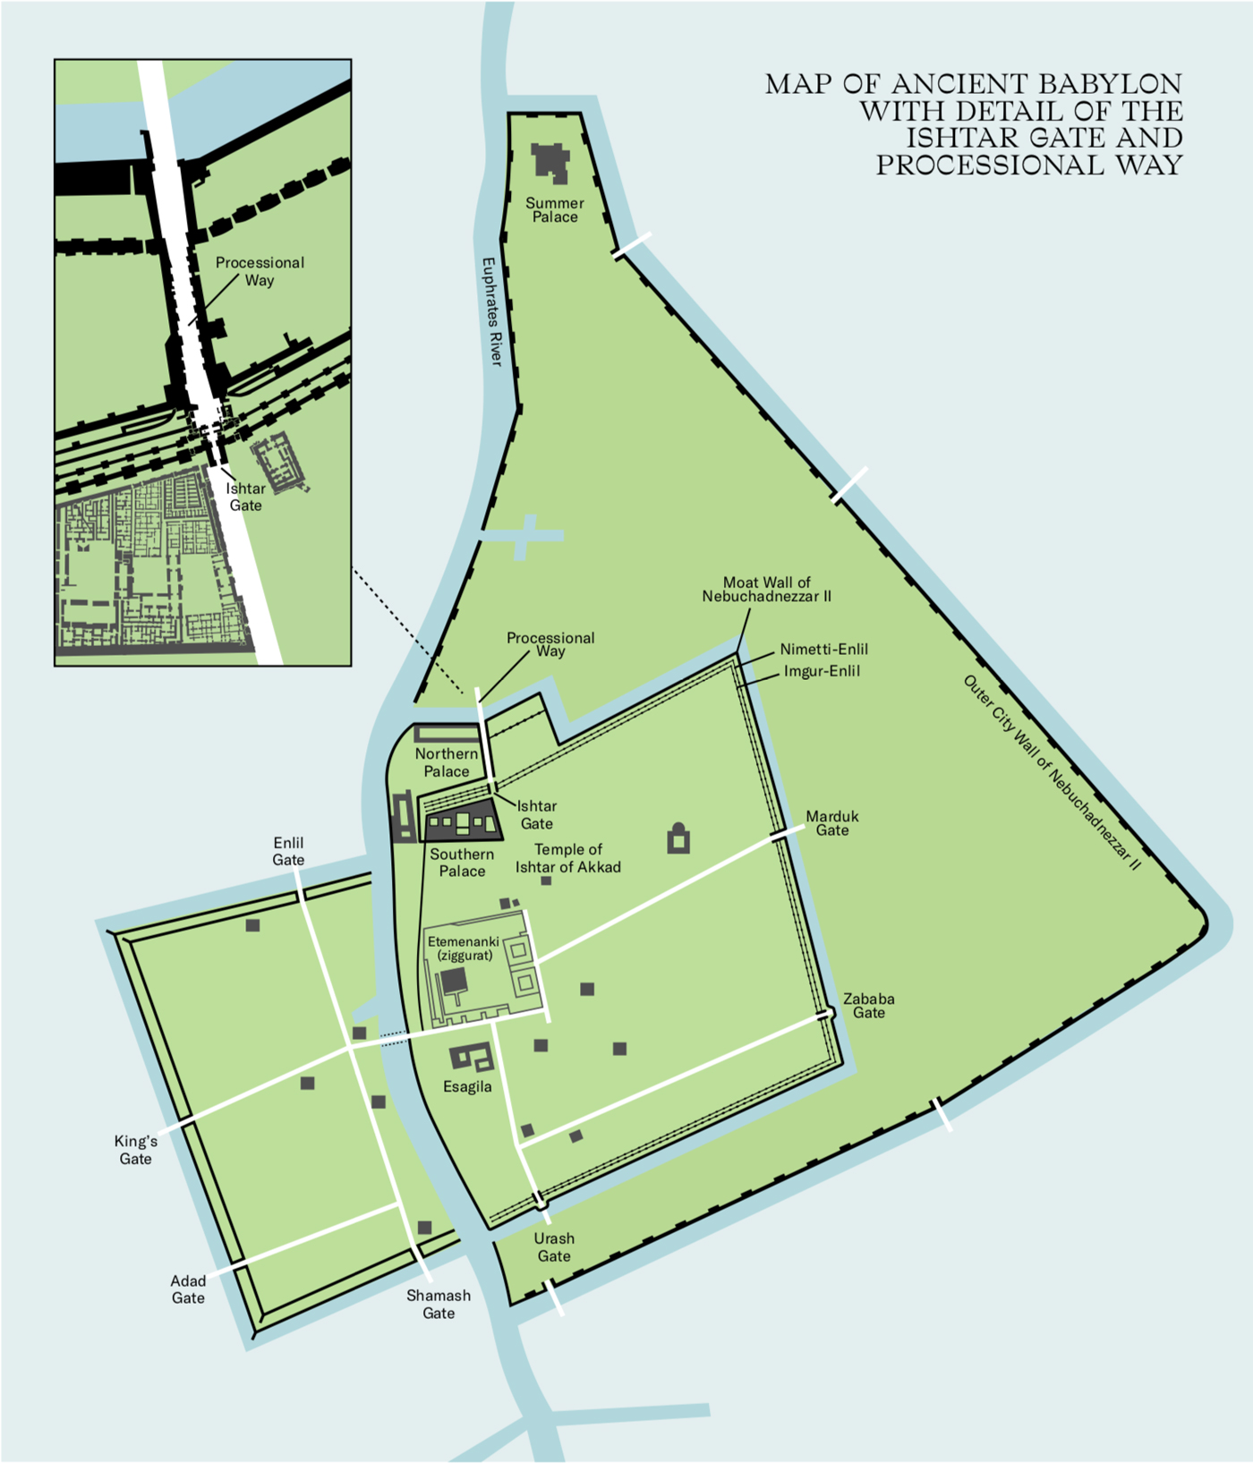
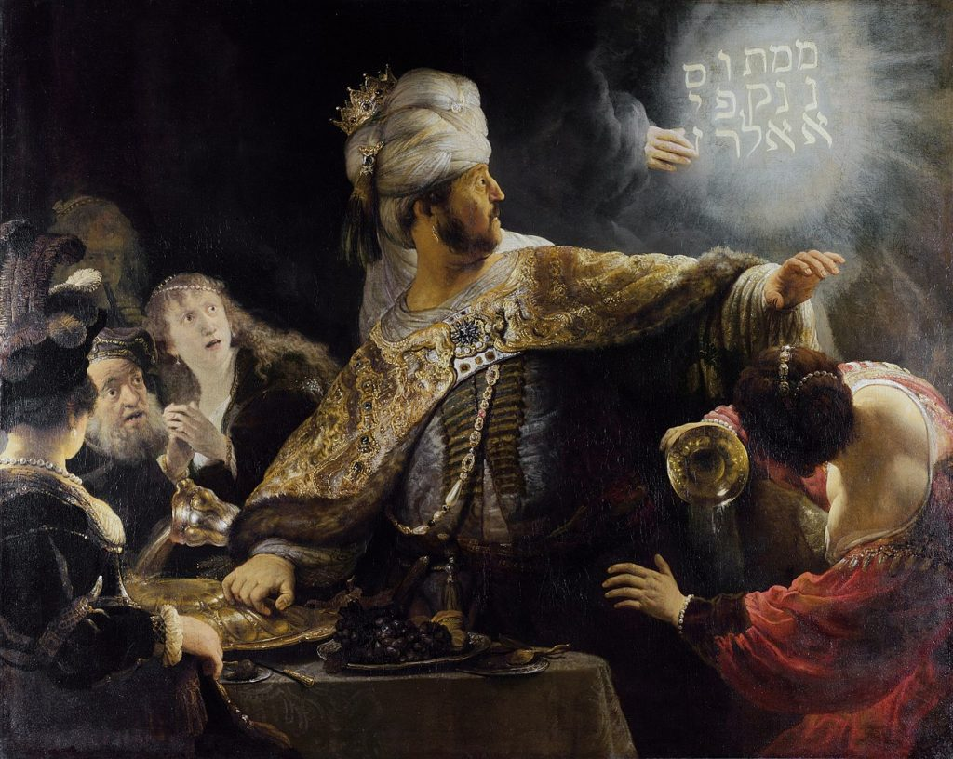
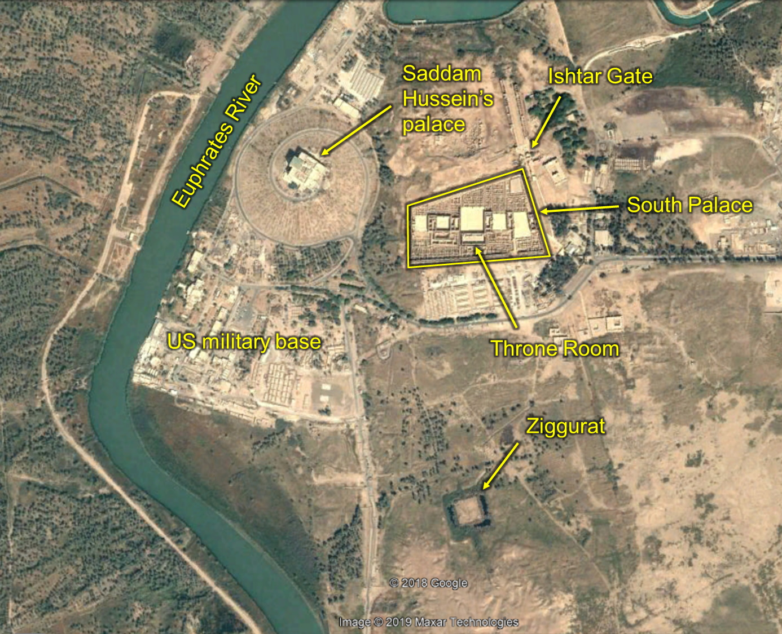
A Time and a Place (Daniel 5)
Time: 539 B.C. (577 – 539 = 38)
Daniel is around 85, 38 years after chapter 4
Place: King’s palace in Babylon
Other:
King Belshazzar - Nebuchadnezzar’s grandson
Queen-mother - Nebuchadnezzar’s widow
Babylonian Empire falls to Medo-Persia
Key words Pride - Judgment
* Party, wine, common vs holy vessels
* Same hour, thoughts troubled, that night
* Read & interpret writing (4x), gifts & rewards (3x)
* Heart lifted up – heart of beast
* Heart not humbled like Nebuchadnezzar

Slide 3
Daniel 5 - The Writing on the Wall
Daniel Old Testament
5:1-4 Party (food, wine, women, prosperity)
profane the holy. Today-Christmas/3 kings?
5:5-9 Writing on the Wall
same hour, mans hand, nobody could read
5:10-12 Queen-mother recommends Daniel
vs 11 master magi & star of Bethlehem
5:13-16 King Talks with Daniel
5:17-21 One King/Govt Becomes Good
5:22-24 One King/Govt Stays Evil
Daniel is a nationalist (policy-narrative-acts)
Habakkuk 2:14 (future reign of Christ on earth)
5:25-30 Daniel Interprets the Writing
Judgment: Isa 44:28-45:7, Jer 51:57-58
Daniel 6 – Daniel in the Lion’s Den – next Sunday
New Testament
Romans 15:4 Old Testament (writings)
are “written for our learning”, and/or
1 Cor 10:11 ”written for our admonition”
Jesus Mt 1:21 Jesus, 1:23 Emmanuel
Matthew 2:1-12 wisemen - star , toddler
Acts 5:29 “obey God, rather than men”
Paul
Romans 13:1-10 good rulers/evil rulers
Eph 5:11 “no fellowship, reprove”
1 Tim 2:1-2 “prayer” What to pray?
2 Tim 2:20-21 “gold, silver,…”
1 Peter 2:13-17 submit to/honor the king
Rev 17-18 Spiritual & Commercial
Babylon, judgment in 1 hour (Luke 21:24)

