Slide 1
Fellowship Church Sunday School Nov 2022 – Feb 2023 Daniel’s Miracles & Prophecies Today – Turn to Daniel 6 The Lion’s Den taught by: Bill Heath

Slide 2
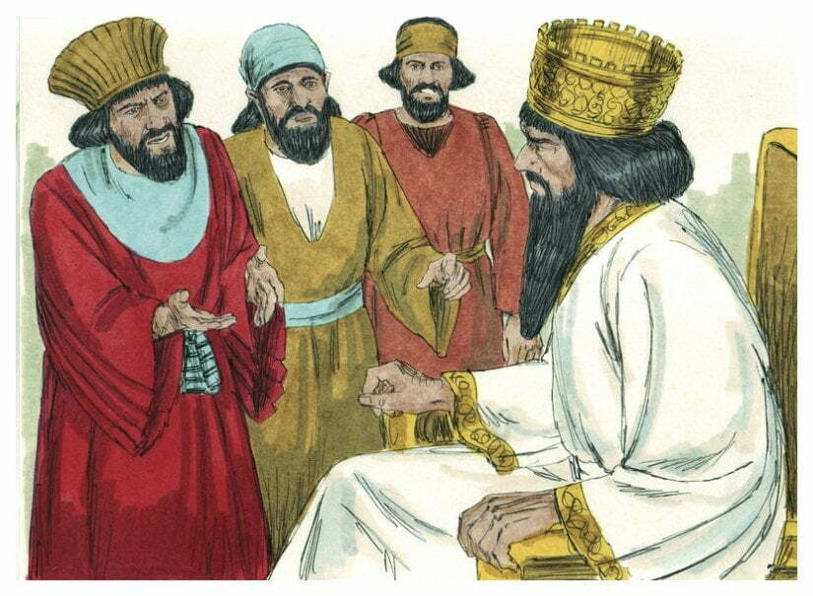
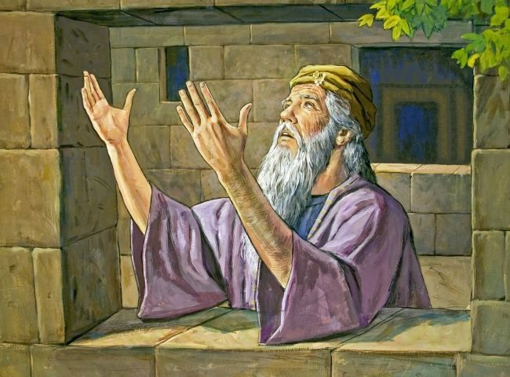
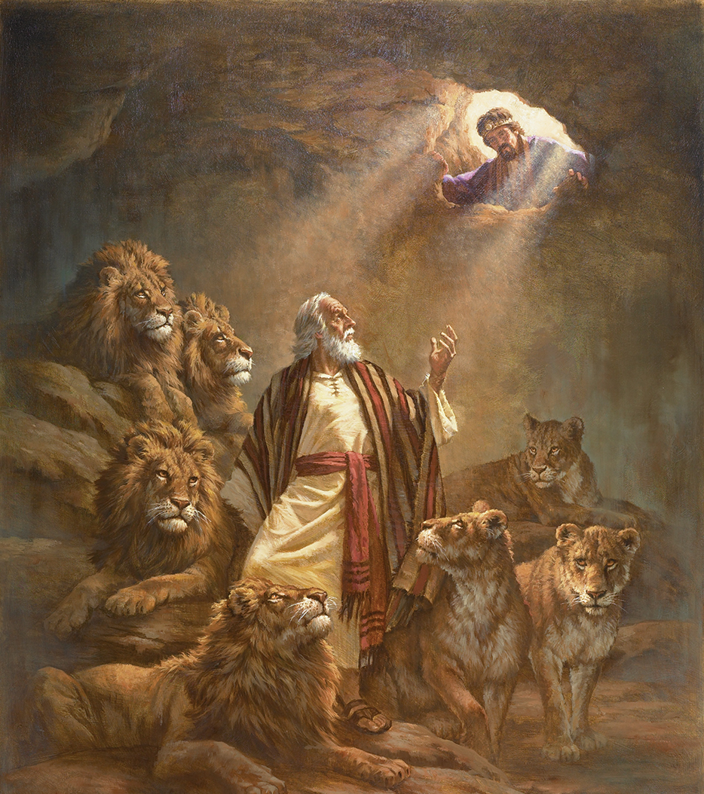
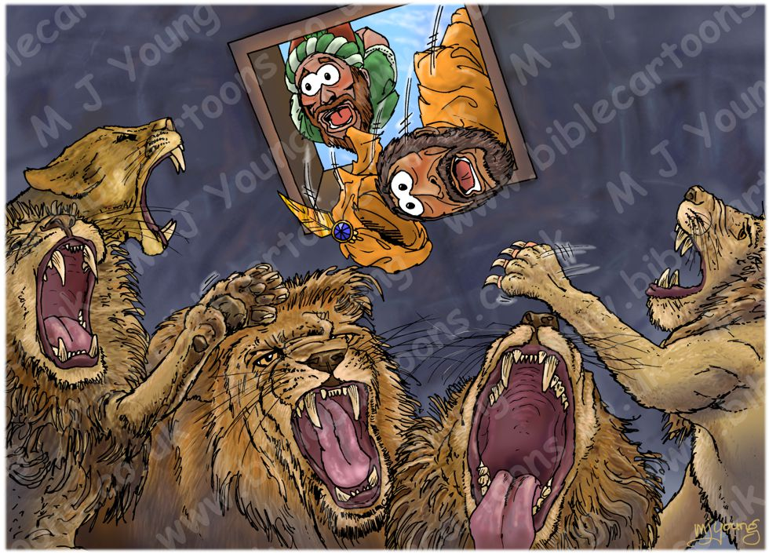
A Time and a Place (Daniel 6)
1
2
Time: 538 B.C.
Daniel is 87, months after chapter 5
Place: City of Babylon
Darius the Median (5:31) 62 yrs
Darius & Cyrus the Persian (6:28)
3
Key words
God (12x), not LORD in Daniel 2-7
Chiasm
a.1-3 a.28 honor
b.4-9 b.25-27 decree
c.10-13 c.23-24 accuse
d.14 d.18-22 deliver
e.15-16a e.17 den
f.16b you
4

Slide 3
Daniel 6 - The Lion’s Den
Daniel Old Testament
Ezra 1:1-5
6:1-3 Honor 6:28 (Ez 14:14, 20)
6:4-9 Decree 6:25-27
6:10-13 Accuse (prayer) 6:24
6:14-15 Deliver 6:18-23
6:16a Den 6:17
6:16b King (God will deliver)
Next: Daniel 7– Prophecy of 4 kingdoms
New Testament
Old Testament “written for our learning”
(Romans 15:4 ) and “written for our
admonition” (1 Corinthians 10:11)
Jesus Luke 11:1-13 Four prayer lessons
Luke 22:41 (40-46) Prayer & Temptation
Acts 3:1, 7:60, 9:40, 20:36, 21:5
pray-power-proclaim -persecute
Paul Hebrews 1:14 (1-2) Angels-minister
Spirits. 11:33 stopped the lion’s mouths
2 Tim 2:20-21 “gold, silver” honor or
dishonor
1 Peter 5:8 devil is roaring lion, devours
Revelation 3:10 kept the word of
My patience, Jesus will keep me . . .

