Slide 1
Fellowship Church Sunday School Jan-Feb 2023 Daniel’s Miracles & Prophecies Today – Turn to Daniel 7 The Four Beast-Kings Teaching Pastor Bill Heath

Slide 2
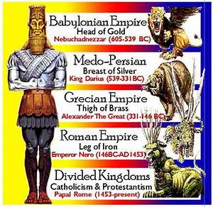
A Time and a Place (Daniel 7)
Time: 556 B.C. One night
1st year of king Belshazzar, 556-539 B.C.
Daniel is around 66
Between chapters 4 and 5
Place: Babylon
Daniel’s home, at night while asleep
Man’s
view
God’s
view
Key words
* Visions (4x) 1st of 4 visions that unfold in chapters 8-12
* Horns: 10 (+ 1 - 3) = 1 , Horns are kings/kingdoms
* Little horn: mouth speaking great things (3x) iron teeth (2x)
(like king Nebuchadnezzar, but the anti-christ)
* Saints of the Most High (4x) war on /wear out the saints (2x)
* Dominion (5x) temporary or everlasting
* Judgment, books, fire OR serve and obey Jesus Christ

Slide 3
Daniel 7 - The Four Beast-Kings
Old Testament
Dream & Visions
7:1-3 Setting
7:4-8 Four Beasts (lion-gold, bear-silver,
leopard-bronze, diverse-iron)
7:9-10 Ancient of Days (God)
7:11-12 4th Beast (iron-2 legs, 10 toes-part clay)
7:13-14 Christ’s Return (stone … brake in pieces
the iron, bronze, clay, silver, and gold )
Interpretation of Dream & Visions
7:15-18 Four Beasts (4 kings)
7:19-25 4th Beast (made war with the saints /
saints of the Most High)
7:26-28 Christ’s Return
serve and obey Him, kept in my heart
New Testament
The Old Testament is “written for our
learning” Romans 15:4 and ”written for
our admonition” 1 Corinthians 10:11.
Jesus Luke 21:24 “times of the Gentiles”
Matthew 24:15 “ spoken of by Daniel”
Acts 2:14-36 Peter “prophesy, visions & dreams”
last days - for Israel during the great tribulation
Paul (application in 1-2 Thessalonians)
2 Thessalonians 2:3 falling away, man of sin
2:17 Lord comfort your hearts, establish U
Colossians 4:5 walk with wisdom,
redeem the time
Revelation
13:1-9 beast from the sea, war with saints,
if any man have an ear, let him hear
17:12-18 Ten horns/kings, woman drunk
with the blood of the saints

