Slide 1
Fellowship Church Sunday School Jan-Feb 2023 Daniel’s Miracles & Prophecies Today – Turn to Daniel 8 The Ram & Goat Horns Teaching Pastor Bill Heath

Slide 2
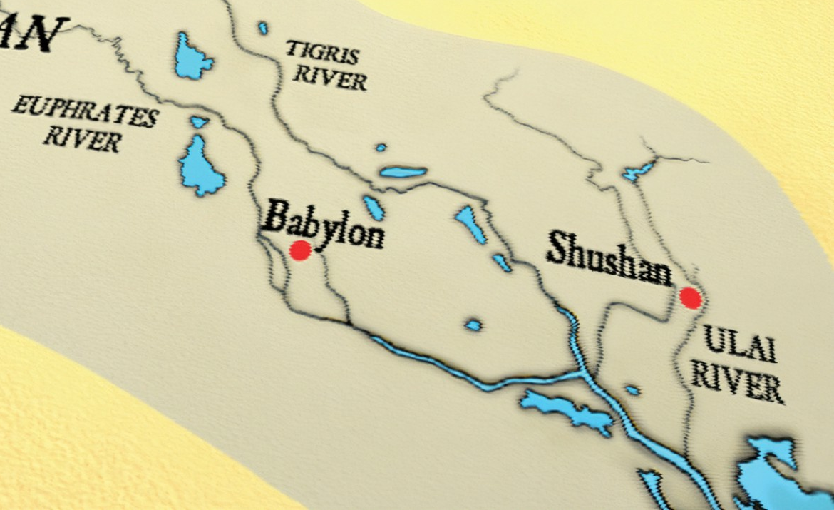
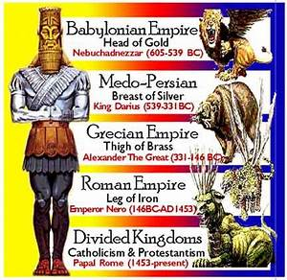
A Time and a Place (Daniel 8)
Time: 554 B.C. 1 day + specific days
3rd year of king Belshazzar, 556-539 B.C.
Daniel is around 68 years old
Vision is 2 years after Daniel 7 and between chapters 4 and 5
Place: Transported to the Shushan Palace
Like John the Apostle in Revelation
Man’s
view
God’s
view
Key words
Media-Persia &
Grecia (8:20-21)
Chapters 8-12 in Hebrew. Times of the Gentiles related to Israel.
Details part of Daniel 7. Same as Genesis 2-1, & 11-10 Babel
Antichrist revealed in Daniel 7, 8, 9, & 11
and 1 John 2:18
Vision of the evening and morning (8:26) like Genesis 1
Daniel 8 Horn song 2 + 1 + 2 = 5
> 70 years later Esther and Nehemiah live in palace at Shushan
The end times events - high level 3 doctrine “Rooted study”

Slide 3
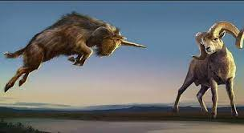
Daniel 8 - The Ram & Goat Horns
Old Testament (shadows)
Vision
8:1-2 Setting
8:3-4 Ram (2 horns, bear-silver, 2 arms-one
stronger, Medo-Persia, 539-331 B.C.)
8:5-8 Goat (One Big Horn, leopard-bronze,
Grecian, Alexander the Great, 334-323 B.C.)
8:9-14 Goat’s Little Horn is Antiochus Epiphanes
(175-164 B.C.) Maccabean Revolt (171 B.C.)
Interpretation of Vision
8:15-22 Angel Gabriel interprets for Daniel
8:23-26 Goat’s Little Horn is a shadow of the
New Testament Antichrist.
8:27 Daniel is sick, then goes back to work
New Testament (substance)
The Old Testament is “written for our learning”
Romans 15:4 and ”written for our admonition” 1
Corinthians 10:11, and “shadow “ Colossians 2:17.
Jesus John 10:22-30 Maccabean Revolt, Festival of Lights, December 25. I am the Light, John 8-9.
Acts 3:17-26 Prophets and Daniel, “times of refreshing, times of restitution of all things, holy prophets since world began”
Paul (application in 1-2 Thessalonians)
2 Thes 2:3-9 falling away first, then the
man of sin revealed, showing he is God
Revelation
19:10 Jesus is the spirit of prophecy

