Slide 1
Fellowship Church Sunday School Jan-Feb 2023 Daniel’s Miracles & Prophecies Today – Daniel 9 Scripture, Prayer, & 70 Weeks Teaching Pastor Bill Heath

Slide 2
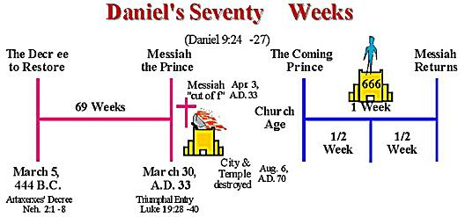
A Time and a Place (Daniel 9)
Time: 554 B.C. 1 day
1st year of king Darius, 538 B.C.
12 years after his vision in chapter 8
Daniel is around 87 years old
Place: Daniel’s home in Babylon
Guidelines for our application today
The Antichrist is revealed in Daniel
7, 8, 9, 11 & 12
and 1 John 2:18
The end times events - high level 3 doctrine “Rooted study”
The angel Gabriel returns to finish his work from vision #2 (Daniel 8:16 )
Key roles:
Daniel and the angel Gabriel
(messenger to Israel)
Daniel was sick and went back to work for 12 years
(Daniel 8:27)
Prayer:
Seek - Voice not heard – sin - judgment – turn - understanding

Slide 3
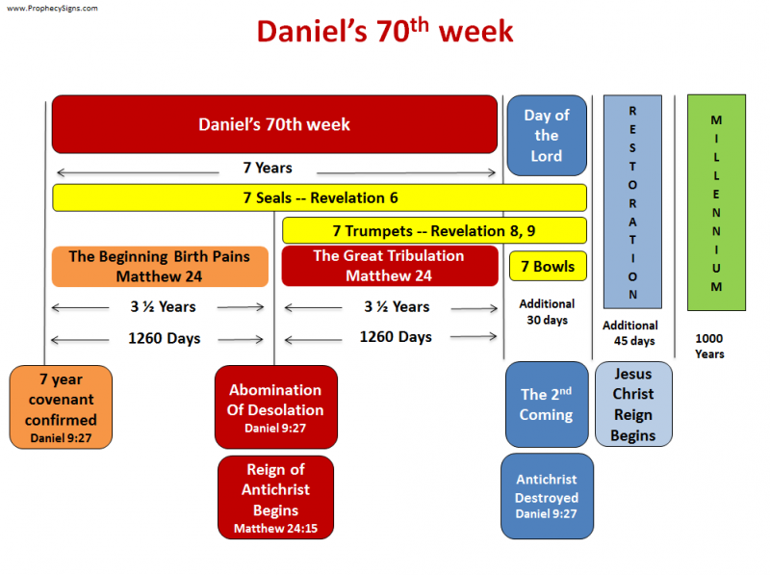
Daniel 9 – Scripture, Prayer, & 70 Weeks
Old Testament (shadows)
Vision
9:1-2 Setting: 70-year prophecy of Jeremiah
Leviticus 25:1-7, Jeremiah 25:11-12
King Saul to Jehoiakim, 490 years/7=70, 2 Chr 36:5-8
9:3-19 Prayer & Supplication
I, me, my: personal, 3-4 & 16-19
we, us, our: national, 5-15
Eternal law: seek >hear >sin >turn >understand
9:20-23 Angel Gabriel finishes vision of Dan 8
Daniel 8:16, 26-27 is 12 years earlier
9:24-27 70-Weeks of Years Prophecy
24 Overview (future >500/2500 years, us <past & future)
25 69 weeks begins, March 14, 445 BC (Neh 2:1-8)
26a 69 weeks ends, April 6, 32 AD (John 12:12-19)
26b-27 70th week (2 Thessalonians 2:1-12, Rev 6-19)
New Testament (substance)
The Old Testament is “written for our learning”
Romans 15:4 and ”written for our admonition”
1 Corinthians 10:11, and “shadow “ Colossians 2:17.

