Slide 1
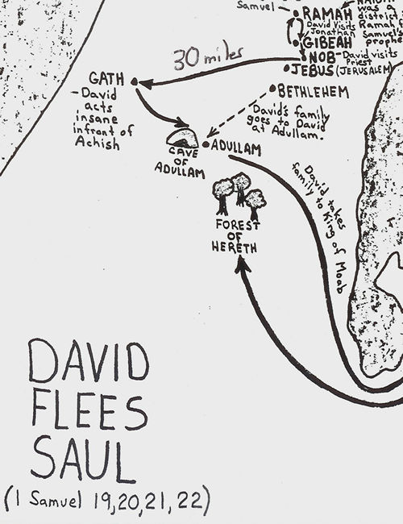
Fellowship Church
(every other Wednesday night
6:30-7:30 pm)
February 2, 2022
Bill Heath
Extreme Lesson #2 Almost Gone
1 Samuel 21-22
______________

Slide 3
Extreme Lesson #2, Almost Gone
1 Samuel 21-22 (Psalms 34, 52)
Romans 7 growing pains of Fear or Faith
David Fears King Saul of Israel and Lies to the Priest (Psalm 52)
21:1-9 David lies to the priest Ahimelech
22:6-19 Saul is enraged with David Doeg the Edomite kills 85 priests, their families and animals
David Fears King Achish of Gad (Psalm 34)
21:10-15 David pretends he is crazy to save his life
22:1-5 David protects his family with the King of Moab
22:20-23 David protects the priest’s son who survived
February 16, Extreme Lesson #3, David King in Jerusalem, II Samuel 5-6

