Slide 1
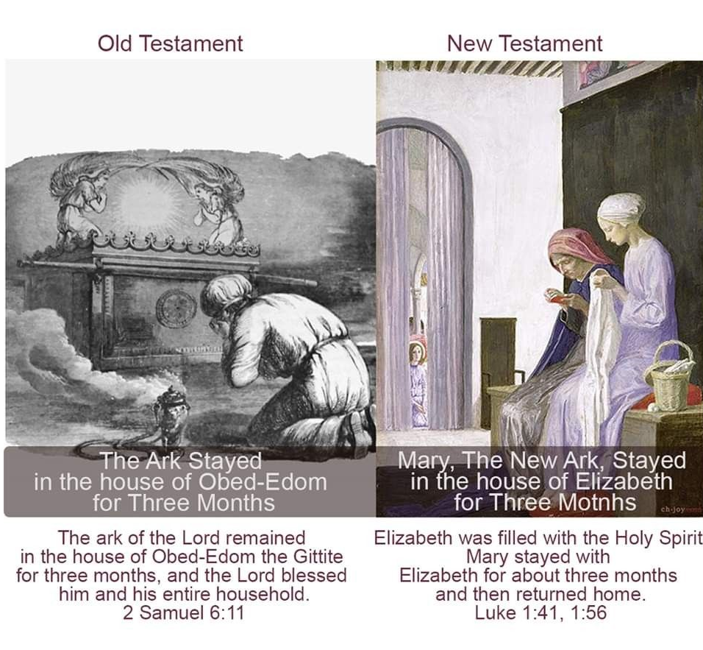
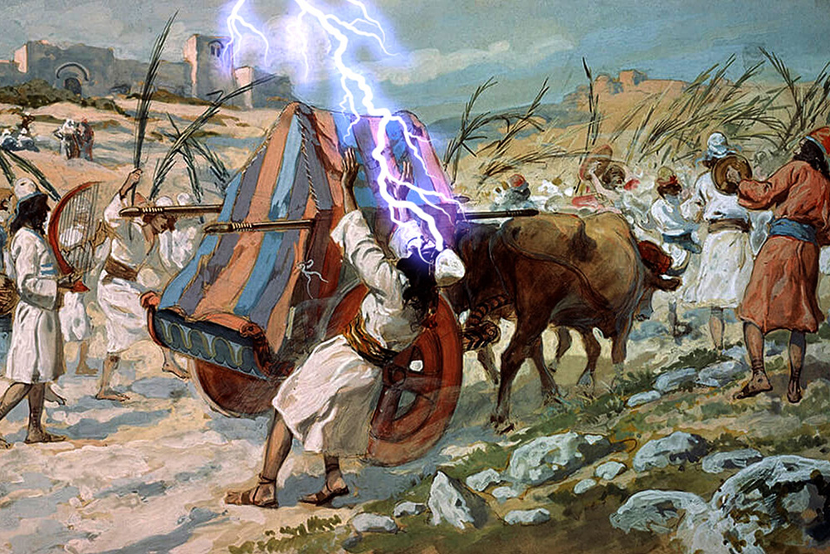
Fellowship Church
(every other Wednesday night)
February 16, 2022 by Bill Heath
Extreme Lesson #3 of 7
Title: The Victorious King
Text: II Samuel 5-6 (Psalm 101, 139, & 68)

Slide 2
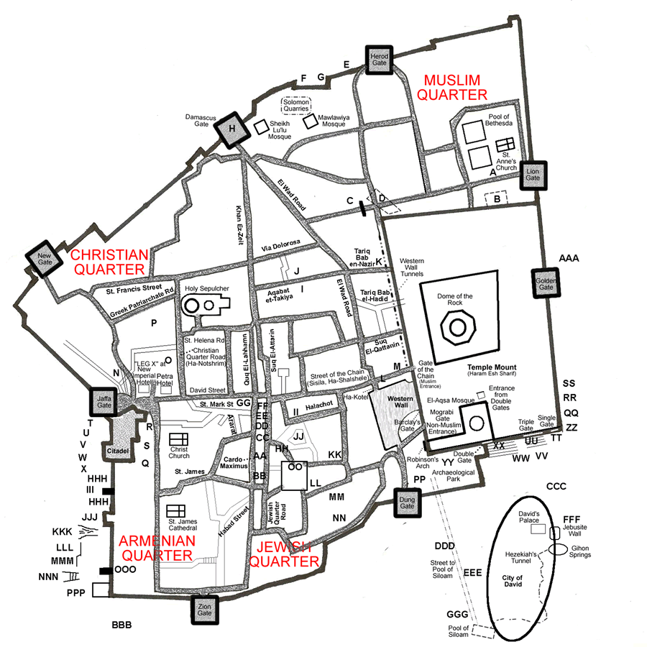
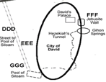
King David’s House (Palace)
II Samuel 5:6-11
years to build ?
David is 37 + years old

Slide 3
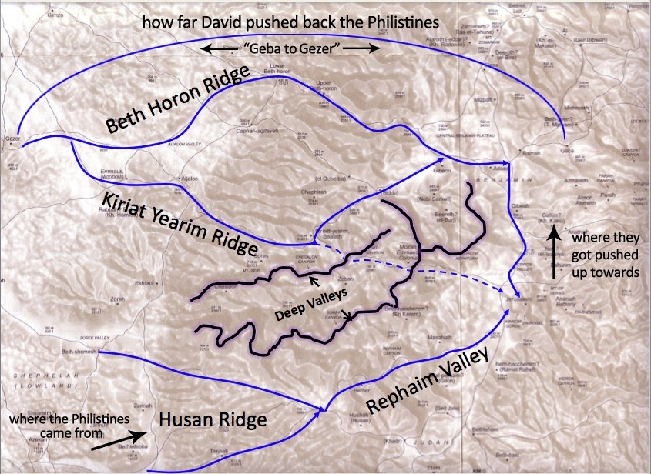
King David’s victories in battle when attacked by the Philistines
II Samuel 5:17-25, Jerusalem is in the red circle

Slide 4
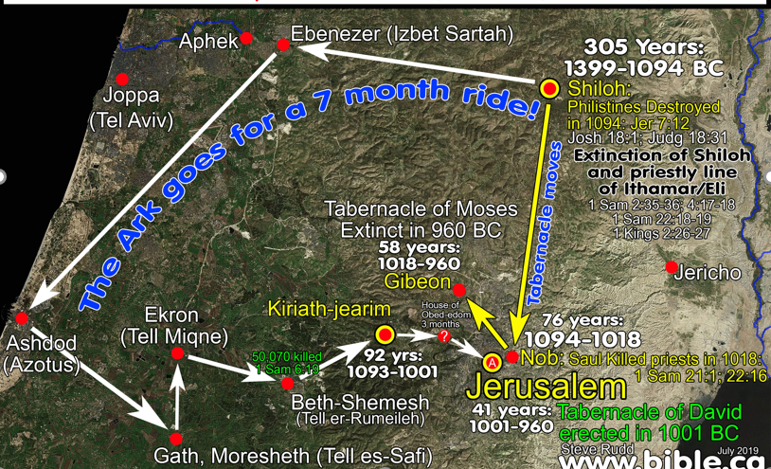
David brings the Ark to Jerusalem, II Samuel 6:1-19 (circled in red)

Slide 6
Extreme Lesson #3, A Victorious King
II Samuel 5-6
Application: Romans 8
5:1-5 David fed and led Israel for 40 years (40 years and 6 months)
6:1-5 David bring the ark to Jerusalem on a new cart (2nd sin)
6:6-12 David is angry and afraid of God after the priest Uzzah is killed
6:13-19 David dances before the Ark like a common person
6:20-23 David’s wife Michal despises him for his common dancing
5:6-10 David leads the capture of Jerusalem
5:11-16 David completes his palace - takes more concubines & wives (1st sin)
David Brings the Ark to Jerusalem (Psalm 68 after 6:13-19)
The Victorious King (Psalm 101 after 5:11 & 139 after 5:12)
5:17-25 David leads to defeat the Philistines twice
March 2, Extreme Lesson #4, King David ‘s Reign in Jerusalem, II Samuel 7-8

