Slide 1
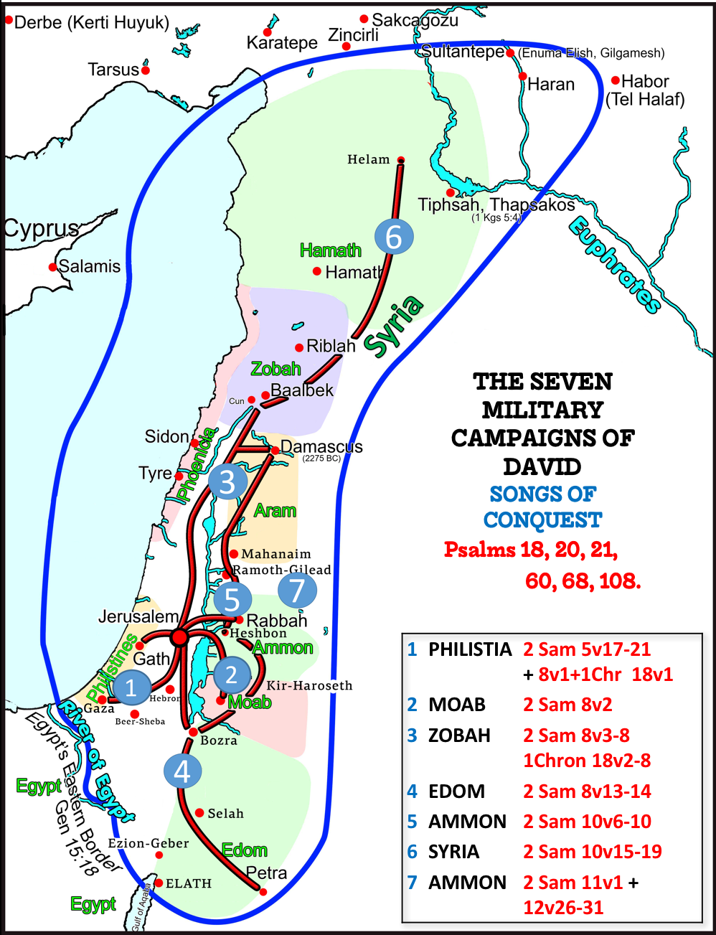
Fellowship Church
(every other Wednesday night)
March 2, 2022 by Bill Heath
Extreme Lesson #4 of 7
Text: II Samuel 7-8
Title: The King ‘s Eternal House and Throne (II Sam 7), and The King of Judgment and Justice (II Sam 8)
(Psalm 18, 20-21, 60 & more)

Slide 3

Extreme Lesson #4, The King of Judgment with Justice
II Samuel 7-8
Application: Romans 8
7:1-17 David cannot build a house for God
8:1-14 David continues as a king victorious over his enemies Riches of silver, gold, and brass dedicated to God
8:15-18 David’s duty in the gates of the city
7:18-29 David’s psalm of praise to God
The King of Judgment with Justice (Psalm 18, 20-21 & more )
The King’s Eternal House and Throne
March 16, Extreme Lesson #5 King David Heart Strays from God, II Samuel 11

