Slide 1
Fellowship Church Sunday School Jul-Sep 2023 Ezekiel – Prophet on a Short Leash Today – Turn to Ezekiel 1-3 Ezekiel’s Mission teacher: Minister William Heath

Slide 2
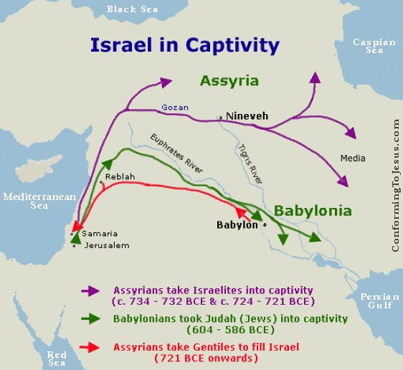
Time of prophecies: 597-571 BC
Writer: Ezekiel
Where: Babylon
Audience: Judah before the temple is destroyed, other nations, then Israelites in captivity
13-week study, July- September
1-3 Ezekiel’s Mission 1
4-24 Judgment on Judah 6
25-32 Judgment on Nations 1
33-48 Hope for Judah 4
Review of Ezekiel 1
No other books mention Ezekiel. He
mentions Noah, Daniel, and Job (Ez 14:14, 20).
Signs (public object lessons) – ?
Visions – ?, Parables – ?, Messages - ?

Slide 3
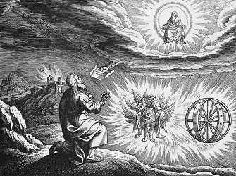
The glory of God
at the Chebar River
in Ezekiel 1, 10, 43
These are cherubim
angels similar to:
Genesis 3
Moses Tabernacle,
Isaiah 6
Revelation 4-5
On the throne is the
Lord Jesus Christ
God sees and has a straight plan
Ezekiel 1 link
Video - 6 minutes
Spiritual of 1920s Ezekiel Saw the Wheel

Slide 4
Ezekiel 1-3 Ezekiel’s Mission
1:1a Background: 30 years old/captives/river of Chebar
1:1b-3:21 Visions (5 in 1) and Mission
1:1b-28 Vision of 4 cherubim, 4 wheels & glory of God
2:1-7 Mission: Stand, listen, rebellious-be not afraid, speak
2:8-3:3 Vision to eat a book sweet to the mouth
3:4-11 Mission: Speak my words, fear not
3:12-14 Vision of 1:1b-28 finishes
3:15-21 Mission: Appointment as a watchman
3:22-27 Sign of home prison and dumb (do not speak)
Next Sunday: Ezekiel 4-7, study sheet on the backside
Background
Priest & Prophet: Jer, Zech,
& John the Baptizer
Prophetical: Ez, Dan, & Zech
Contemporaries: Jeremiah
Habakkuk, & Daniel
Nebuchadnezzar’s exiles:
1st Daniel & Leaders, 605 BC
2nd Ezekiel & 10,000, 597 BC
3rd Temple destroyed, 586 BC
King Jehoiachin captive:
5th year - baseline for 13 dates
Chebar River (only in Ezekiel)
1-3 (4x), 10 (3x), 43:2 (1x)
Telabib: city near Chebar River
7 days mourning (Job 2:13)

Slide 5
Ezekiel 4-7 preparation for next Sunday
Share your experience of playing army. (this is the 2nd of Ezekiel’s public object lessons)
What does Ezekiel laying on his left side for 390 days and right side for 40 days mean?
How do you respond to God turning His face away from His people?
In what ways may Ezekiel’s silence affect his message when spoken?
What may the phrase “the morning has come” mean in Ezekiel 7:7?
How did the Holy Spirit speak to you while studying Ezekiel chapters 1-3 or 4-7?

