Slide 1
Fellowship Church Sunday School Jul-Sep 2023 Ezekiel: Prophet on a Short Leash Today: Turn to Ezekiel 25-28 God Curses Seven Gentile Nations teacher: Bill Heath

Slide 2
Tyre and Zidon (Ezekiel 26-28)
Luke 10:13-14 Woe unto thee, Chorazin! woe unto thee, Bethsaida! for if the mighty works had been done in Tyre and Sidon, which have been done in you, they had a great while ago repented, sitting in sackcloth and ashes. But it shall be more tolerable for Tyre and Sidon at the judgment, than for you.
Luke 10:15 And thou, Capernaum, which art exalted to heaven, shalt be thrust down to hell.
Luke 10:16 He that heareth you heareth me; and he that despiseth you despiseth me; and he that despiseth me despiseth him that sent me. (KJV)
By erasing, avoiding, or twisting undesirable Scripture, man conforms God to their own image (bottom photo from Jesus of Nazareth, MOTB. Sea of Galilee cities noted from 2017 to 2021, then painted over in 2022, W. Heath)

Slide 3
God Curses Israel
Deuteronomy 11:26-29
Past: Ezekiel 1:1-2
597 BC, Ezekiel is 25 and in exile
592 BC, Ezekiel‘s 30th birthday
(priest to prophet)
Ezekiel 1:3-7:27
592 BC, 5th year, 4th month, 5th day
(of Jehoiachin in exile)
Ezekiel 8-19
591 BC, 6th year, 6th month, 5th day
Ezekiel 20-23
590 BC, 7th year, 5th month, 10th day
Ezekiel 24
588 BC, 9th year, 10th month, 10th days
Siege of Jerusalem begins
God Curses Gentiles
1 Peter 4:17-19
Present: Ezekiel 25
>588 BC, 9th year, 10th month & day
Ezekiel 26-28
586 BC, 11th year, 1st day
1-2. Ammon & Moab
3. Edom
4. Philistia
5-6. Tyre & Zidon
Ezekiel 29-32
7. Egypt
BC, 10th year, 10th month, 12th day
BC, 27th year, 1st month, 1st day
BC, 11th year, 3rd month, 1st day
BC, 12th year, 12th month, 1st day
BC, 12th year, 15th day
God Blesses Israel
Deuteronomy 11:26-29
Future: Ezekiel 33-39
585 BC
12th year, 10th month, 5th day
Jerusalem destroyed
20XX AD
The 7-year tribulation
Revelation 6-18
Ezekiel 40-48
572 BC
25th year, 1st month, 10th day
(14th year after Jerusalem falls)
20XX AD
The Millennial Temple
Revelation 19-20

Slide 4
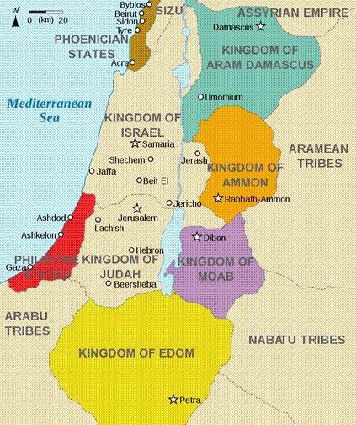
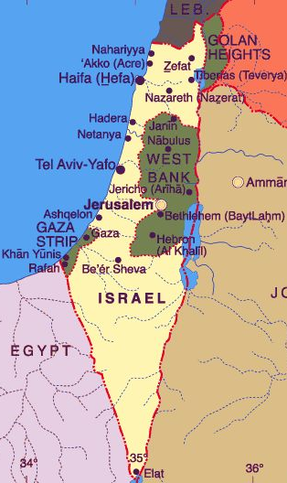
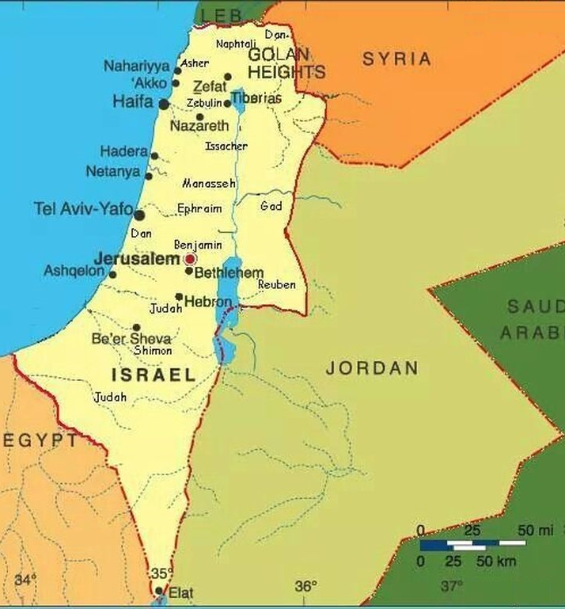
God Curses Seven Gentile Nations, Ezekiel 25-32
Zechariah 12:2
“I will make Jerusalem
a cup of trembling
unto all the people
round about”
United Nations
view of Israel
Israel’s
View of Israel
Aug 2023
6-Zidon
5-Tyre
1-Ammon
2-Moab
4-Philistines
7-Egypt
Egypt led wars against Israel
in 1948, 1967, and 1973
3-Edom

Slide 5
God Curses Seven Gentile Nations, Ezekiel 25-28
GOD IS LOVE 1 Cor 13:5-6, Phil 4:8
25:1-17 Cursing on Ammon, Moab, Edom, and Philistia New Testament
25:1-7 Ammon Genesis 19:30-38 Lot’s younger daughter/aha Ez 21:28-32/Molech 2 Peter 2:7-9
25:8-11 Moab Genesis 19:30-38 Lot’s older daughter Ruth, 1 Samuel 22:1-4 “West Bank”
25:12-14 Edom Genesis 25:23 Jacob & Esau, Esther, Obadiah, Malachi 1:2-5 Herodians
25:15-17 Philistia Genesis 21:32 despiteful heart, old hatred “Palestine-Gaza-Hamas”
26:1-28:19 Cursing on Tyrus Matthew 11:20-24
26:1-14 Prophecy: aha, Nebuchadnezzar siege-13 years. Alexander the Great siege–7 months, 332 BC.
26:15-27:36 Lamentation: great military & merchandise, commercialism & riches, no music. Revelation 17-18
28:1-10 Prince: a man, similar to his god, a king “Lebanon-Hezbollah, Syria-Golan Heights”
28:11-19 King: satan’s past (11-15a), fall (15b-16a), future (16b-19) //stones of fire to fire within//
vs 17 (lifted up heart, wisdom, bright, & beauty – cast down) 2 Cor 11:12-15
28:20-23 Cursing on Zidon (border w/Tyrus, sister city, together 22x in the Old Testament) 1 Peter 4:17
28:24-26 Blessing on Israel Romans 9-11 (11:33-36)
partial w/Nehemiah and the Maccabees - completely in the future (Genesis 12:1-3, 15:18)
Next Sunday: Ezekiel 29-32; Cursing on Egypt, read ahead questions on the back.

Slide 6
Ezekiel 29-32 read ahead questions
1. Who invades Egypt? (Ezekiel 29:8-12)
2. What gentile nation does God’ use for His work? (Ezekiel 30:10-12)
What does Ezekiel say about Assyria? (Ezekiel 31)
What animal does God call Pharaoh of Egypt? (Ezekiel 32:1-10)
Note: Egypt led war against Israel in 1948, 1967, and 1973
5. How did the Holy Spirit speak to you while reading /studying Ezekiel chapters 29-32?

