Slide 1
Fellowship Church Sunday School Jul-Sep 2023 Ezekiel: Prophet on a Short Leash Today: Turn to Ezekiel 29-32 Egypt: a Way, a Truth, and a Afterlife teacher: Bill Heath

Slide 2
God Curses Israel
Deuteronomy 11:26-29
Past: Ezekiel 1:1-2
597 BC, Ezekiel is 25 and in exile
593 BC, Ezekiel‘s 30th birthday
(priest to prophet)
Ezekiel 1:3-7:27
593 BC, 5th year, 4th month, 5th day
(of king Jehoiachin in exile
1st of 13 exact dates)
Ezekiel 8-19
592 BC, 6th year, 6th month, 5th day
Ezekiel 20-23
591 BC, 7th year, 5th month, 10th day
Ezekiel 24
588 BC, 9th year, 10th month, 10th days
Siege of Jerusalem begins
God Curses Gentiles
1 Peter 4:17-19
Ezekiel 25
Ezekiel 26-28
586 BC, 11th year, 1st day
1-2. Ammon & Moab
3. Edom
4. Philistia
5-6. Tyre & Zidon
Present: Ezekiel 29-32
Egypt (this world)
(John 15:9, 1 John 2:15)
587 BC, 10th year, 10th month, 12th day
571 BC, 27th year, 1st month, 1st day
587 BC, 11th year, 1st month, 7th day
587 BC, 11th year, 3rd month, 1st day
585 BC, 12th year, 12th month, 1st day
585 BC, 12th year, 15th day
God Blesses Israel
Deuteronomy 11:26-29
Future: Ezekiel 33-36
585 BC
12th year, 10th month, 5th day
News of Jerusalem destroyed
Ezekiel 37-39
1900-20XX AD
The 7-year tribulation
Revelation 6-18
Ezekiel 40-48
573 BC
25th year, 1st month, 10th day
(14th year after Jerusalem falls)
20XX AD
The Millennial Temple
Revelation 19-20

Slide 3
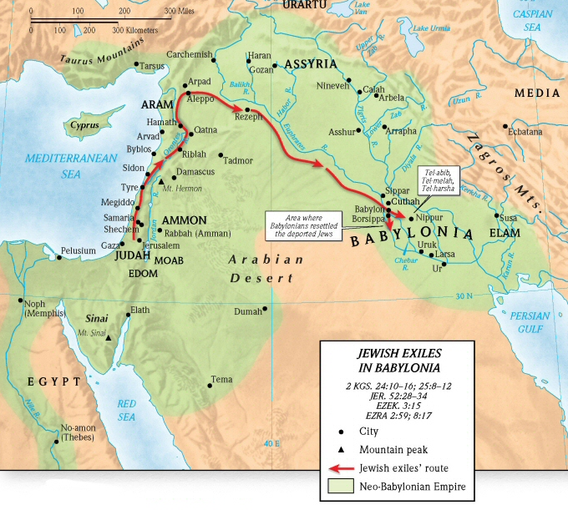
Prophets in Jerusalem
Zephaniah
630 BC
National perspective
Habakkuk
btwn 610 -605 BC
Personal perspective
Jeremiah
627-580 BC
47 years
capital perspective
(many depart to Egypt after 586 BC)
Key person: King Josiah
640-609 BC
Prophets in Babylon
Daniel
602-536 BC
66 years
(Babylon,
550 miles to Jerusalem)
Ezekiel
592-570 BC
22 years
(by Chebar river, appx 50 miles south of Babylon)
Key person: King Nebuchadnezzar
605-562 BC
Battle in 605 BC
Ezekiel 29-32
He increases the nations, and destroys them (Job 12:23)

Slide 4
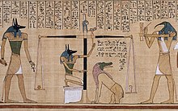
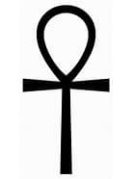
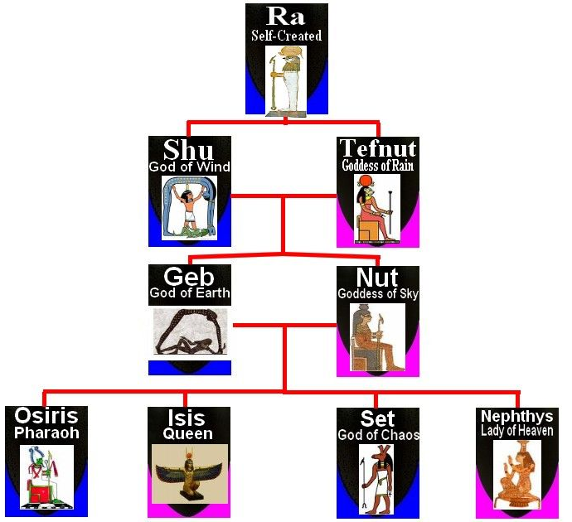
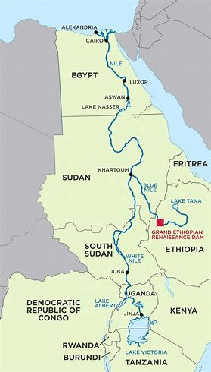
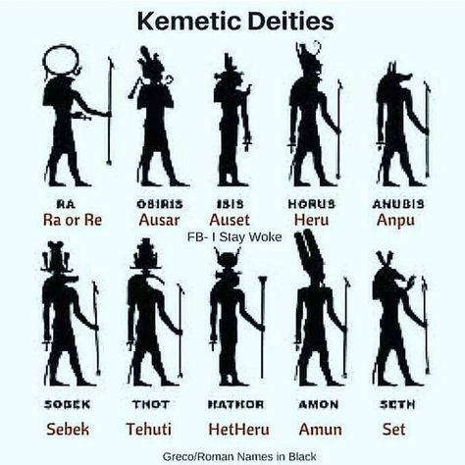
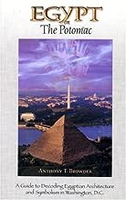
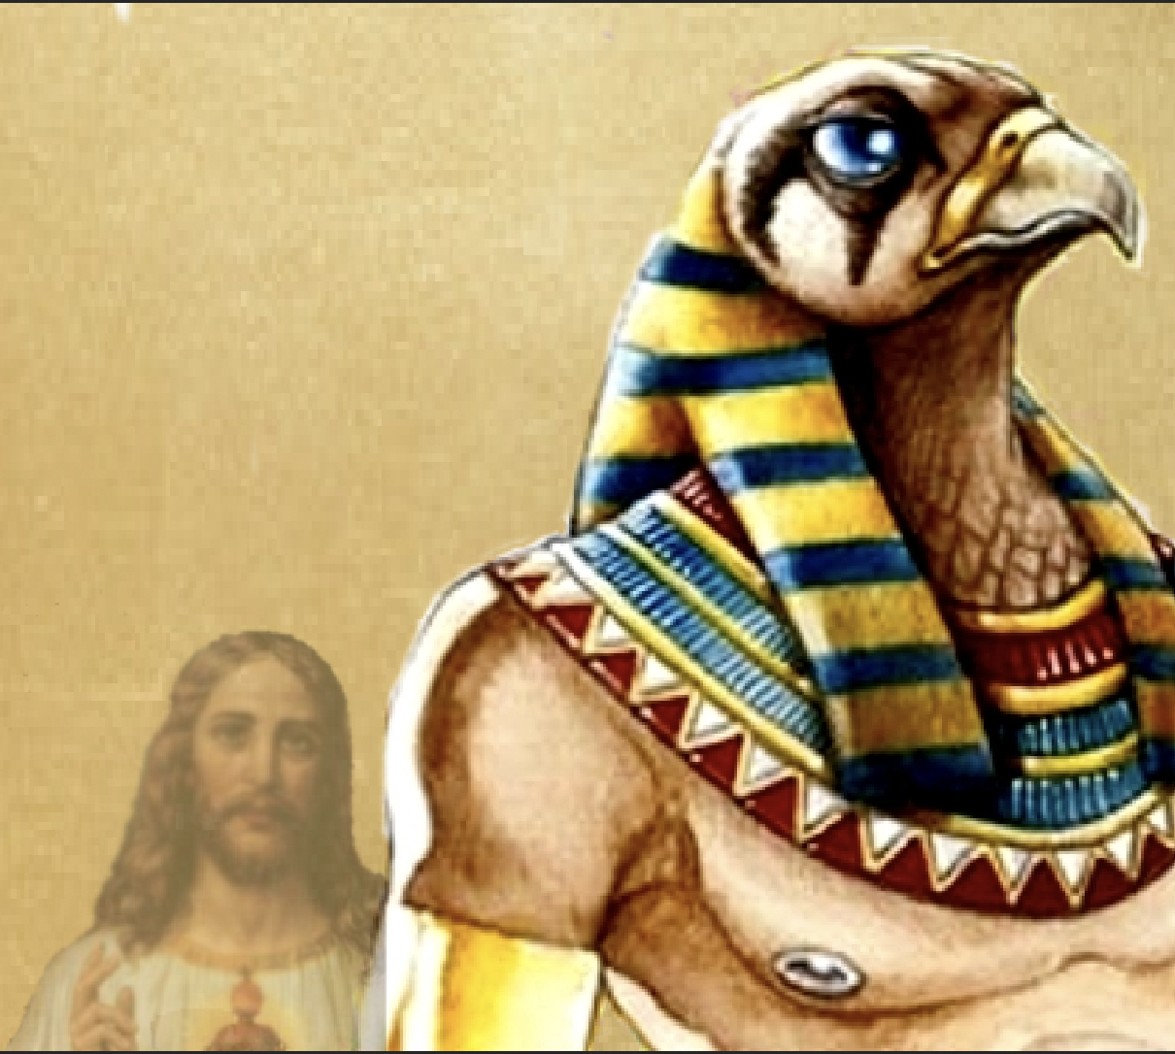
Afterlife - Balance of feather and heart
ANKH – cross like with teardrop
Ra is the Sun God – Ezekiel 8:16-18
Neter
ancestral
memory
Divine
Key
Babylon
Nimrod-Semiramis
Tammuz
Ez 8:14-17
Egypt
Osiris-Isis
Horus
Set (nephew)
energy
117th Congress
Amen and
a-woman
unity/peace
hieroglyphic symbol = life
Nile River prophecy, Ezekiel 29-32
Revival of Egyptian God worship in the U.S.A.
Set killed Osiris, whom Isis raised from the dead
Kemetic Religion in Washington DC
Nile
region

Slide 5
Egypt: a way, a truth, and a afterlife
Ezekiel Jesus Christ is the way, the truth, and the life (John 14:6)
29:1-16 Pharoah the Great Dragon Slain
7 months before the fall of Jerusalem. Pride – I am God who made the Nile.
29:17-21 Nebuchadnezzar’s Wage Paid
After an unsuccessful 13-year siege of Tyre, the LORD rewarded Nebuchadnezzar with Egypt.
30:1-19 Time of the Heathen (Gentiles)
30:3 heathen, day of the LORD, cloudy day. (Daniel 2-7, Luke 21:24, Romans 11:25)
30:20-26 Two Broken Arms
1st arm broke Assyria in 609 at Harran. 2nd arm broke Egypt in 605 at Carchemish.
31:1-18 Trees of Eden in the Garden of God
Nations are fallen trees, as in Ezekiel 17 and Daniel 4. Since Adam sinned in Genesis 3.
32:1-16 Lamentation for Pharoah
Pharoah is like a whale–caught in a net, cast to shore, eaten, and much blood. (Rev 8:8-9)
32:17-32 Egypt & Daughters Cast Down to the lowest pit (Heb 9:27) (uncircumcised - Ro 2:29)
Egypt: Mummies, pyramids, the Book of the Dead, and a good works system for the afterlife.
Next Sunday: Ezekiel 33-36; read ahead questions on the back.

Slide 6
Ezekiel 33-36 read ahead questions
1. What two groups does the watchman speak to? (Ezekiel 33:1-9)
2. Who says “the way of the LORD is not equal? (Ezekiel 33:17-20)
What time is this prophecy fulfilled? (Ezekiel 34:11-16a)
Who is taken from the heathen and brought into their own land? (Ezekiel 36:24)
5. How did the Holy Spirit speak to you while reading /studying Ezekiel chapters 33-36?

