Slide 1
Fellowship Church Sunday School Jul-Sep 2023 Ezekiel: Prophet on a Short Leash Today: Turn to Ezekiel 37-39 Let us Sanctify God’s Holy Name teacher: Bill Heath

Slide 2
God Curses Israel
Deuteronomy 11:26-29
Past: Ezekiel 1:1-2
597 BC, Ezekiel is 25 and in exile
593 BC, Ezekiel‘s 30th birthday
(priest to prophet)
Ezekiel 1:3-7:27
593 BC, 5th year, 4th month, 5th day
(of king Jehoiachin in exile
1st of 13 exact dates)
Ezekiel 8-19
592 BC, 6th year, 6th month, 5th day
Ezekiel 20-23
591 BC, 7th year, 5th month, 10th day
Ezekiel 24
588 BC, 9th year, 10th month, 10th days
Siege of Jerusalem begins
God Curses Gentiles
1 Peter 4:17-19
Ezekiel 25
1-2. Ammon & Moab
3. Edom
4. Philistia
Ezekiel 26-28
586 BC, 11th year, 1st day
5-6. Tyre & Zidon
Ezekiel 29-32
Egypt
587 BC, 10th year, 10th month, 12th day
571 BC, 27th year, 1st month, 1st day
587 BC, 11th year, 1st month, 7th day
587 BC, 11th year, 3rd month, 1st day
585 BC, 12th year, 12th month, 1st day
585 BC, 12th year, 15th day
God Blesses Israel
Deuteronomy 11:26-29
Ezekiel 33-36
585 BC – Jerusalem destroyed
12th year, 10th month, 5th day
Present/Future: Eze 37-39
1900-20xx AD
(Zionist and Israel-1948/67/73)
* The rapture of the church
Is before the 7-year tribulation.
Future: Ezekiel 40-48
573 BC
25th year, 1st month, 10th day
(14th year after Jerusalem falls)
20xx AD - Millennial Temple
design – worship - location
(Revelation 6-20)

Slide 3
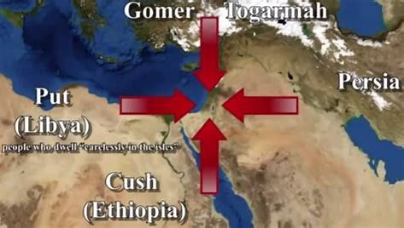
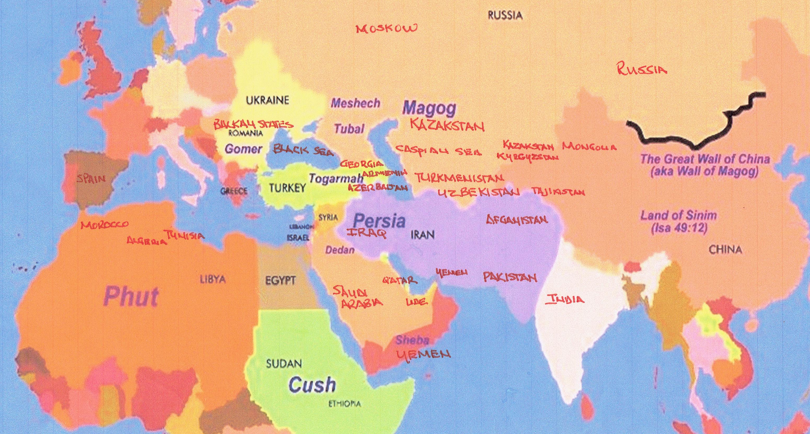
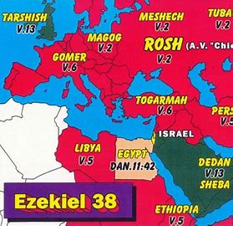
God knows and reveals to man in His time and timing, Ezekiel 37:3 (“it is written in the prophets” John 6:45
Black Sea
THE THREE MAJOR NEW TESTAMENT ENDTIME PROPHETIC BATTLES CONCERN ISRAEL AND THE NATIONS
1st Ez 38-39 & Rev 16: at end of the 7-year tribulation. (Return of Christ: Armageddon, Revelation 16-18)
2nd Revelation 20: at end of the 1000 years kingdom. (Reign of Christ: Gog & Magog, Revelation 19-20)
Note: The rapture of the church is before the wrath of God. Wars and rumors of wars, Matthew 24-25 & Psalm 83.
Gog is north of the Black Sea! Togarmah = Turkey area. Persia = Iran area.
Tarshish = Great Britain. Young Lions = U.S.A., Canada, Australia.

Slide 4
Let us Sanctify God’s Holy Name
Ezekiel
37:1-14 The Valley of “Very” Dry Bones
Hebrew Ruah (10x): Spirit (Gen 1:2), wind (Gen 3:18), spirit (Gen 6:3), breath (Gen 6:17), mind (Gen 26:35)
False: T-rex dinosaur bones with tissue and blood cells billions of years old (no, 6-10K years old)
37:15-28 Writing on Two Sticks and Uniting into One Stick
Ezekiel’s last meme: Judah & Israel united and cleansed (when? not Ezra – Nehemiah, but the far future)
12-14, grave to Israel (who & when? Jews as a nation & trib saints). 26-28, My sanctuary/tabernacle, Ez 40.
38-39 I am Against Gog (in the land of Magog, chief prince of Meshech & Tubal – north of Black Sea)
38:1-13 (Gog referred to 34x) Gog is from the far north (38:6, 15, 39:2)
38:10-12 (Persia, Ethiopia, Libya, Gomer, Togarmah) against 38:13 (Sheba-Dedan, Tarshish-young lions)
38:14-39:29 (only God referred to 59x. I/Me/My)
38:19-23 a great earthquake (19-20), sword, pestilence, blood, rain, hailstones, fire, brimstone (21-22)
39:1-7, Gog is turned back after 5/6 destroyed (38:19-23).
39:8-20, Endtime battle of Armageddon is at the end of 7-year tribulation in Rev 16-18.
39:21-29 (house of Israel 30x – they/them/their). God sets His glory among the heathen.
Next Sunday: Ezekiel 40-42; read ahead questions on the back.

Slide 5
Ezekiel 40-42 read ahead questions (the Millennial Temple’s Design)
1. Preconceptions: Do you believe this temple is past, present, future; or unsure? (Ezekiel 40-48, Rev 19-20)
2. What impressed you about the design of:
The Temple of God (Ez 40), The Holy Place in the Temple (Ez 41), and The Courtyards of the Temple (Ez 42)?
What is your overall impression of the design of this temple?
How does this temple relate to your life as a disciple of Jesus Christ?
5. How did the Holy Spirit speak to you while reading /studying Ezekiel chapters 40-42?

