Slide 1
Fellowship Church Sunday School Jul-Sep 2023 Ezekiel: Prophet on a Short Leash Today: Turn to Ezekiel 40-42 Design of the Millennial Temple teacher: Bill Heath

Slide 2
God Curses Israel
Deuteronomy 11:26-29
Past: Ezekiel 1:1-2
597 BC, Ezekiel is 25 and in exile
593 BC, Ezekiel‘s 30th birthday
(priest to prophet)
Ezekiel 1:3-7:27
593 BC, 5th year, 4th month, 5th day
(of king Jehoiachin in exile
1st of 13 exact dates)
Ezekiel 8-19
592 BC, 6th year, 6th month, 5th day
Ezekiel 20-23
591 BC, 7th year, 5th month, 10th day
Ezekiel 24
588 BC, 9th year, 10th month, 10th days
Siege of Jerusalem begins
God Curses Gentiles
1 Peter 4:17-19
Ezekiel 25
1-2. Ammon & Moab (Lot’s daughters)
3. Edom (Ez 35, Obadiah)
4. Philistia (Palestine)
Ezekiel 26-28
586 BC, 11th year, 1st day
5-6. Tyre & Zidon
Ezekiel 29-32
Egypt
587 BC, 10th year, 10th month, 12th day
571 BC, 27th year, 1st month, 1st day
587 BC, 11th year, 1st month, 7th day
587 BC, 11th year, 3rd month, 1st day
585 BC, 12th year, 12th month, 1st day
585 BC, 12th year, 15th day
God Blesses Israel
Deuteronomy 11:26-29
Ezekiel 33-36
585 BC – Jerusalem destroyed
12th year, 10th month, 5th day
Present/Future: Eze 37-39
1900-20xx AD
(Zionist and Israel-1948/67/73)
* The Battle of Armageddon,
Revelation 16. Romans 11.
Future: Ezekiel 40-48
573 BC
25th year, 1st month, 10th day
(14th year after Jerusalem falls)
20xx AD - Millennial Temple
design – ministry - location
(Revelation 19-20)

Slide 3
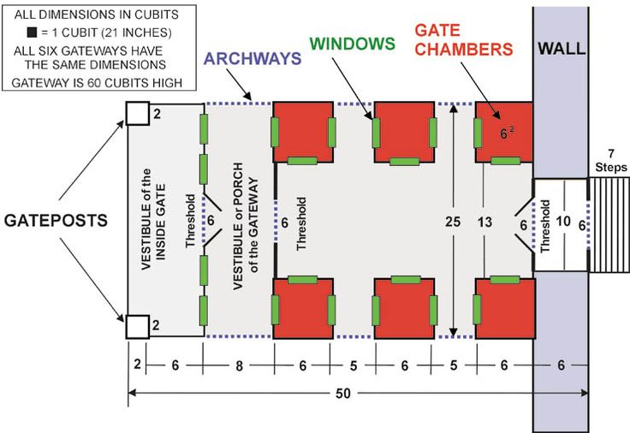
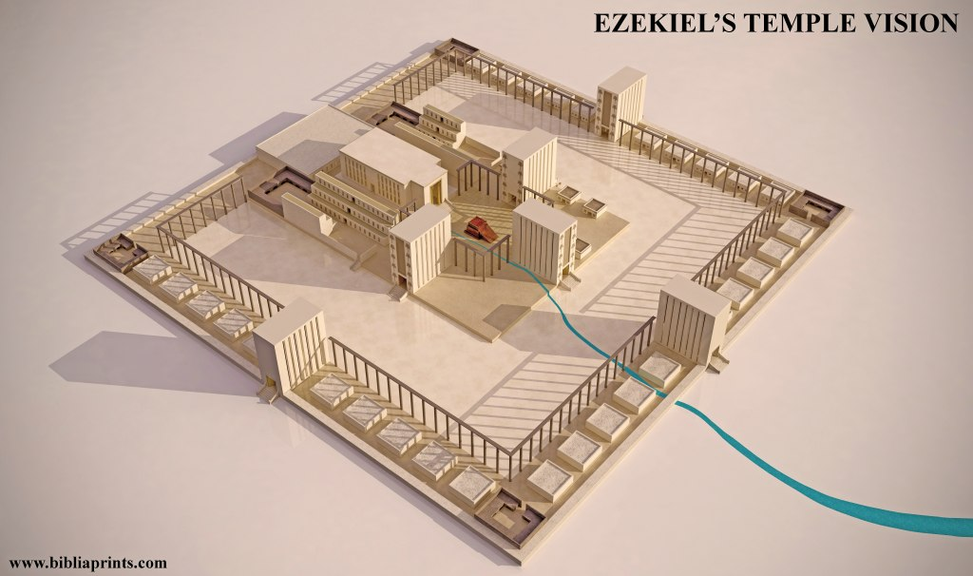

Slide 4
Design of the Millennial Temple
Ezekiel
40:1-4 A date, visions, land of Israel, a man (angel), a measuring line and rod
cubit = 21 inches, reed (rod = 5 cubits or 10.5 feet), hand breadth = 3 inches
look with your eyes, hear with your ears, set your heart, and declare to the house of Israel
40:5-27 Outer Court, 28-49 Inner Court
gates – 6 each (east, north, south – 3 to outer court and 3 to inner court), palm trees
burnt offering, sin offering, and trespass offering.
41:1-16 Temple, 17-26 Sanctuary
1-16 temple measurements. 17-26 sanctuary, cherubim and palm trees.
42:1-20 Courtyards of the Temple
Offerings: grain, sin, and trespass. Holy things. Priests minister.
15-20: outer wall measures 500 x 500 reeds to separate the sanctuary from the profane place
What is missing? Court of the gentiles, court of the women, laver, table of showbread, lampstands, altar of
incense, the ark, the curtain between the holy place and most holy place.
Next Sunday: Ezekiel 43-46; read ahead questions on the back.

Slide 5
Ezekiel 43-46 read ahead questions (the Millennial Temple’s Ministry)
1. Preconceptions: Do you believe this temple is past, present, future; or unsure? Literal or symbolic?
Why? Specify Scripture. (Ezekiel 40-48, Rev 19-20)
2. What Levitical feasts are specified? (45:21-25)
3. What Levitical offerings are specified? (43:19-46:20)
4. Why are the Old Testament law of Moses feasts and offerings practiced?
5. How did the Holy Spirit speak to you while reading /studying Ezekiel chapters 43-46?

