Slide 1
Fellowship Church Sunday School Jul-Sep 2023 Ezekiel: Prophet on a Short Leash Today: Turn to Ezekiel 43-46 Ministry of the Millennial Temple teacher: Bill Heath

Slide 2
God Curses Israel
Deuteronomy 11:26-29
Past: Ezekiel 1:1-2
597 BC, Ezekiel is 25 and in exile
593 BC, Ezekiel‘s 30th birthday
(priest to prophet)
Ezekiel 1:3-7:27
593 BC, 5th year, 4th month, 5th day
(of king Jehoiachin in exile
1st of 13 exact dates)
Ezekiel 8-19
592 BC, 6th year, 6th month, 5th day
Ezekiel 20-23
591 BC, 7th year, 5th month, 10th day
Ezekiel 24
588 BC, 9th year, 10th month, 10th days
Siege of Jerusalem begins
God Curses Gentiles
1 Peter 4:17-19
Ezekiel 25
1-2. Ammon & Moab (Lot’s daughters)
3. Edom (Ez 35, Obadiah)
4. Philistia (Palestine)
Ezekiel 26-28
586 BC, 11th year, 1st day
5-6. Tyre & Zidon
Ezekiel 29-32
Egypt
587 BC, 10th year, 10th month, 12th day
571 BC, 27th year, 1st month, 1st day
587 BC, 11th year, 1st month, 7th day
587 BC, 11th year, 3rd month, 1st day
585 BC, 12th year, 12th month, 1st day
585 BC, 12th year, 15th day
God Blesses Israel
Deuteronomy 11:26-29
Ezekiel 33-36
585 BC – Jerusalem destroyed
12th year, 10th month, 5th day
Present/Future: Eze 37-39
1900-20xx AD. (Zion/Israel-Arab
battles-1948/67/73)
* Tribulation - Armageddon,
Revelation 16-18. Romans 11.
Future: Ezekiel 40-48
573 BC
25th year, 1st month, 10th day
(14th year after Jerusalem falls)
20xx AD - Millennial Temple
design – ministry - location
(Revelation 20)

Slide 3
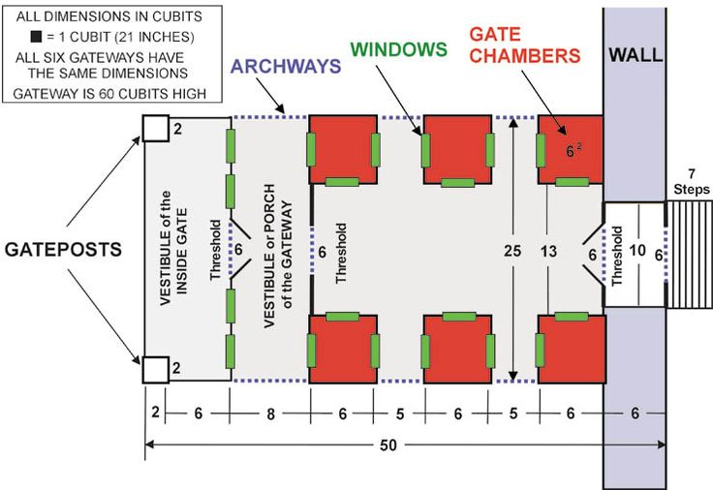
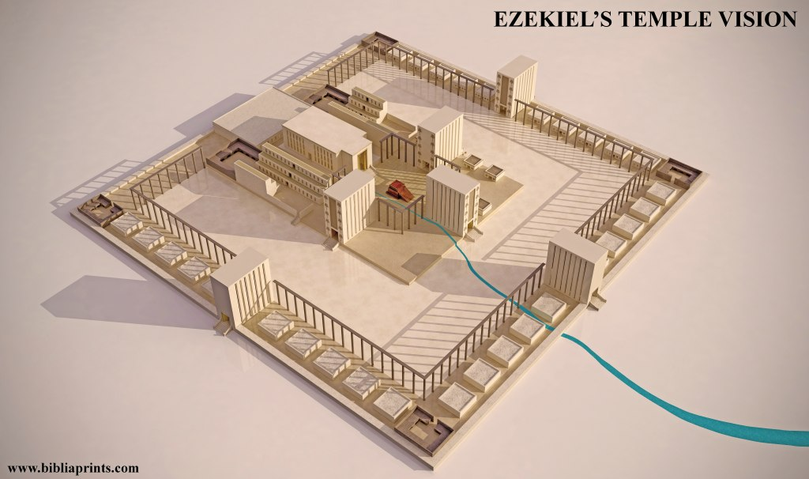

Slide 4
Ez 43-46, Ministry of the Sacrifices and Feasts at the Millennial Temple
OFFERINGS (Leviticus 1-7) Priest’s duty to discern and teach (Lev 10:1-11)
1. Burnt (12x) 43:18, 24, 27; 44:11; 45:15, 17, 23, 25; 46:2,12-13, 15 Altar consecrated: 40:27, 43:13-17
2. Sin (11x) 43:19, 22, 25; 44:27, 29; 45:17, 19, 22-23, 25; 46:20
3. Peace (5x) 43:27, 45:15, 17; 46:2, 12
4. Grain (10x) 44:29, 45:13, 15, 17, 24-25; 46:11, 14-15, 20. with oil (8x): 45:14, 24-25, 46:5, 7, 11, 14-15
5. Trespass (2x) 44:29; 46:20
6. Drink (1x) 45:17 (44:21 no priest drinks wine in the inner court)
FEASTS (Leviticus 23) SPECIAL DAYS
1-2. Passover & Unleavened Bread 45:18-24 1. New moons: 45:17, 46:1 (monthly)
3. Tabernacles 45:25 2. Sabbaths: 45:17, 46:1 (every 7th day)
3. Year of liberty: 46:17 (every 50th year)
OMITTED
Offerings: daily burnt each evening, incense, wave or heave, high priest
Feasts: Firstfruit, Pentecost, Trumpets, Atonement
Special days: Land rest (every 7th year)
PRINCE (Ezekiel 44:3, 45:7, 16-17, 22; 46:2, 4, 6, 8, 10, 12, 16-18; 48:21-22)
Who is the prince? has sons, no priestly rights to enter the temple court.
What is his role? Only he ministers at the east gate between the people and the priests (45:16-17).

Slide 5
Ministry of the Millennial Temple
Ezekiel
43:1-6 God’s Glory Fills the Temple Again
43: 7-12 Israel’s Sin Prevented God’s Presence
43:13-27 The Altar in the Temple (the sons of Zadok, not the Levites, minister at the altar)
44:1-3 East Gate is Sealed
44:4-14 Levites ministry in the temple (routine support duties)
44:15-31 Priests ministry in the temple (offering sacrifice duties - only the sons of Zodak)
45:1-8 Portions of land
45:9-12 Honest weights and measures (law of the house)
45:13-46:15 Laws for Ministry
46:16-18 The prince’s inheritance for his sons
46:19-24 Outer court kitchens at 4 corners, for boiling
Next Sunday: Ezekiel 47-48 and review of Ezekiel 40-48.

