Slide 1
Fellowship Church Sunday School Jul-Sep 2023 Ezekiel: Prophet on a Short Leash Today: Turn to Ezekiel 47-48 Land Around the Millennial Temple teacher: Bill Heath

Slide 2
God Curses Israel
Deuteronomy 11:26-29
Past: Ezekiel 1:1-2
597 BC, Ezekiel is 25 and in exile
593 BC, Ezekiel‘s 30th birthday
(priest to prophet)
Ezekiel 1:3-7:27
593 BC, 5th year, 4th month, 5th day
(of king Jehoiachin in exile
1st of 13 exact dates)
Ezekiel 8-19
592 BC, 6th year, 6th month, 5th day
Ezekiel 20-23
591 BC, 7th year, 5th month, 10th day
Ezekiel 24
588 BC, 9th year, 10th month, 10th days
Siege of Jerusalem begins
God Curses Gentiles
1 Peter 4:17-19
Ezekiel 25
1-2. Ammon & Moab (Lot’s daughters)
3. Edom (Ez 35, Obadiah)
4. Philistia (Palestine)
Ezekiel 26-28
586 BC, 11th year, 1st day
5-6. Tyre & Zidon
Ezekiel 29-32
Egypt
587 BC, 10th year, 10th month, 12th day
571 BC, 27th year, 1st month, 1st day
587 BC, 11th year, 1st month, 7th day
587 BC, 11th year, 3rd month, 1st day
585 BC, 12th year, 12th month, 1st day
585 BC, 12th year, 15th day
God Blesses Israel
Deuteronomy 11:26-29
Ezekiel 33-36
585 BC – Jerusalem destroyed
12th year, 10th month, 5th day
Present/Future: Eze 37-39
1900-20xx AD
(Zionism & Israel-1948/67/73)
* Romans 11, Revelation 16-18,
Battle of Armageddon
Future: Ezekiel 40-48
573 BC
25th year, 1st month, 10th day
(14th year after Jerusalem falls)
20xx AD - Millennial Temple
Design – Ministry – Land
(Revelation 20)

Slide 3
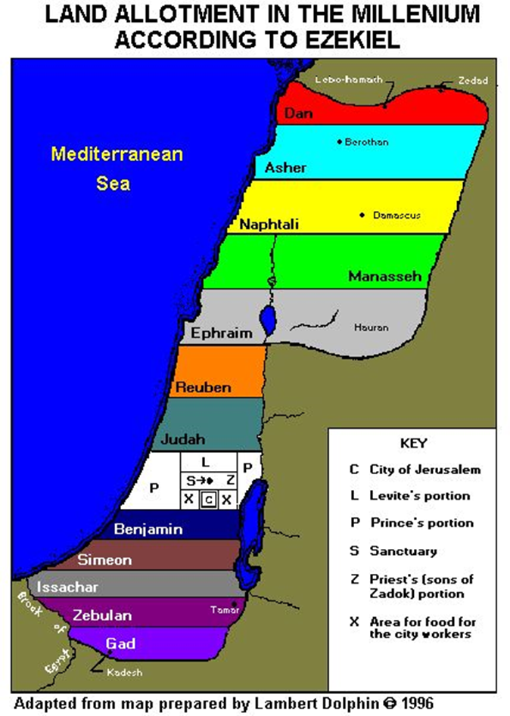
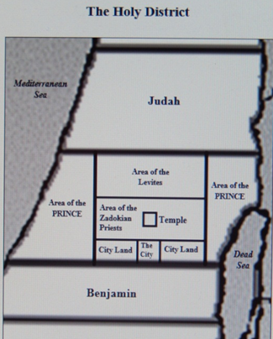
Ezekiel 47-48
Land around
the
Millennial
Temple
What is the
resurrected
saint’s
duty during
the reign
of Christ?
Matthew 5:3, 5
1 Cor 6:2, 10:11
2 Timothy 2:12,
Revelation 2:26,
27; 3:21,
5:10, 20:6, 22:5

Slide 4
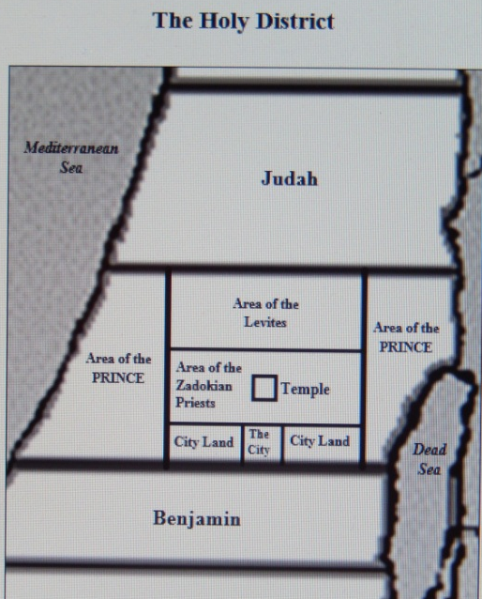
Land Around the Millennial Temple
Ezekiel
47:1-12 Water from “the Temple” (water from “the throne of God & the Lamb” in Revelation 22:1)
1-5 Water deepens every 1000 cubits (1/3 mile). Trickle, to ankle, to knee, to waist, to swim in.
6-12 Life-giving water: many trees, many fish, tree fruit for food, and leaves for medicine
47:13-48:29 Land Boundaries and Division
47:13-48:7 Seven tribes (strangers, 47:22-23)
48:8-12 Sanctuary and priests (sons of Zadok)
48:13-14 Levites
48:15-20 City
48:21-22 Prince (seed of David via Joseph in Matthew 1)
* not Jesus Christ, not King David resurrected
48:23-29 Five tribes of Israel
48:30-35 Twelve City Gates named after the 12 Tribes of Israel
the name of the city from that day shall be, the LORD is there
Ezekiel 40-48 Q & A on the millennial design, ministry, and land. Application for saints today!
Next Sunday: Review the book of Ezekiel, chapters 1-48. Q & A.

Slide 5
Tabernacle / Temple Design Glory (shekinah) 1. Temple in Heaven (Hebrews 8:1-6) *!? after the rebellion of the Devil (Ez 28:15, Rev 12:4-5) 2. Tabernacle Exodus 25-30 (Heb 9, Ex 40:34-38 / 1 Sam 4:21-22) Glory enters / departs 3. Solomon's Temple 1 Kings 5-6 (1 Ki 8:10-11 / Ez 8-11) Glory enters / departs 4. The exile is a little sanctuary spiritual, Jew’s body (Ez 11:16, Is 8:13-14a) 5. Zerubbabel’s Temple small compared to Solomon’s temple 6. Herod's Temple Herod’s glory 7. Jesus is the Temple (Ps 22-Lamb) spiritual, full of grace and truth (Jerusalem desolate: Matthew 23, Romans 9-11) 8. The pilgrim is a temple (Ps 23-Shepherd) spiritual, believer’s body (1 Cor 3:17, 6:19, Heb 11:13. Ephesians 1-3, Colossians 1) 9. Tribulation Temple Antichrist‘s glory 10. Millennial Temple (Ps 24-King) Ezekiel 40-48 (restitution: Acts 3:12-26, Luke 1:67-80) Glory enters (Ez 43:1-6 (Gen 15:18, Isaiah 2:4, 11:6, 9; Hab 2:14, Jer 31:34, 35-37, Romans 8:19-22, 1 Corinthians 6:2, 2 Timothy 2:12) No temple Revelation 21:10-27 (God & Lamb) Glory forever

