Slide 1
Fellowship Church Sunday School
Jul-Sep 2023
Ezekiel: Prophet on a Short Leash
Today: Turn to Ezekiel 8-11
God Sees and Glory Departs teacher: Minister William Heath

Slide 2
Ezekiel 8-11, God Sees and Glory Departs
Judgment to come
Past: Ezekiel 1:1-2
597 BC, Ezekiel is 25 and in exile
592 BC, Ezekiel‘s 30th
birthday (priest to prophet)
Ezekiel 1:3-7:27
592 BC, 5th year, 4th month, 5th day
(of Jehoiachin in exile)
Present: Ezekiel 8-19
591 BC, 6th year, 6th month, 5th day
Future: Ezekiel 20-23
590 BC, 7th year, 5th month, 10th day
Ezekiel 24
588 BC, 9th year, 10th month & day
Siege of Jerusalem
Ezekiel 25-32
586 BC, 11TH year
Destruction of Jerusalem
Judgment of Nations
8:1-4 Glory Present (Ez 1:26-28, Rev 1:13-15)
1 Ezekiel sat with elders at home (Ez 11:24-25)
2-4 spirit lifted up, visions to Jerusalem (10 -15 minutes)
8:5-18 God sees (from heaven in the north to the temple)
5-6 king - image of jealousy
7-12 govt of 70 men - images of animals
13-14 women - weep for Tammuz (Babylonian God/dess, fall/spring)
15-16 priests of 25 men – back to the temple, face to worship the sun
17-18 their (vs 5-16) cries to God will not be heard
9:1-11:23 Glory Departs (from the temple to the east)
9:1-10:7 6 angels with weapons (1 in linen writes, 6x)
(9:3, 10:4) Glory moves from holy of holies to holy place to outer court
10:8-22 Description of heavenly creature (same in Ez 1-3)
11:1-13 (God sees) 25 evil men devise mischief and wicked counsel
11:14-20 Remnant blessed & (11:21) others cursed
(11:22-23) Glory departs from the east gate to the Mount of Olives
11:24-25 Ezekiel returns home and speaks to them of the captivity
Next Sunday: Ezekiel 12-17, reading questions on the back.

Slide 3
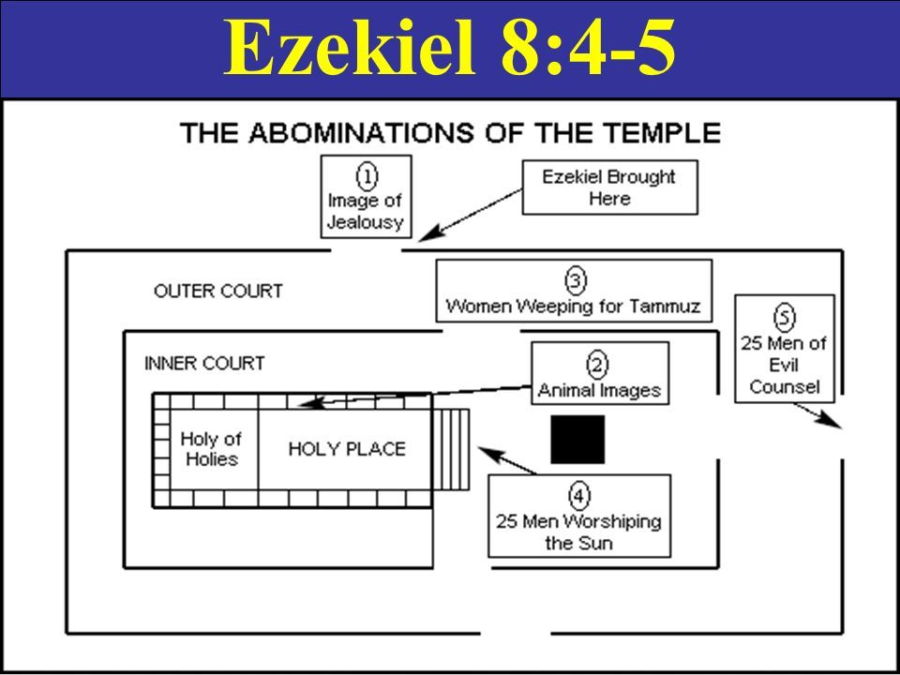
North (heaven - God)
Ez 8:16, 10:19, 11:1, 23
Job 26:7, 37:22
Isaiah 14:13
Song of Songs 4:16
East (glory - Jesus )
Ez 8:3, 5, 14; 9:2
Psalm 103:12
Zechariah 14:4
Matthew 24:27
Revelation 7:2, 21:3
8:5-6
(king)
NORTH
8:13-14
(women)
8:7-12
(70-govt)
EAST
11:1-13
(25 evil men)
8:15-17
(25 priests)

Slide 4
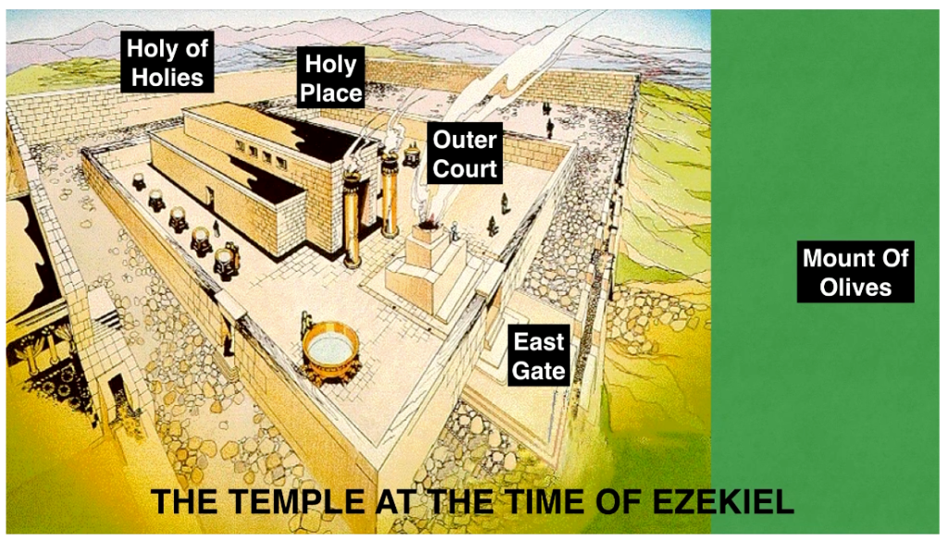
God’s Glory Departs Israel until Jesus is Born in Bethlehem
NORTH
9:3
10:4
EAST
10:19
11:23

Slide 6
Ezekiel 12-16
What sometimes causes us, like the Israelites, to believe that we will not suffer consequences for our actions?
What would be some everyday terms we use to describe spiritual blindness and deafness?
Explain your perspective on the relationship between our belief in God’s judgment and our obedience to God’s commands?
If someone asked you for the top three ways to identify a false prophet, what would you tell them?
If faith can’t be “borrowed,” how does the presence of righteous people benefit a city or a culture?
How did the Holy Spirit speak to you while reading Ezekiel chapters 8-11?

