Slide 1

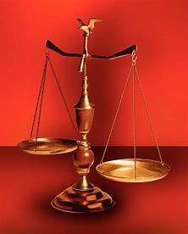
Fellowship Church, Sept 11, 2024 B. Heath
Straight and Balanced
(Luke 3:4-6)
Biblical characters (Hebrews 11:1-3, 6, 39-40)
#1 – Abel’s Faith & Innocent Blood (Heb 11:4, Gen 4)
#2 – Walking with God & with Enoch (Heb 11:5-6, Gen 5)
#3 – Secure on the Ark with Noah (Heb 11:7, Gen 6-11)
#4a – Faith with Abraham (Heb 11:8-19, Gen 12-23)
#4b – Faith with Sarah (Heb 11:11-12, 1 Peter 3:6)
#4c – OT & NT Strangers & Pilgrims (Heb 11:13-16, 1 Pe 2:11)
#5 – Faith & Laughter with Isaac (Heb 11:17-19, Gen 18-24)
#6 – Your Faith with Jacob/Israel (Heb 11:20-21, Gen 25-36)
#7 – Faith with Joseph (Heb 11:22, Gen 37- 50)
#8 – Faith with Moses (Heb 11:23-29, Exodus-Deut)
#9 – Faith with Joshua (Heb 11:30, Joshua)
#10 – Faith with Rahab (Heb 11:31, Joshua 6)
#11 – Faith with the Judges (Heb 11:32, Judges)
#12 – Faith with David (Heb 11:32, 2 Samuel, 1 Chr)
#13 – Faith with Samuel (Heb 11:32, 1 Samuel)
#14 – Faith with the Prophets (Heb 11:32-38, Is-Malachi)
#15 – Faith for All (Heb 11:39-40, Old Testament saints)
OT: Ps 5:8, Pr 4:25-27
Amos 7:7-8, Is 28:13, 17
NT: Mt 3:3, Acts 9:11
Hebrews 12:13, Jude 3
1 Cor 15:1-4, 2 Tim 3:10
John 7:16
OT: Deut 25:13-16
Pr 20:10, Dan 5:25-28
NT: Hebrews12:1
1 Cor 3:11-15,
Philippians 4:5,
James 3:17

Slide 2
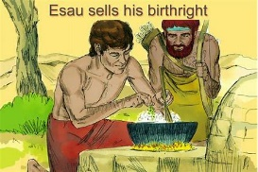
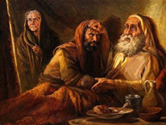
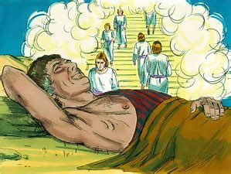
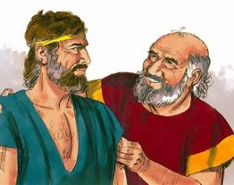
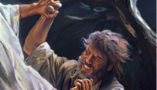
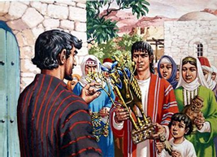
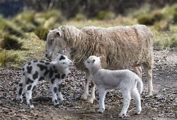
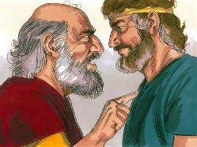
By Faith with Jacob/Israel for your personal learning (Romans 15:4)
Genesis 25:29-34 (Esau sells his birthright to Jacob)
Genesis 27:1-28:5 (tricked, Isaac
blesses Jacob with the inheritance)
Genesis 28:10-22 (Jacob dreams of angels and God’s blessing)
Genesis 30:25-43 (Uncle Laban and Jacob ‘s relations in Genesis 29-31)
Genesis 32:24-32 (Jacob wrestles with Jesus and named Israel, Hosea 12:2-6)
Genesis 35:1-15 (Jacob’s house puts away strange gods)

Slide 3
By Faith with Jacob/Israel (Hebrews 11:20-21)
Text: 11:20 By faith Isaac blessed Jacob and Esau concerning things to come.
(Jacob: Gen 27: 27-29, Esau: Gen 33-40 & Hebrews 12:16-17)
21 By faith Jacob, when he was dying, blessed both the sons of Joseph; and worshipped, [leaning] upon the top of his staff. (Simeon and Levi in Gen 49:5-7 for Shechem in Gen 34)
Old Testament: Jacob/Israel is 81x in the same sentence and in the same order.
Genesis 25-36 (12x), Psalms (12x), Isaiah (22x), Micah (5x)
New Testament: Jacob/Israel is 1x in Romans 11:26 “And so all Israel shall be saved: as it is written, There shall come out of Zion the Deliverer, and shall turn away ungodliness from Jacob.” (written in Isaiah 59:20; detailed in Zechariah 13:8-9, Matthew 24-25 and Romans 11)
Straight and balanced truth: The law and the prophets proclaim the Lord Jesus Christ.
Application: Christ-followers learn from Jacob/Israel the design of God to grow in Christ as
Peter affirms in 2 Peter 3:18 and John in 1 John 2:12-14. Also Romans 6-8.
Decision: Seek, trust, and obey God our Father in heaven to grow in Christ.

