Slide 1
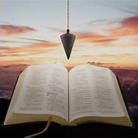
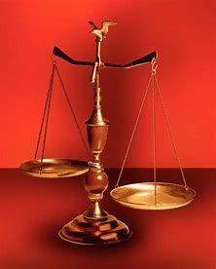
Fellowship Church, July 3, 2024 B. Heath
Straight and Balanced
(Luke 3:4-6)
Biblical characters (Hebrews 11:1-3)
#1 – Abel’s Faith & Innocent Blood (Heb 11:4, Gen 4)
#2 – Walking with God & with Enoch (Heb 11:5-6, Gen 5)
#3 – Secure on the Ark with Noah (Heb 11:7, Gen 6-11)
#4a – Our Faith with Abraham (Heb 11:8-19, Gen 12-23)
#4b – Our Faith with Sarah (Heb 11:11-12, 1 Peter 3:6)
#4c – Good & Faithful Strangers & Pilgrims (Heb 11:13-16)
#5 – Isaac (Heb 11:20, Gen 24)
#6 – Jacob (Heb 11:21, Gen 25-36)
#7 – Joseph (Heb 11:22, Gen 37- 50)
#8 – Moses (Heb 11:23-29, Exodus-Deut)
#9 – Joshua (Heb 11:30, Joshua)
#10 – Rahab (Heb 11:31, Joshua 6)
#11 – Gideon, Barak, Samson & Jephthah (Heb 11:32, Judges)
#12 – David (Heb 11:32, 2 Samuel, 1 Chronicles)
#13 – Samuel (Heb 11:32, 1 Samuel)
#14 – Prophets (Heb 11:32-38, Isaiah-Malachi)
#15 – All (Heb 11:39-40, Old Testament saints)
OT: Ps 5:8, Pr 4:25-27
Amos 7:7-8, Is 28:13, 17
NT: Mt 3:3, Acts 9:11
Hebrews 12:13, Jude 3
1 Cor 15:1-4, 2 Tim 3:10
John 7:16
OT: Deut 25:13-16
Pr 20:10, Dan 5:25-28
NT: Hebrews12:1
1 Cor 3:11-15,
Philippians 4:5,
James 3:17

Slide 2
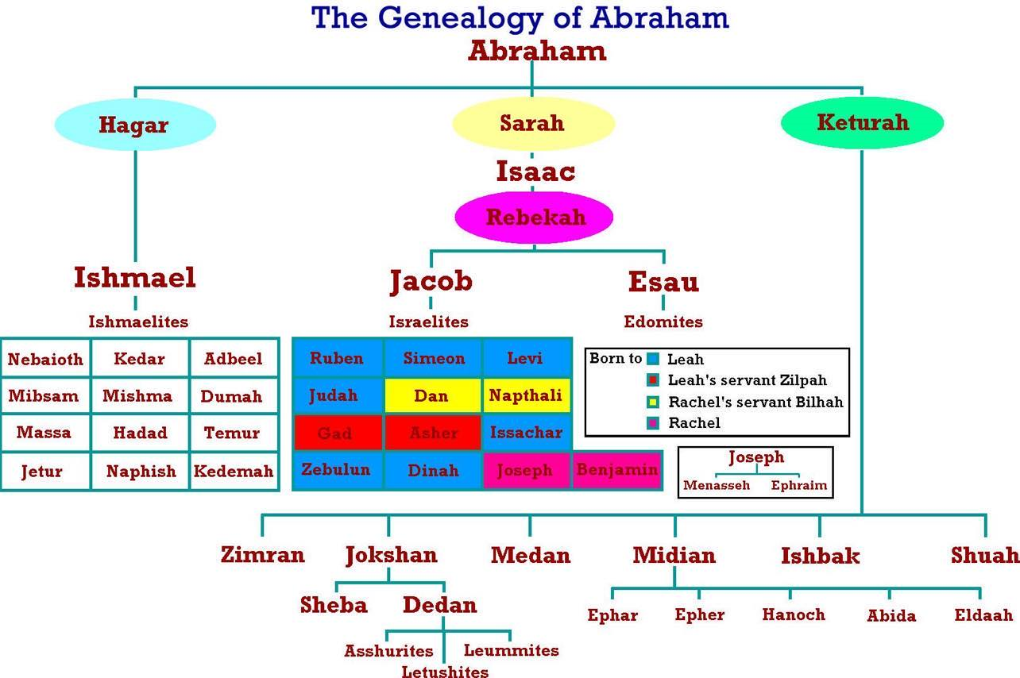
Children of Ishmael, Esau, and Keturah and others surround & hate Israel today.
50% of the
world religions
(Judaism, Islam,
Christian)
Egyptian slave
wife after Sarah died

Slide 3
Our Growing Faith with Sarah
Old Testament
Genesis 1-2, 3-8, 9-11
Eve? Mother of all living, Gen 3:20. Eve deceived,
1 Tim 2:13-14. Eve beguiled, 2 Cor 11:3. Gen 5:2.
Gen 12-25 (Abrahamic covenants-seed 19x, land 4x)
Gen 17:15-16 only woman in the Bible with
a new name by the LORD, and mother of nations
New Testament
Jesus: no mention. Acts: no mention.
Letters: Romans 4:19 (today: unbeliever’s salvation, by faith as Abraham & Sarah)
Romans 9:9 (Israel past: salvation from Israel to the Gentiles)
Galatians 4:22-31 (today: believer’s sanctification, Sarah/grace or Hagar/law)
Hebrews 11:11-12 (today: believer’s sanctification & growing faith)
1 Peter 3:6 (today: believer’s marriage and prayers; Ephesians 5:21-33)
Revelation: no mention New name: Rev 2:17, 3:12, 22:3-4
Genesis Event Age
12:1-3 Left Ur to Canaan 60 12:10-20 Half truth to Pharaoh (Egypt) 66
16:3 Ishmael of Hagar born (10 yr) 76
17:15-17 New name Sarah 90
18:17, 21 Sarah laughs at words of Angel 90
20:1-18 Half truth to Abimelech 90
21:5-7 Isaac born - all laugh with joy 90
21:8-21 Ishmael (16) laugh at Isaac (3) 93
22:1-15 Abraham offer’s Isaac (12-37?) 127?
Isaac comforted in Gen 24:67
23:1 Sarah ‘s burial / 400 shekels 127

Slide 4
Our Growing Faith with Sarah (Hebrews 11:11-12)
Time: 1970-1843 BC. Places: Ur (Garden of Eden after the flood), Canaan, Egypt, Canaan
People: A woman, the wife of Abraham, the mother of Isaac
Sarai = my princess (13x Gen 11:29-16:8), Sarah = mother of nations (30x Gen 17:15-25:12)
Scripture
Hebrews 11:11-12 ¹¹ Through faith also Sara herself received strength to conceive seed,
and was delivered of a child when she was past age, because she judged Him faithful who had promised. ¹² Therefore sprang there even of one, and him as good as dead, [so many] as the stars of the sky in multitude, and as the sand which is by the sea shore innumerable.
1 Peter 3:6-7 Even as Sarah obeyed Abraham, calling him lord: whose daughters ye are,
as long as ye do well, and are not afraid with any amazement. Likewise, ye husbands, dwell with [them] according to knowledge, giving honor unto the wife, as unto the weaker vessel, and as being heirs together of the grace of life; that your prayers be not hindered.
Decision: Let us learn from Sarah for application today (Romans 15:4-6)
Notes:
-

