Slide 1
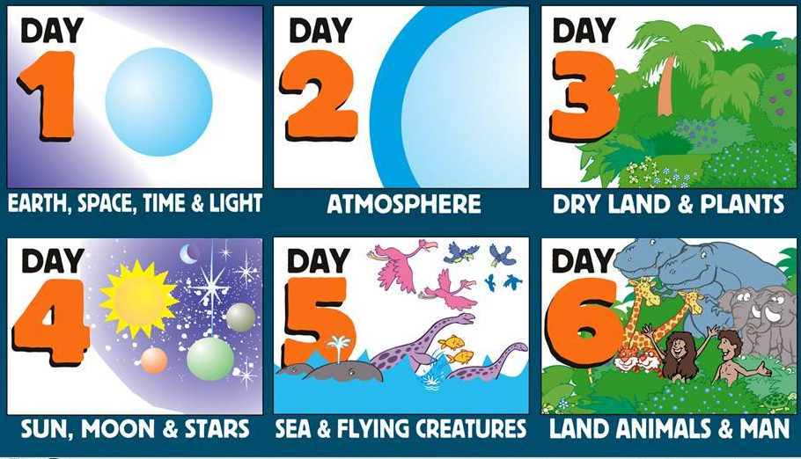
The Creation Song
(sing to cadence rhythm)
Men: 7 days creation, I believe
Both: Light-dark-light, on day one (SOFTLY)
Men: Water-sky-water, on day two
Women: Land-grass-seed, on day three
Men: Sun-moon-stars, on day four
Women: Fish-birds-fish, on day five
Men: Beast-man-woman, on day six
Both: Rest-rest-rest, on day seven (VERY SOFTLY)
Women: 7 days creation, I believe (STRONGLY)
Both: Believe the Bible, you will see (STRONGLY)

Slide 2
Title: Foundations for our Faith Text: Genesis 1-12 Key verse: 1:1 In the beginning God created the heaven & the earth
Lessons Scripture
1. Eternity past and heavenly rebellion (time begins) 1:1-2
2. Evening and Morning (6-24 hours days), and the Sabbath 1:3-2:3
3. Seed, Man and Woman (details of chapter 1, days 3&6) 2:4-2:25
4. Sin and Redemption (Adam and Eve) 3
5-6. Religion and Relation (Cain and Abel) 4:1-6:13
7-9. Flood (Noah, the Ark, and the Great Flood) 6:14-9:17
10-11. Tower of Babel (Noah’s 3 sons and Nimrod) 9:18-11
12. A Chosen Land, People-Nation & language (Abraham) 12

Slide 3
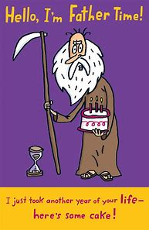
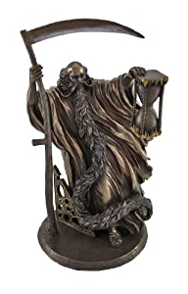
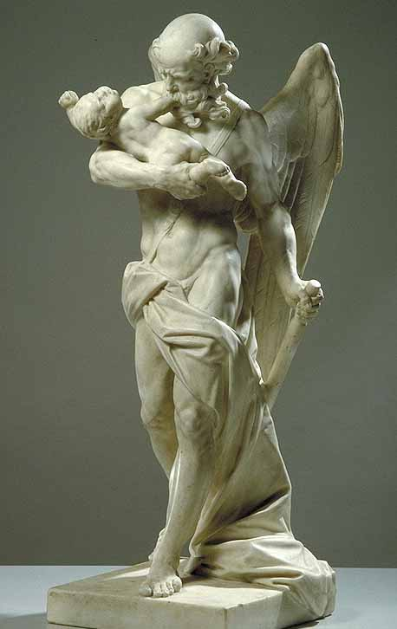
Chronos Father Time (Greek Mythology)
Hourglass & Sickle
Hourglass & SKULL
Saint Jerome
Tatoo Wings & Baby

Slide 4
Title: The Foundations for our Biblical World View (belief system) Text: Genesis 1-12 Turning to my “first love” of God in 2021 (Hosea 12:6)
Foundation Truth Lie
1. God’s Creation Young Earth- 7 days Old Earth- Evolution
2. Marriage & Family Man-Woman Man-man
3. Sin & Redemption Sin – skin clothes Sin - fig leaf clothes
4-5. Religion or Relation Animal sacrifice Food sacrifice
6-8. Sin’s Judgment World-wide flood Local flood
9-11. Government Law of Moses Central government
12. Jesus Christ Growing faith in God Faith in humanity

Slide 5
2021 Quiet Time (QT) Schedule
A healthy scriptural pattern is to seek God
the first thing each morning - our tithe of time.
This is a Scripture reading, journaling, meditation, and prayer system. A daily schedule covers the Bible in 9 years.
Try it for Jan-Feb 2021!
Monday through Saturday
Jan-Feb (Hebrews, 1 John), Mar-Jun (1-2 Samuel), 1-2 Thessalonians, John (Jul-Oct) Acts 1-3 (Nov-Dec).
Sundays - Psalms 137-150,
Song of Songs, and Job 1-5.

Slide 6
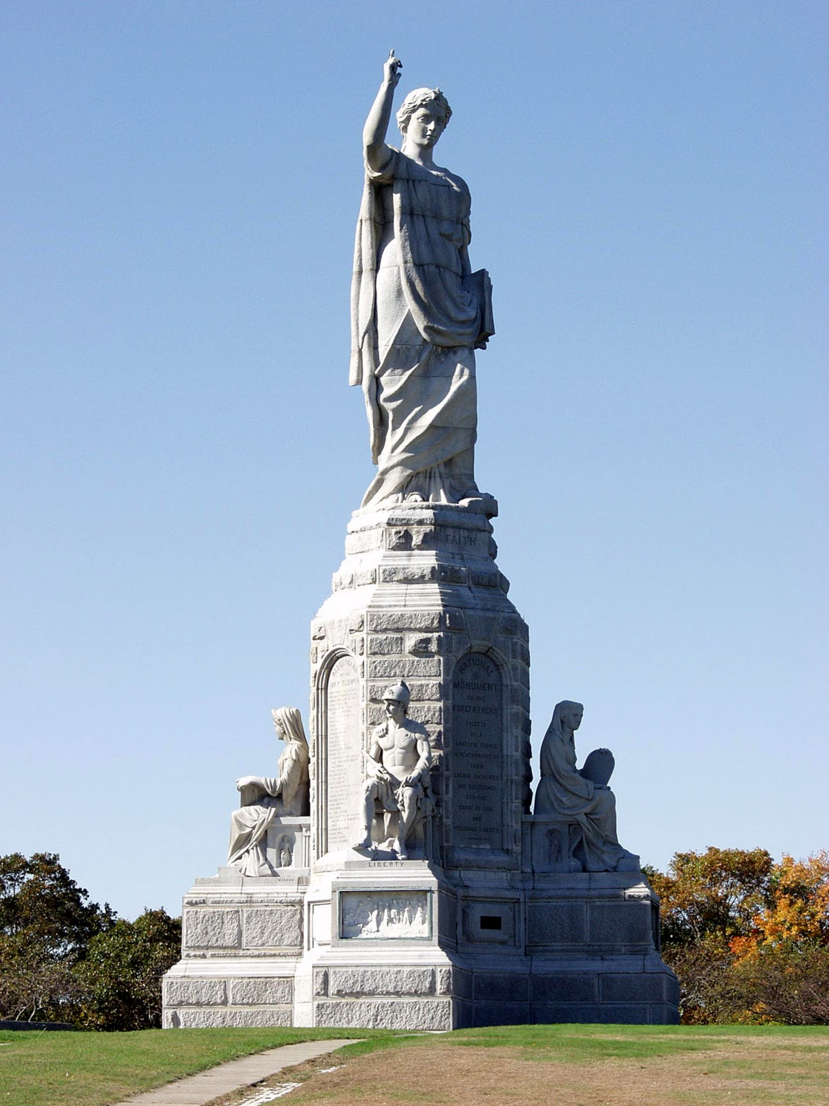
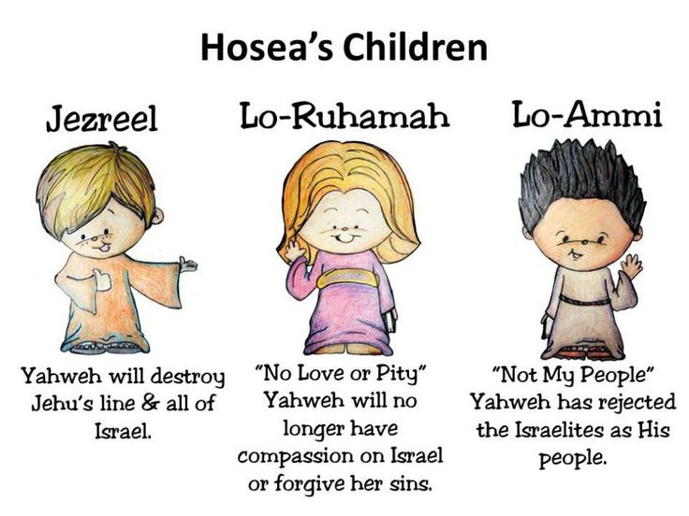
Next Sunday – January 3, 2021
The Pilgrim Fathers
Foundations for our nation, the U.S.A.
Hymn: On Christ the Solid Rock
I Stand
and
Hosea (January 2021)
5-week study
Chapter 1 read-ahead
Introduction and Outline
New Jerusalem
Revelation 21-22
National Monument
to the Forefathers

