Slide 1
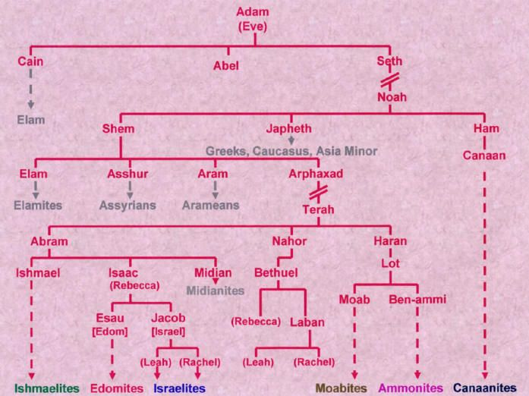
Genesis 1-5
Genesis 6-11
Genesis 12
RAC 3
Jesus Christ

Slide 2
In The Beginning - god – created - the heaven - and the earth
Genesis is the book of firsts and a solid foundation to glorify God
Lessons Scripture
1. Eternity past and heavenly rebellion (time begins) 1:1-2
2. Evening and Morning (6-24 hours days), and the Sabbath 1:3-2:3
3. Seed, Man and Woman (details of chapter 1, day 6) 2:4-2:25
4. Sin and Redemption (Adam and Eve) 3
5-6. Religion plus Relation (Cain and Abel) 4:1-6:13
7-9. Flood (Noah, the Ark, and the Great Flood) 6:14-9
10-11. Tower of Babel (Noah’s 3 sons and Nimrod)kk 10-11
12. A Chosen Nation (Abraham) 12

Slide 3
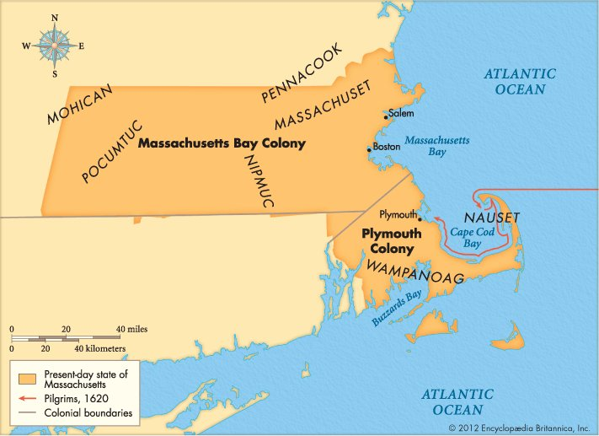
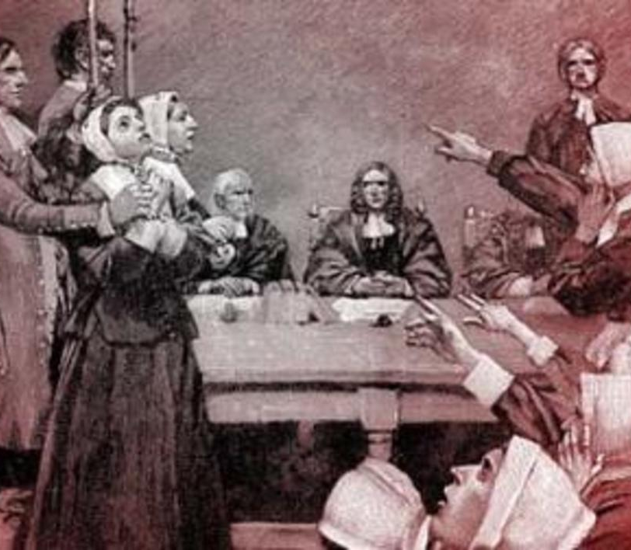
Salem Witch Trials The Scarlet Letter

Slide 4
Salem Witch Trials (1692-1693) lead Judge John Hathorne (9 judges. Judge Samuel Sewall led salem in repentance w/prayer and fasting annually) and The Scarlet Letter (1850) writer Nathaniel hawthorne (He was born in salem, Massachusetts bay colony. He is the great-great grandson of john hathorne.)
The Pilgrim fathers of Plymouth Colony provided solid foundations for God to bless the U.S.A.
Today’s public education
focus on one,
“The Salem Witch Trials”
some of the girls and even Judge Sewell publicly repented of their role in the events of those months. Most of the accused were innocent of practicing the “dark arts.” The number of executions at one small town in New England were dwarfed by the hundreds and thousands who died for “witchcraft” in Germany, France and England in that same era, but the events of Salem have been grasped by the enemies of godly government and Puritan culture to condemn all Christian rule in America as nothing but witch burning and hypocrisy.

Slide 5
Genesis 10 – Seventy (70) Nations from Shem, Ham, and Japheth
Son Genesis 10 Other Scripture
1 Genesis 9:18
1. Japheth is enlarged 2-5
Gog and Magog Ezekiel 38-39
2. Canaan is cursed 6-20 Leviticus 18
Nimrod / Tower of Babel / Babylon Revelation 17-18
3. Shem is blessed 21-31
Pelag – earth divided 32 Genesis 11:1-9
Next Sunday: Genesis 11 - The Tower of Babel

Slide 6
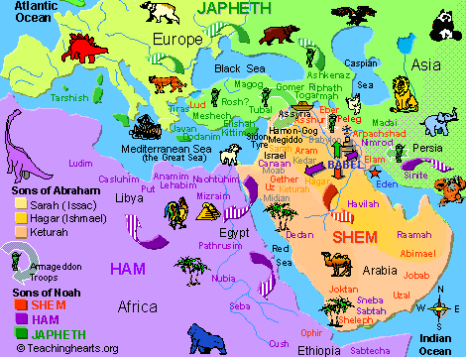

Slide 7
Genesis 10 & 11 - Babel - The Genesis Music Project – YouTube
(5 minutes, 43 seconds)
https://youtu.be/Oya2fK0pfFk Mary did you know YouTube Link
Genesis 10 - KJV | Christian bible rap. - YouTube
Genesis 1 in song - In the Beginning - The Genesis Music Project – YouTube
Genesis 4 - Cain & Abel - The Genesis Music Project - YouTube
Genesis 7 in song - The Flood - The Genesis Music Project – YouTube

