Slide 1
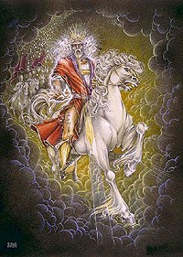
How Can I Stand? by Joe Vermeulen
Page 1 of 3
A glorious appearance
Behold the Son of man
Overwhelming vision
How can I stand?
Your voice, like the thunder
You speak the life-giving breath
Your presence, shake the mountains
How can I stand?
When I see your face, shining bright as lightning
Flaming eyes, piercing my darkness
I’m overcome, by your glorious presence
How can I stand?
(Revelation 1:13-16)

Slide 2
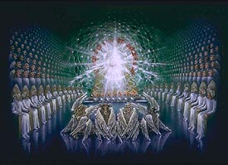
Page 2 of 3
The ancient King of heaven
God my righteous judge
Revealer of my portion
You are the all-knowing One
You’ll walk me through the fire
Save me from the grave
From the dust of the earth
You’ll raise me up again (Revelation 4 - 24 Elders and 4 Beasts)
When I see your face, shining bright as lightning (2 times)
Flaming eyes pierce my darkness
I’m overcome by your glorious presence
How can I stand?

Slide 3
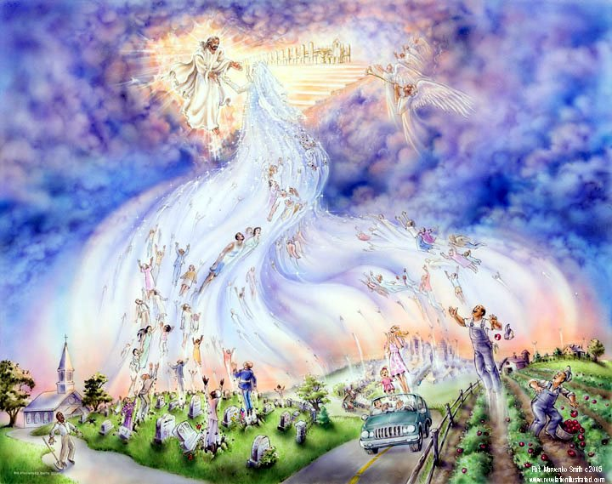
Page 3 of 3
Maranatha come Lord Jesus come!
Maranatha come Lord Jesus come!
The trumpet shall sound, look at the clouds
Jesus comes forth, in glory and power
Angels sent forth, unstoppable force
Gathering saints, all over the earth
Ancient of days, taking his place
Heavens roll back ,and the mountains give way
Now falls the sword, of wrath and reward
Who can stand, in the Day of the Lord?
Revelation 4

Slide 4
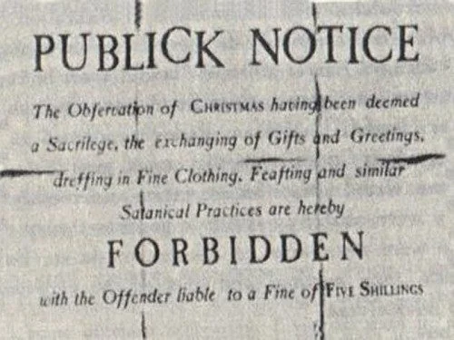
In 1659, the Massachusetts Bay Colony officially outlawed the celebration of Christmas
The Pilgrim fathers of Plymouth Colony provided solid foundations for God to bless the U.S.A.
Christmas with the pilgrims
The next year, a second group of colonists, mostly bachelors, arrived in Plymouth in November 1621. Unlike their predecessors, these colonists did not come solely for religious reasons, but were seeking financial opportunity.
When the Pilgrims headed out to work the following Christmas, just a few weeks after celebrating the first Thanksgiving, some of the newcomers objected. Gov. William Bradford wrote an account of this disagreement in his journal, Of Plymouth Plantation, in which he referred to himself as “the Gov”:
One the day called Christmas day, the Gov called them out to work, (as was used,) but the most of this new-company excused themselves and said it went against their consciences to work on that day. So the Gov told them that if they made it matter of conscience, he would spare them till they were better informed.
Bradford thought they would celebrate Christmas privately in their homes with prayer, said Richard Pickering, chief historian and deputy executive director at Plimoth Plantation.
Romans 14:5-6 (KJV) One man esteemeth one day above another: another esteemeth every day. Let every man be fully persuaded in his own mind. He that regardeth the day, regardeth [it] unto the Lord; and he that regardeth not the day, to the Lord he doth not regard [it]. He that eateth, eateth to the Lord, for he giveth God thanks; and he that eateth not, to the Lord he eateth not, and giveth God thanks. Galatians 4:10.

Slide 5
In The Beginning - god – created - the heaven - and the earth
Genesis is the book of firsts and a solid foundation to glorify God
Lessons Scripture
1. Eternity past and heavenly rebellion (time begins) 1:1-2
2. Evening and Morning (6-24 hours days), and the Sabbath 1:3-2:3
3. Seed, Man and Woman (details of chapter 1, days 3&6) 2:4-2:25
4. Sin and Redemption (Adam and Eve) 3
5-6. Religion and Relation (Cain and Abel) 4:1-6:13
7-9. Flood (Noah, the Ark, and the Great Flood) 6:14-9:17
10-11. Tower of Babel (Noah’s 3 sons and Nimrod) 9:18-11
12. A Chosen Nation (Abraham) 12

Slide 6
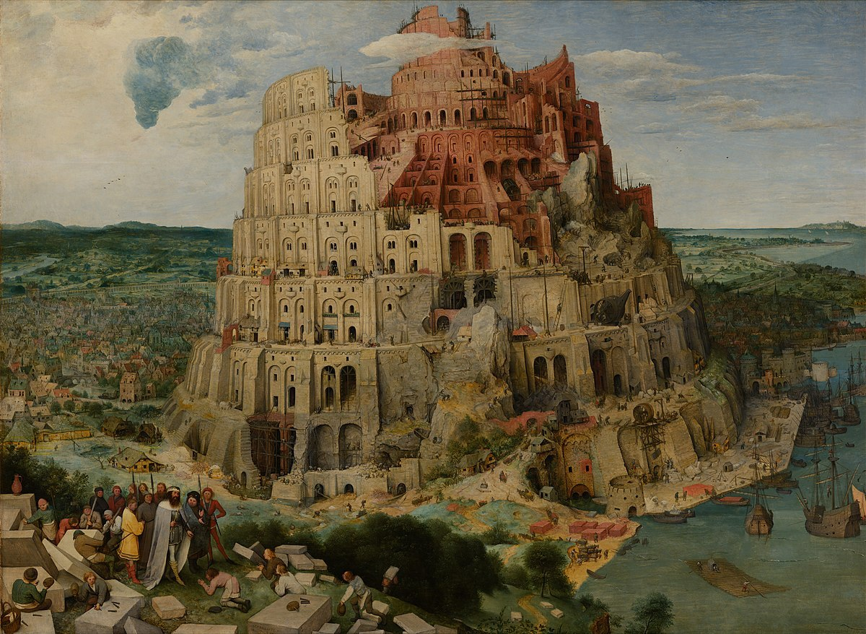
The City and Tower of Babel – Genesis 9:18-29, 10:6-20, 11:1-9
Nimrod the first tyrant
hunter of souls
1 world government – 1 leader
Babylon the city-Tower of Babel
false religious systems
Nebuchadnezzar in Daniel 1-4
Acts 1:8, Acts 2, 8 10, 19
Gospel spread - Jew to gentile
1 Corinthians 14:21-22
tongues is sign of judgment
Revelation 17-18
religious and commercial
James 4:4, 1 John 1:1-3, Rev 2:20
The Bible is a book of two rival cities - Babylon and Jerusalem

Slide 7
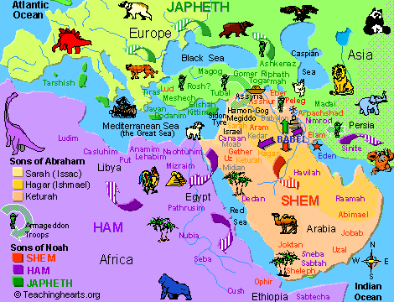

Slide 8
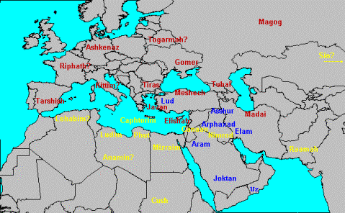

Slide 9
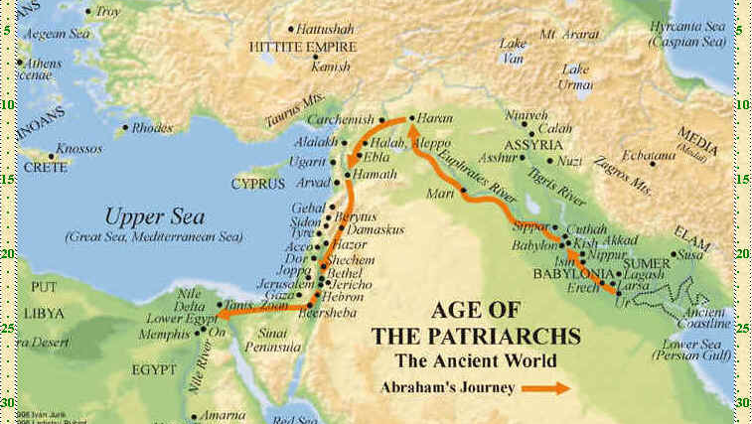
Mt Ararat
Haran
Babylon
Canaan
Ur

Slide 10
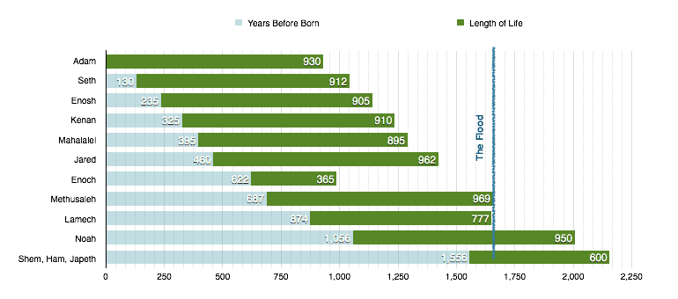
Adam knew Enoch/Methusaleh who knew Noah/Shem who Knew Job/Abraham
to pass on the inspired spoken truth and written truth in the Hebrew Language
Abraham, Isaac, Jacob

Slide 11
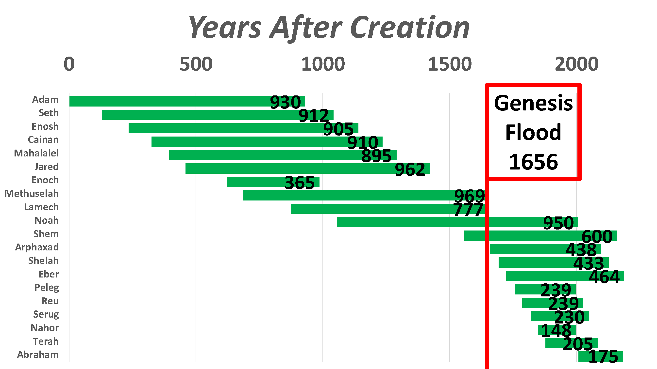
Adam knew Enoch/Methusaleh who knew Noah/Shem who Knew Job/Abraham
to pass on the inspired spoken truth and written truth in the Hebrew Language
Noah, Shem, and Abraham
lived together for 39 years
(Shem lived with Isaac and Jacob before going to Egypt)

