Slide 1
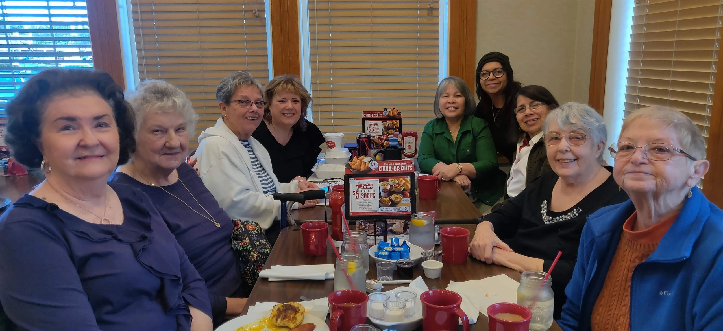
Trust and Obey by John Sammis. D.L. Moody/D.Towner/Young Man/J. Sammis/D. Towner
When we walk with the Lord, In the light of His word, What a glory He sheds on our way! Let us do His good will; He abides with us still, And with all who will trust and obey. Trust and obey, for there's no other way To be happy in Jesus, but to trust and obey. Not a burden we bear, Not a sorrow we share, But our toil He doth richly repay; Not a grief or a loss, Not a frown or a cross, But is blest if we trust and obey. Trust and obey, for there's no other way To be happy in Jesus, but to trust and obey.

Slide 2
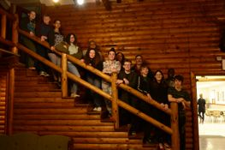
But we never can prove, The delights of His love, Until all on the altar we lay; For the favor He shows, And the joy He bestows, Are for them who will trust and obey. Trust and obey, for there's no other way To be happy in Jesus, but to trust and obey. Then in fellowship sweet, We will sit at His feet, Or we'll walk by His side in the way; What He says we will do, Where He sends we will go, Never fear, only trust and obey. Trust and obey, for there's no other way To be happy in Jesus, but to trust and obey.

Slide 3
Plymoth pilgrim pastors, MINISTERS, REVERENDS and ministers are solid rock or shifting sands (Matthew 7) Solid rock Foundations 1. 1608-1620 Pastor John Robinson puritan/Separatist Founder and spiritual father 2. 1608-1658 Elder William Brewster Separatist Faithful until death temporary SHIFTING SAND TIMES 3. 1623-1624 Minister William Morrell ordained-Church of England No clerical duties (wrote Latin poetry) 4. 1624-1625 Minister John Lyford ordained-Church of England Opportunist & sexual misconduct (pilgrims believed ordination must be by the church he would serve, not a bishop or church hierarchy) 5. 1625 Minister Rogers Isaac Allerton brought YOUNG, crazed, without church sending Solid rock continuance 6. 1629-1636 Minister Ralph Smith (teacher) Separatist rejected by Salem Prayer ministry - teacher Roger Williams (came by way of Mass Bay Colony) 7. 1634-1635 Reverend Roger Williams godly, zealous, teaching well approved Church for saved, baptism temporary SHIFTING SAND TIMES 8. 1636 minister Glover – sick and died in England. Sought by EDward Winslow in England 9. 1636 Minister John Norton 1 year – moved to richer church brought by Edward Winslow from England SOLID rock continuance 10. 1637-1655 minister John Rayner Pilgrims well pleased served 18 years 11. 1638-1641 Minister Charles Chauncy Baptism by immersion-Bradford ok, except too cold weather (2nd president of Harvard College, 1654 to 1671)

Slide 4
In The Beginning - god – created - the heaven - and the earth
Genesis is the book of firsts and a solid foundation to obey God
Lessons Scripture
1. Eternity past and heavenly rebellion (time begins) 1:1-2
2. Evening and Morning (6-24 hours days), and the Sabbath 1:3-2:3
3. Seed, Man and Woman (details of chapter 1, days 3&6) 2:4-2:25
4. Sin and Redemption (Adam and Eve) 3
5-6. Religion and Relation (Cain and Abel) 4:1-6:13
7-9. Flood (Noah, the Ark, and the Great Flood) 6:14-9:17
10-11. Tower of Babel (Noah’s 3 sons and Nimrod) 9:18-11
12. A Chosen People, Land, and Nation (Abraham) 12

Slide 5
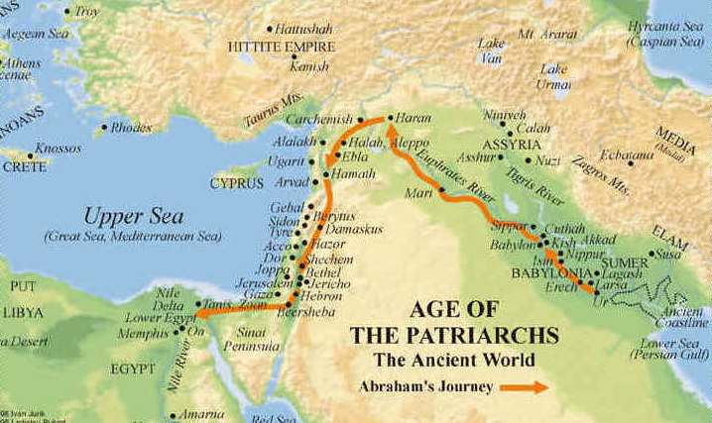
West - East
North – South
Mt Ararat
Abraham’s Journey
Genesis 12
Haran (70-75 years)
Babylon
Canaan
Egypt
Ur

Slide 6
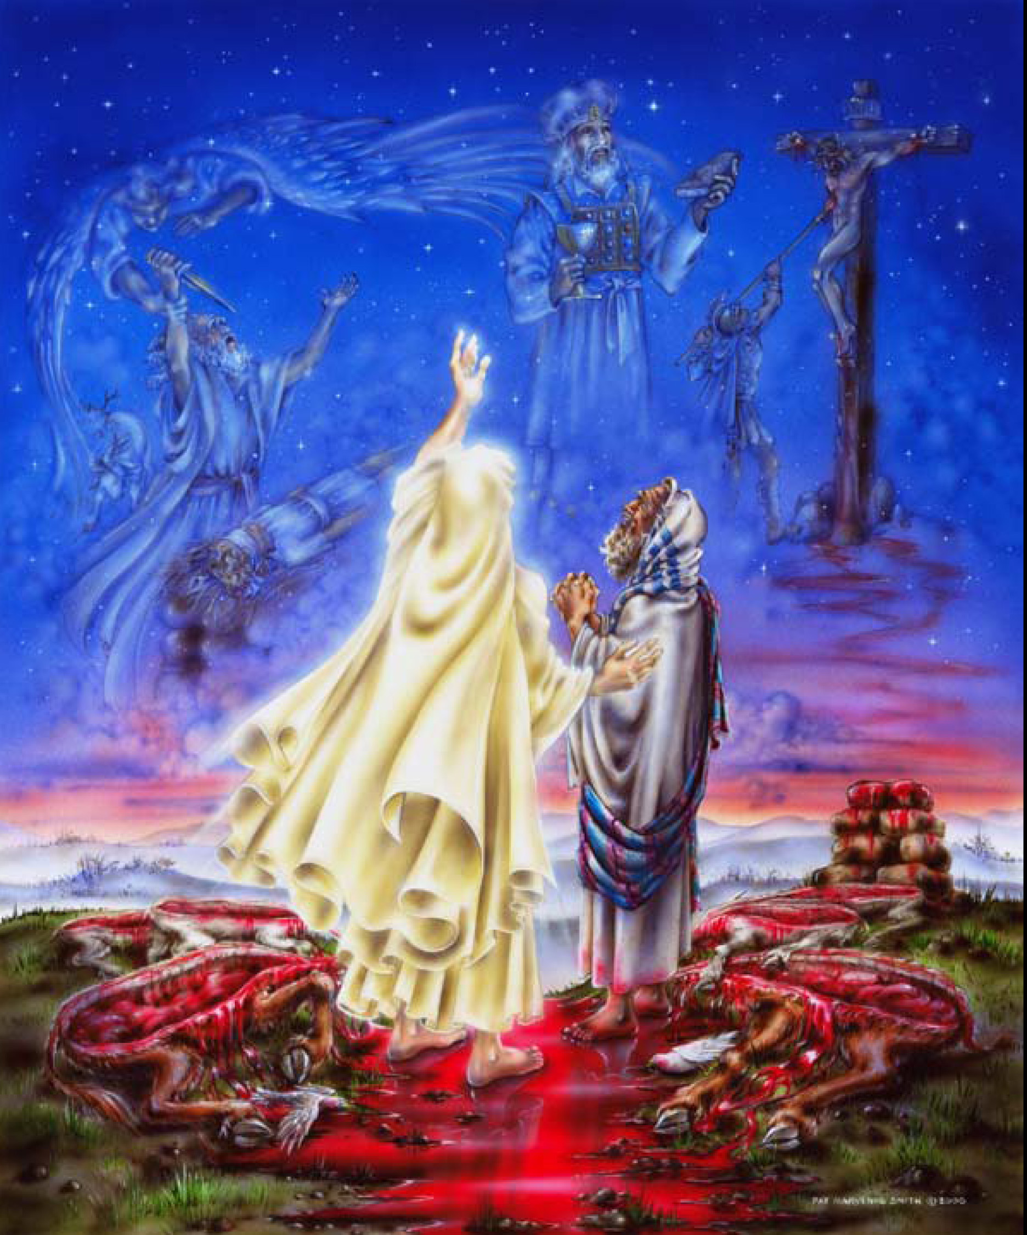
Our Father Abraham (Romans 4:12)
7 locations: Faith moves on
3 sins: growing in obedience
2 altars: worshipping God
12:1-3 Abram’s Call (sin 1 & 2)
Ur-Haran (father dies, 75 yrs old)
Acts 7:2-3 (430 years begin, Gal 3:17)
12:4-10 Abram’s altars (Praise & Prayer)
Shechem, plain of Moreh, Bethel, Ai, south
Hebrews 11:8-19 (strangers & pilgrims)
12:11-20 Sarai submits (sin 3) in Egypt
1 Peter 3:1-7

Slide 7
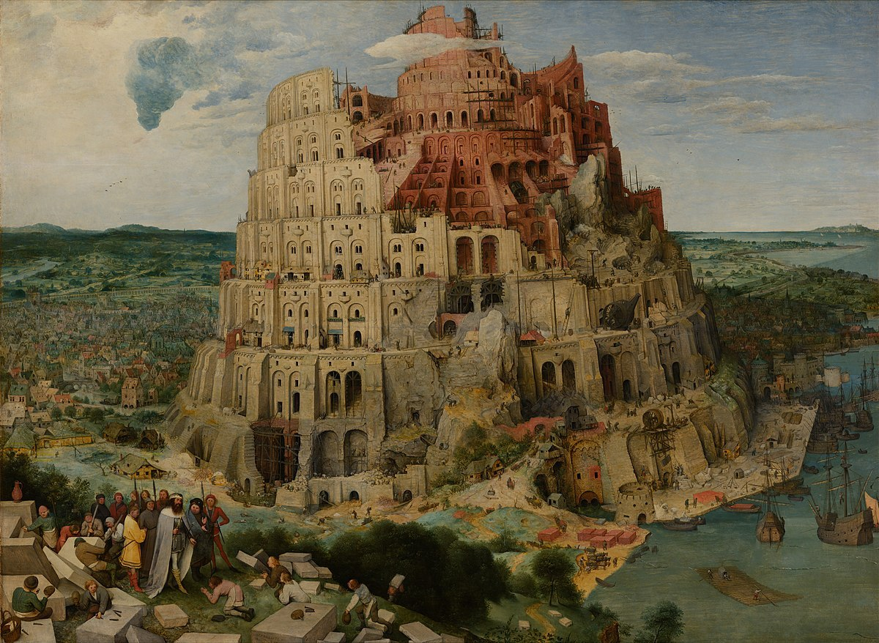
Last Sunday of 2020 - New Beginnings in 2021
Remember Genesis 1-12
Foundations for our world belief system
and
Remember the Pilgrim Fathers
Foundations for our nation, the U.S.A.

