Slide 1

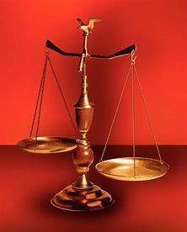
Fellowship Church, April 24, 2024 B. Heath
Straight and Balanced
(Luke 3:4-6)
Biblical characters (Hebrews 11)
The Death and Resurrection of Jesus
#1 – with Jesus at the Tomb (John 20:1-18)
#2 – Abel’s Faith & Innocent Blood (Heb 11:4, Gen 4)
#3 – Enoch’s Faith & taken up (Heb 11:5-6, Gen 5:21-24)
#4 –
OT: Ps 5:8, Pr 4:25-27
Amos 7:7-8, Is 28:13, 17
NT: Mt 3:3, Acts 9:11
Hebrews 12:13, Jude 3
1 Cor 15:1-4, 2 Tim 3:10
John 7:16
OT: Deut 25:13-16
Pr 20:10, Dan 5:25-28
NT: Hebrews12:1
1 Cor 3:11-15

Slide 2
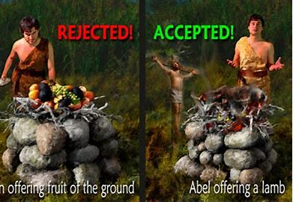
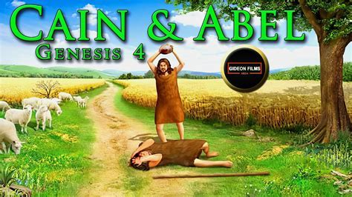
Abel’s Faith & Innocent Blood (Hebrews 11:4)
Time: < 3870 BC (Seth born when Adam 130, Gen 5:3) Place: East of the Garden of Eden
People: Cain > Enoch > Lamech. Abel (innocent). Seth > Enos.
Division: 4:1-15 The murder of Abel by brother Cain
4:16-24 Cain’s culture is immoral - no God (humanism)
4:25-26 Mankind calls upon the LORD (Seth & Enos)
Shadow of Jesus: Acceptable sacrifice of a sheep, in violence
and blood (John 1:29, Is 53, Ps 22)
Beginnings: 1st person angry at the LORD (vs 3-7)
1st Murder (vs 8), 1st city,/government (vs 17), 1st polygamy (vs 19)
1st family business/commerce (20-22: herds, music, mines, military
weapons & tools), 1st poetry & mockery of the LORD (vs 23-24)
Repeat after the flood (Genesis 10-11) until the end ( Rev 17-18)
Decision: Am I following the way of Cain or the way of Abel?
Notes:
-

