Slide 1
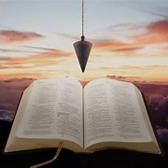
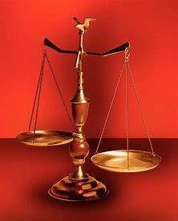
Fellowship Church, May 22, 2024 B. Heath
Straight and Balanced
(Luke 3:4-6)
Biblical characters (Hebrews 11:1-3)
#1 – Abel’s Faith & Innocent Blood (Heb 11:4, Gen 4)
#2 – Walking with God & with Enoch (Heb 11:5-6, Gen 5)
#3 – Secure on the Ark with Noah (Heb 11:7, Ez 14:14, 20)
#4 – Abraham (Heb 11:8-10, Gen 12-21)
#5 – Sarah (Heb 11:11, Gen 12-21)
#6 – Strangers & Pilgrims (Heb 11:12-16)
#7 – Isaac (Heb 11:17-19, Gen 22-24)
#8 – Jacob & Esau (Heb 11:20-21, Gen 25-36)
#9 – Joseph (Heb 11:22, Gen 37- 50)
#10 – Moses (Heb 11:23-29, Exodus-Deut)
#11 – Joshua (Heb 11:30, Joshua)
#12 – Rahab (Heb 11:31, Joshua 6)
#13 – Gideon, Barak, Samson & Jephthah (Heb 11:32, Judges)
#14 – David (Heb 11:32, 2 Samuel, 1 Chronicles)
#15 – Samuel (Heb 11:32, 1 Samuel)
#16 – Prophets (Heb 11:32-38, Isaiah-Malachi)
#17 – All (Heb 11:39-40, Old Testament saints)
OT: Ps 5:8, Pr 4:25-27
Amos 7:7-8, Is 28:13, 17
NT: Mt 3:3, Acts 9:11
Hebrews 12:13, Jude 3
1 Cor 15:1-4, 2 Tim 3:10
John 7:16
OT: Deut 25:13-16
Pr 20:10, Dan 5:25-28
NT: Hebrews12:1
1 Cor 3:11-15

Slide 2
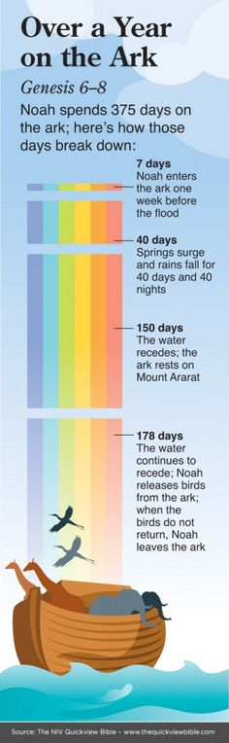
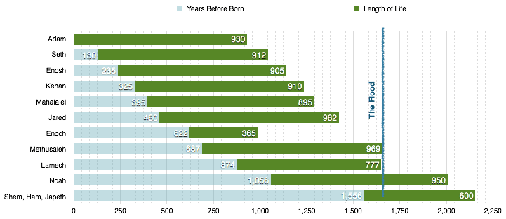
Adam knew Enoch/Methuselah
who knew Noah/Shem
who knew Job/Abraham
to pass on the spoken truth
driven with the inspired truth in the Hebrew language

Slide 3
Secure on the Ark with Noah (Hebrews 11:7)
Time: Birth c. 3000 BC. Flood c. 2400 BC. Place: Mountains of Ararat, Turkey
People: Noah and his family (8 souls)
Scripture
Hebrews 11:7 by faith Noah, being warned of God of things not seen as yet, moved with fear, prepared an ark to the saving of his house; by the which he condemned the world,
and became heir of the righteousness which is by faith.
Ezekiel 14:14, 20
Noah’s world perspective: Genesis 6-9, Job 26:10, 38:10, Isaiah 54:9
Daniel’s national perspective: Daniel 9:1-27, Matthew 24:37-40, Luke 17:26-30
Job’s personal perspective: 1 Peter 3:18-22, 2 Peter 2:5, Hebrews 11:7
Decision: How secure on you in the ark of Jesus Christ?
Notes:
-

Slide 4
Secure on the Ark with Noah (Hebrews 11:7, Genesis 6-9)
6:1-7 Evil continually before the flood
6:8-13 Noah was a just (righteous) man, perfect in his generations, [and]
walked with God (just like Enoch)
6:14-22 Directions to build the ark (Heb 11:7 by faith Noah moved with fear, 50-70 yrs)
Matthew 24:37-40, Luke 17:26-30)
7:1-9 Noah and family enter the ark (1 Peter 3:18-22, 2 Peter 2:5)
7:10-24 The water rises from below and lowers from above (Job 26:10, 38:8-11)
8:1-14 The water lowers
8:15-19 Noah and family leave the ark
8:22-24 Noah builds an altar unto the LORD (the LORD smelled a sweet fragrance)
9:1-7 Dispensation of government (until Abraham in Genesis 12)
9:8-17 Covenant of the rainbow to not destroy all flesh again by water
Notes:
-

