Slide 1
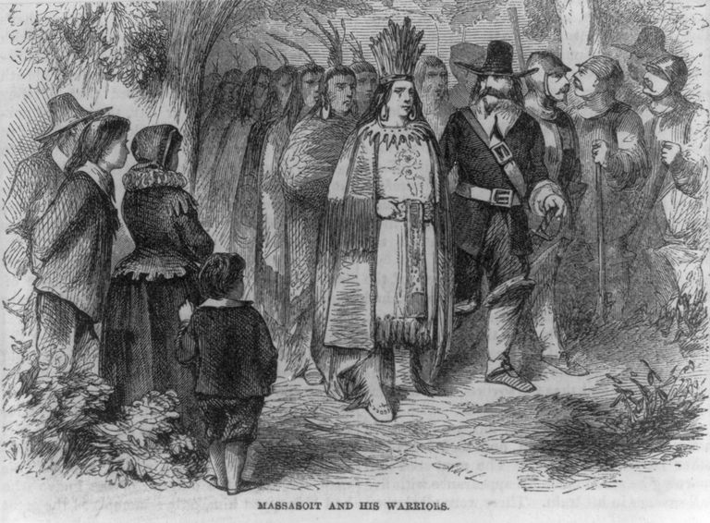
Massasoit Sachem of the Wampanoag confederacy
“the English are my friends and love me … whilst I live I will never forget their kindness they have showed me.”
Edward Winslow
Pilgrim printer and diplomat

Slide 2
In The Beginning -god –created -the heaven -and the earth
Genesis is the book of firsts and a solid foundation to glorify God
Truths Scripture
Eternity past and heavenly rebellion (time begins) 1:1-2
Evening and Morning (6-24 hours), and the Sabbath 1:3-2:3
Seed, Man and Woman (details of chapter 1, day 6) 2:4-2:25
Sin and Redemption (Adam and Eve) 3
Religion plus Relation (Cain and Abel) 4:1-6:13
Flood (Noah) 6:14-10
Tower of Babel (Nimrod) 11
A Chosen Nation (Abraham) 12

Slide 3
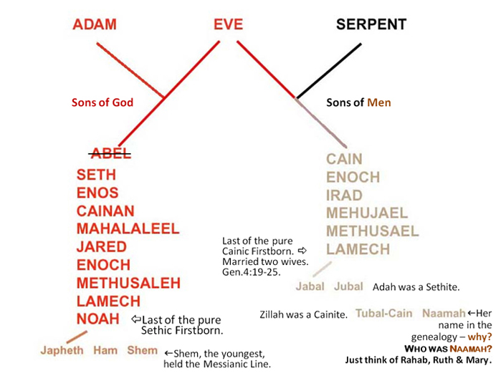

Slide 4
Doctrine of the Fallen Angels (priority 3)
Genesis 6:1-13, 2 Peter 2:4, Jude 6
sons of God knew the daughters of men, and Tartarus

Slide 5
Way before the Flood and Return
GENESIS 6:1-13
Multiply (6:1)
Angels knew women (6:4)
Great wickedness (6:5)
Imagination evil continually (6:5)
Corrupt (6:11-12)
Violence (6:11, 13)
MATTHEW 24:37-39
Eating & drinking
Marrying & giving in marriage
Jude 1:6-7, 1 Pet 3:19-20a, 2 Pet 2:4-5

Slide 6
Next Sunday
Genesis 6:14-8:19
Noah & the Ark
Build the Ark
Enter the Ark
The water rises
The water lowers
Leave the Ark

