Slide 1
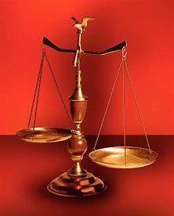
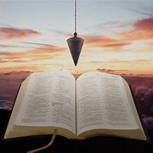
Perplexity to Praise, Trouble to Triumph, Grief to Glory
Fellowship Church, February 15, 2023 by Bill Heath
Following Christ in a
Balanced and Straight Way
Precept upon precept,
line upon line, here a little,
there a little (Isaiah 28:10,13)
#1 – Daily Scripture & Prayer Plan
#2 – Worldly Sin (Romans1:18-3)
#3 – God’s Salvation (Romans 4-5)
#4 –
#5 –
#6 –
#7 –
#8 – Habakkuk
OT: Deut 25:13-16
Daniel 5:25-28
NT: Hebrews12:1
1 Cor 3:11-15
OT: Ps 5:8, Pr 4:25-27
Amos 7:7-8
NT: Mt 3:3, Acts 9:11
Hebrews 12:13

Slide 3
The God Squad or 9 Commanding Officers (CO)
Leader: in front, Jesus Christ with binoculars & a pistol
Fire Team #1: Doctrine (by faith, from the heart)
1st: COntent
2nd: COntext
3rd: COncise
4th: COncept
Fire Team #2: Application (obey or disobey)
1st: COnfirm or COnvict
2nd: COmfort or COnfess
3rd: COnverse or COnsult
4th: COnduit and COnduit
behind, Medic & grenadier: as needed
Goal: COnsistently, COnsumed for the glory of God
God’s Salvation (Romans 4-5)
Romans 1:1-17 Introduction
- Establish the called, 16:25
4:1-22 Faith not works /God
- Abraham our father, our father Abraham
- Uncircumcision and circumcision
- Law or faith, - Imputed righteousness
4:23-5:11 Faith brings peace /God
- we/us/our - 21x
- grace, rejoice in hope, hearts - Holy Spirit
- trials > patience > experience > hope
5:12-21 Faith in Jesus Christ
- 1 man Adam - 8x, 1 Man Jesus Christ - 8x
- Adam’s sin brings death to many
- God’s gift brings much more grace and Jesus Christ’s righteousness and Life to many
Inductive Bible Study
(passage based)
Observations
Interpretations
What? What?
Application
WWJD
WDJD
WMID

