Slide 1
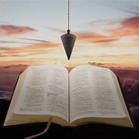
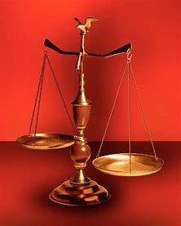
Fellowship Church, July 31, 2024 B. Heath
Straight and Balanced
(Luke 3:4-6)
Biblical characters (Hebrews 11:1-3, 6, 39-40)
#1 – Abel’s Faith & Innocent Blood (Heb 11:4, Gen 4)
#2 – Walking with God & with Enoch (Heb 11:5-6, Gen 5)
#3 – Secure on the Ark with Noah (Heb 11:7, Gen 6-11)
#4a – Our Faith with Abraham (Heb 11:8-19, Gen 12-23)
#4b – Our Faith with Sarah (Heb 11:11-12, 1 Peter 3:6)
#4c – OT & NT Strangers & Pilgrims (Heb 11:13-16, 1 Pe 2:11)
#5 – Our Faith with Isaac (Heb 11:20, Gen 24)
#6 – Our Faith with Jacob-Israel (Heb 11:21, Gen 25-36)
#7 – Our Faith with Joseph (Heb 11:22, Gen 37- 50)
#8 – Our Faith with Moses (Heb 11:23-29, Exodus-Deut)
#9 – Our Faith with Joshua (Heb 11:30, Joshua)
#10 – Our Faith with Rahab (Heb 11:31, Joshua 6)
#11 – Our Faith with the Judges (Heb 11:32, Judges)
#12 – Our Faith with David (Heb 11:32, 2 Samuel, 1 Chr)
#13 – Our Faith with Samuel (Heb 11:32, 1 Samuel)
#14 – Our Faith with the Prophets (Heb 11:32-38, Is-Malachi)
#15 – Our Faith for All (Heb 11:39-40, Old Testament saints)
OT: Ps 5:8, Pr 4:25-27
Amos 7:7-8, Is 28:13, 17
NT: Mt 3:3, Acts 9:11
Hebrews 12:13, Jude 3
1 Cor 15:1-4, 2 Tim 3:10
John 7:16
OT: Deut 25:13-16
Pr 20:10, Dan 5:25-28
NT: Hebrews12:1
1 Cor 3:11-15,
Philippians 4:5,
James 3:17

Slide 2
CONGregational reading - Hebrews 11:13-16
13 These all died in faith, not having received the promises,
but having seen them afar off, and were persuaded of [them], and embraced
[them], and confessed that they were strangers and pilgrims on the earth.
CONG 14 For they that say such things declare plainly that they seek a country.
And truly, if they had been mindful of that [country] from whence they came out, they might have had opportunity to have returned.
CONG 16 wherefore God is not ashamed to be called their God:
for he hath prepared for them a city.

Slide 3
OT & NT Strangers & Pilgrims
1) Read Hebrews 11:13-16 (in the context of Hebrews 11:8-16 concerning Abraham)
2) Reckon WHO, WHAT, WHEN, WHERE, WHY?
3) Identify eight (8) steps to be “strangers and pilgrims” in the Old Testament
4) Learn the New Testament application in 1 Peter 2:11
5) 1 Peter challenge. Read the book in 5 minutes, then read-think-meditate-study in 1 or more hours, focusing on these keywords:
Suffer – 16x, Glory or Glorified – 14x. Holy – 8x, Love – 6x. Grace-8x. The Will of God – 4x.
Decision: Share with the congregation how the Word of God spoke to you about being a “stranger and pilgrim” in 2 Wednesdays, August 14, in a 1-2 minute testimony.

Slide 4
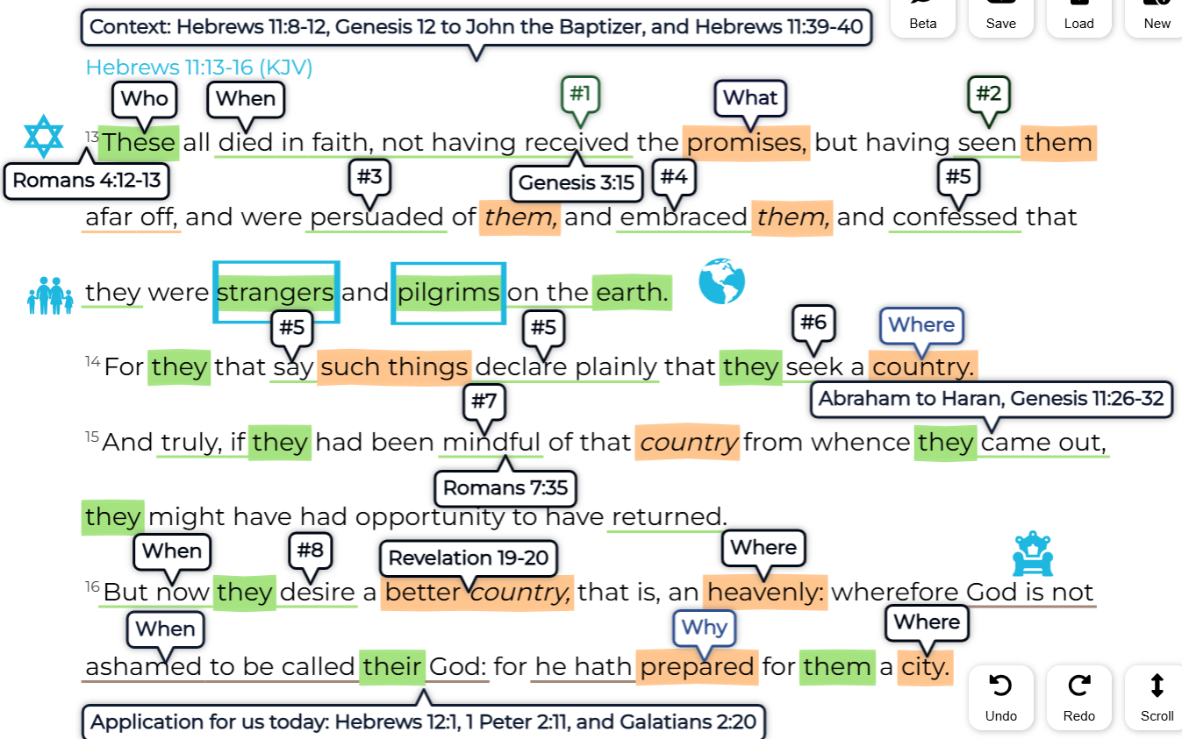
Old
Testament
&
New
Testament
Strangers
&
Pilgrims
Notes:
-

