Slide 1
Fellowship Church Sunday School March-June 2023 Hebrews - Jesus Christ is Better Today, Hebrews 13 Look Around taught by: Minister William (Bill) Heath

Slide 2
Outline of Hebrews, Jesus is Better (12x)
Introduction to Hebrews
1:1 God spoke
- at various times
- in many ways
- unto the fathers by the prophets
1:2-3 in these last days spoke by [his] Son
- appointed heir of all things
- by Jesus God made the worlds
- being the brightness of glory
- express the image of God’s person
- upholding all things by the word of
God’s power //dunamis//
- when Jesus purged our sins
- sat down on the right hand of
the Majesty on high
Note: Same introduction for nine ways Jesus is better, perfect, and all-sufficient.
Look back at the Old Testament 1-11
1:1-3 Introduction (Jesus is better in 9 ways)
(1) 1:1-3 better than the prophets
(2) 1:4-2:18 so much better than the angels
(3) 3:1-17 worthy of more glory than Moses
(4) 4:1-13 better rest than Joshua
(5) 4:14-7:28 greatest of all priests
(6) 8:1-13 better than the old covenant
(7) 9:1-28 greater & more perfect tabernacle
(8) 10:1-39 better eternal sacrifice
(9) 11:1-40 better faith
Look up to Heaven 12
Heavenly Father,
Heavenly Jerusalem, shakable or unshakable
Look around 13
Brotherly love,
outside the camp, prayer & grace
Danger of
Apostasy
1. Neglect
(2:1-4)
2. Unbelief
(3:7-4:11)
3. Dull of
hearing
(5:11-6:12)
4. Draw
back
(10:26-39)
5. Refuse
God
(12:15b-17,
12:25-27a)

Slide 3
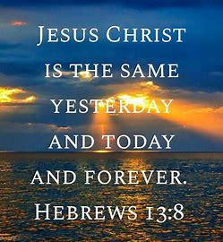
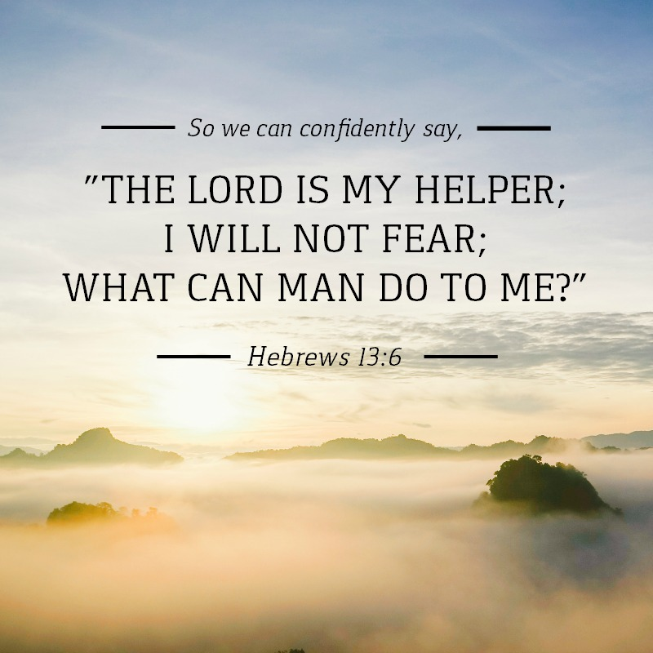
Hebrews 13 Look Around
New Testament (believers)
13:1-8 Persecuted believers (1-3), morals (4-6), help (7-8)
13:9-13 Diverse & strange doctrines (9a > apostates)
or outside the camp (9b-13 > believers)
13:14-17 New Testament sacrifices to God (Rom 12:1-2)
13:18-21 Prayer requested (18-19) & prayer given (20-21)
13:22-25 Typical farewell of the Apostle Paul
Next week: Hebrews Review and Apostates, Q & A
18 Commandments, Promises, and Expectations,
to be blessed by God
Let brotherly love continue
Do not forget to entertain strangers
Remember the prisoners – persecuted saints
Marriage is honorable
Be without covetousness and content
The Lord is my Helper – I will not fear man
Remember your leaders
Jesus Christ the same yesterday, today, & forever
Do not go after diverse & strange doctrines,
9. Your heart be strengthened by grace
10-13. Go with Jesus outside the camp / Jerusalem
14. Heavenly city -Hebrews 12:18-24 & Revelation 21-22
Praise & thanks
Do good & communicate – do not forget
Obey leaders - watch for your souls, give account
Prayer requested and prayer given

