Slide 1
Fellowship Church Sunday School March-May 2023 Hebrews - Jesus Christ is Better Today, Hebrews 9 Christ the Perfect Eternal Tabernacle (access to God) taught by: Pastor Bill Heath

Slide 2
Outline of Hebrews, Jesus is Better (12x)
Introduction to Hebrews
1:1 God spoke
- at various times
- in many ways
- unto the fathers by the prophets
1:2-3 in these last days spoke by [his] Son
- appointed heir of all things
- by Jesus God made the worlds
- being the brightness of glory
- express image of God’s person
- upholding all things by the word of
God’s power //dunamis//
- when Jesus purged our sins
- sat down on the right hand of
the Majesty on high //in heaven//
Note: Same introduction for nine ways Jesus is better, perfect, and all-sufficient.
Look back at the Old Testament 1-11
1:1-3 Introduction (Jesus is better in 9 ways)
(1) 1:1-3 better than the prophets
(2) 1:4-2:18 so much better than the angels
(3) 3:1-17 worthy of more glory than Moses
(4) 4:1-13 better rest than Joshua
(5) 4:14-7:28 greatest of all priests
(6) 8:1-13 better than the old covenant
(7) 9:1-28 greater & more perfect tabernacle
(8) 10:1-39 better eternal sacrifice
(9) 11:1-40 better faith
Look forward to Heaven 12
Heavenly Father,
Heavenly Jerusalem, unshakable
Look around in the present 13
Brotherly love,
outside the camp, prayer & grace
Danger of
Apostasy
1. Neglect
(2:1-4)
2. Unbelief
(3:7-4:11)
3. Dull of
hearing
(5:11-6:12)
4.
(10:26-39
5.
(12:

Slide 3
Question for Hebrews 8 With whom and when is the New Covenant? (Jeremiah 31:31-34) 1. The Universal Church until Christ returns? (present reign of Christ on earth until Revelation 21-22) or 2. The Nation of Israel in the future? (future 1000-year reign of Christ, Revelation 19-20) or 3. Both the Church and Israel? or 4. never considered or unsure Answer: Choose one

Slide 4
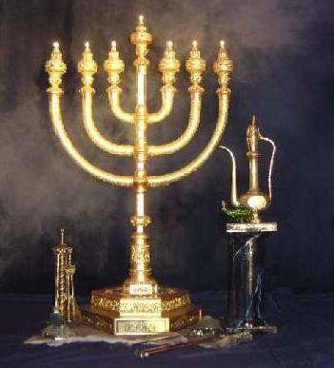
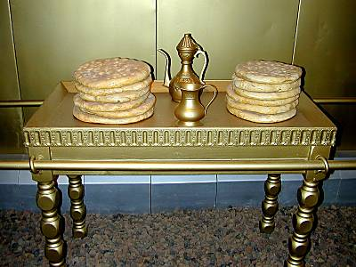
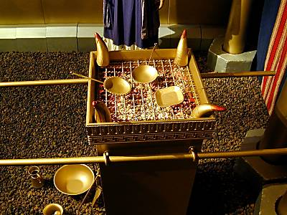
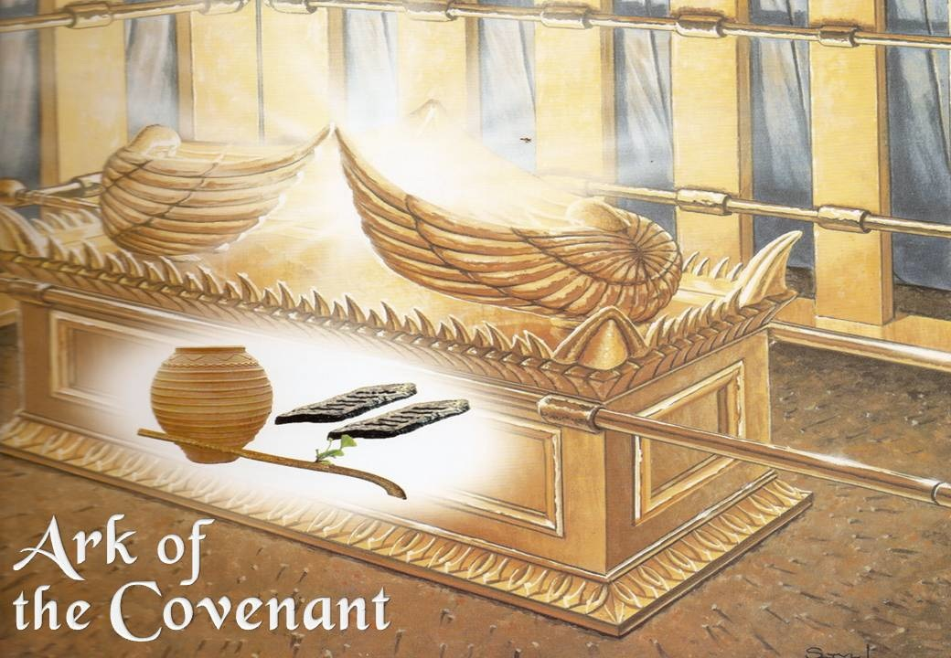
Hebrews 9:1-28 Christ the Perfect Eternal Tabernacle (access to God)
New Testament (eternal)
9:1-14 Christ is the greater & more perfect tabernacle
vs 1, first covenant had a worldly sanctuary
vs 2-5, censer has incense rising as prayers (Rev 8:3, 5)
vs 6-10, reformation – to make the crooked straight
vs 11-14, purge conscience to serve the living God
9:15-23 Christ’s death provides the better New Testament
vs 15, mediates New Testament of eternal inheritance
vs 16-17, the testator makes a will for after death
vs 18-22, Moses law used blood frequently
vs 23, patterns = examples or ensamples
9:24-28 Christ ‘s bloody sacrifice was once for us
vs 24, figures = made w/hands, parables reveal the true
vs 25-28, Christ present (24), past (26), future (28)
Key words: blood-12x, tabernacle-6x, testament-6x,
first-6x, Christ-4x, second-3x, conscience-2x, testator-2x
Hebrews 10 – Jesus is a better eternal sacrifice
Old Testament (temporary)
Exodus 25:40 And look that thou make [them] after
their pattern, which was showed thee in the mount.
1
1-3
Holy
Place
2
MOST HOLY PLACE
Censer
3
Tabernacle–msg on Wed, Apr 26
Manna, Aaron’s rod, 2 tablets

