Slide 1
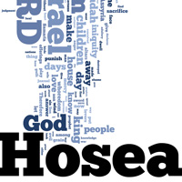
Adult Sunday School Fellowship Church January 31, 2021
Hymn: Onward Christian Soldiers
Hosea 12-14 (Strike 3 of 3)
Parallels with our Nation today and in the near future
EasyWorship Background - 5 Minutes Countdown Timer - Bing video
Tibits on Hosea Chapters 4-14
Compared to one inning in a baseball game
Three strikes or judgments in divine order (out)
Three salvations after judgment
Loser – The sinning nation is judged
Winner – The right people are saved (homerun)
Final score: 1-0

Slide 2
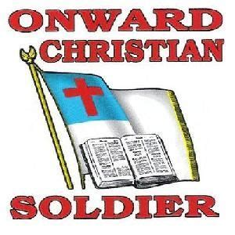
Onward Christian soldiers Marching as to war With the cross of Jesus Going on before Christ the royal master Leads against the foe Forward into battle See his banners go Onward Christian soldiers Marching as to war With the cross of Jesus Going on before Onward Christian soldiers Marching as to war With the cross of Jesus Going on before

Slide 3
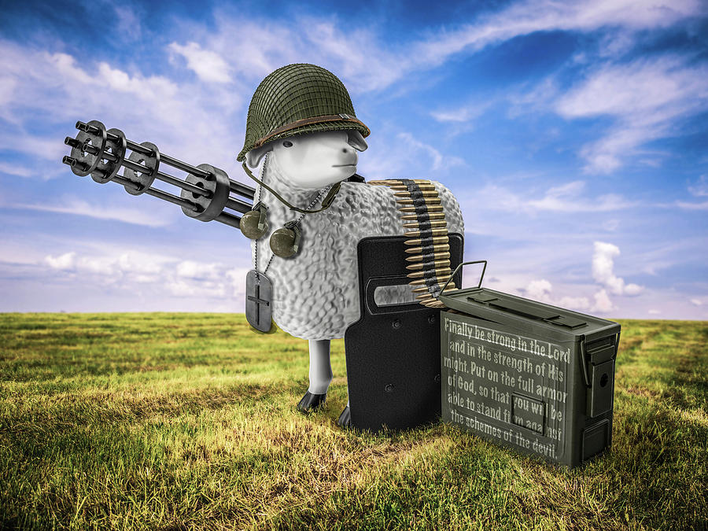
We are not divided All one body we One in hope and doctrine One in charity Onward Christian soldiers Marching as to war With the cross of Jesus Going on before With the cross of Jesus Going on before

Slide 4
Hosea – Introduction (1:1), Body (1:2-14:8), and Conclusion (14:9)
Part 1) Gomer’s Faithful Husband (Romans 15:4) 1-3
Lesson 1 Judgment 1:2-9 Hosea’s family
Salvation 1:10-11 Far future of Israel
Lesson 2 Judgment 2:1-13 Gomer’s unfaithfulness
Salvation 2:14-3:5 Far future of Israel
Part 2) Israel’s Faithful Husband (Israel’s and God’s baseball inning) 4-14
Strike 1 Judgment 4-5 Strike 1 - First things
Salvation 6:1-3 Home run - far future of Israel
Strike 2 Judgment 6:4-11:7 Strike 2 – 5 foul balls (like) & 1 look ahead (10:11-12)
Salvation 11:8-12 Home run - Ekklesia now and far future of Israel
Strike 3 Judgment 12-13 Strike 3 – Last call (death of a nation)
Salvation 14 :1-8 Home run - Ekklesia now and far future of Israel
Israel is OUT when conquered by the Assyrians in 722 B.C. until 1948 and after

Slide 5
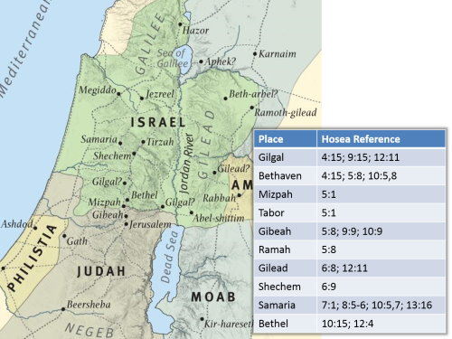
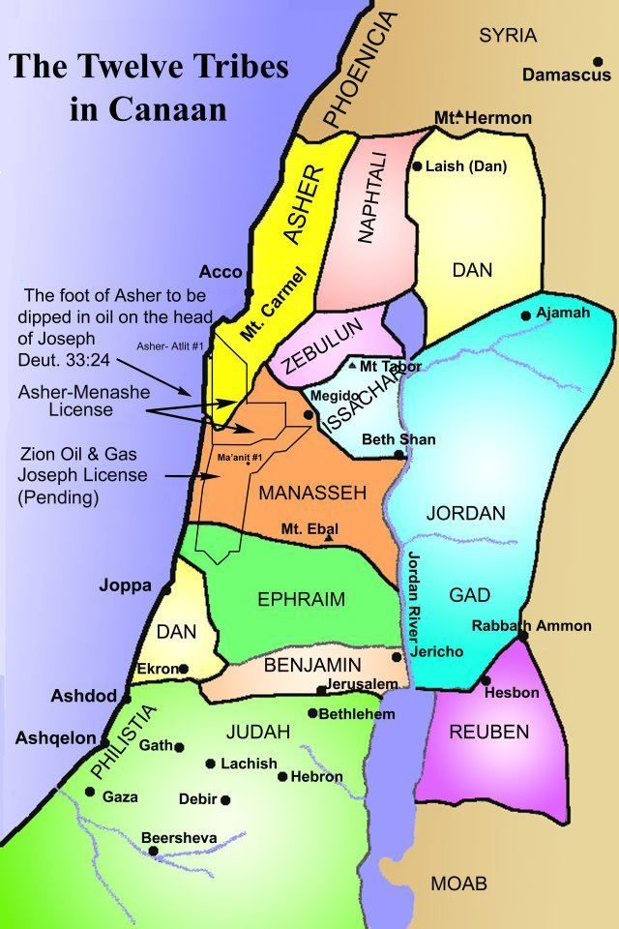
Not continued
Bethaven or Aven (4x)
Bethaven / Aven - house of wickedness
Gibeah – Gibeonite Lewdness (Judges 19)
Mizpah & Tabor
Shechem – city of refuge

Slide 6
Hosea 12-14
JUDGEMENT (Strike 3 of 3) near future by Assyria in 722 BC
12:1-14 Lies increase (1), Jacob wrestles an angel (2-6), anger with Ephraim (7-14)
13:1-16 Sin more and more (1-8) and repentance is hid (9-16)
SALVATION (the ekklesia and Israel in the near future today – begun in 1948)
14 :1-3 Return and turn with words to God (1-2); not nation, military nor idols (3)
14:4-8 God will heal-love-water to grow-root-branch,-beauty-smell, revive(4-7)
Ephraim : no idols, hear & observed him, like a fir tree with his fruit (8)
14:9 Wise-understand, prudent-know. Right-just walk or transgressors fall.
2021 Challenge: Is the U.S.A. like Ephraim, Israel, or Judah? WWJD-WDJD-WMID?
Next Sunday: How to Have Victory with Temptation (1 Corinthians 10)
Later: Life, Light, and Love Text: 1 John for 5 weeks

