Slide 1
Adult Sunday School Fellowship Church January 17, 2021
Hymn: Great is Thy Faithfulness
Hosea 4:1-6:3
A Tale of Two Cities by Charles Dickens
It was the best of times – It was the worst of times.
It was the age of wisdom – It was the age of foolishness.
It was the epoch of belief – It was the epoch of incredibility.
It was the season of light – It was the season of darkness.
It was the spring of hope – It was the winter of despair.
We had everything before us – We had nothing before us.
We were all going direct to heaven – We were all going direct the other way.

Slide 2
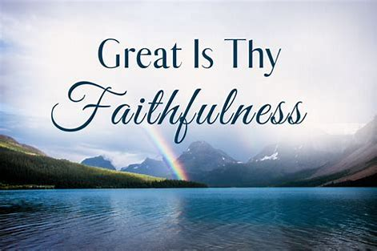
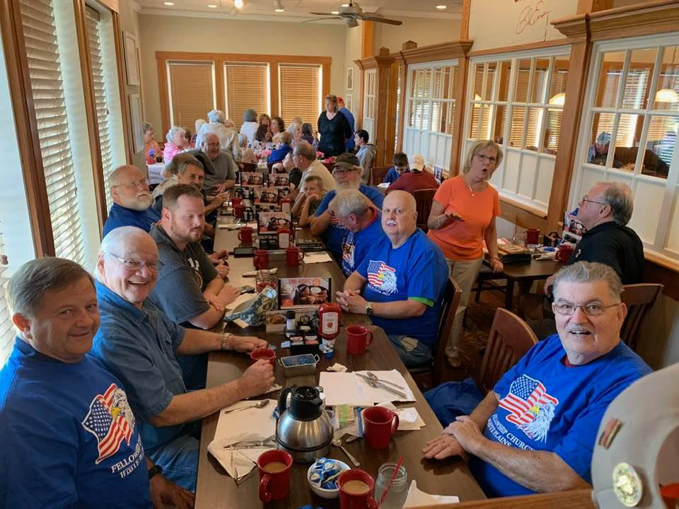
Great is Thy Faithfulness by Thomas Chishom, 1923. He had very poor health his entire life. He became a Christian at 27, and Methodist minister at 36 only one year due to illness. Lamentations 3:22-23 inspired a poem which a friend organist gave music to. Fanny Cosby was a close friend. Pubic Domain.
1. Great is Thy faithfulness, O God my Father, There is no shadow of turning with Thee; Thou changest not, Thy compassions, they fail not As Thou hast been Thou forever wilt be.
Great is Thy faithfulness! Great is Thy faithfulness! Morning by morning new mercies I see; All I have needed Thy hand hath provided— “Great is Thy faithfulness,” Lord, unto me!
2. Summer and winter, and springtime and harvest, Sun, moon and stars in their courses above, Join with all nature in manifold witness To Thy great faithfulness, mercy and love. Great is Thy faithfulness! Great is Thy faithfulness!” Morning by morning new mercies I see; All I have needed Thy hand hath provided— “Great is Thy faithfulness,” Lord, unto me!

Slide 3
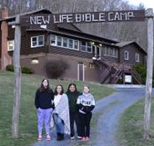
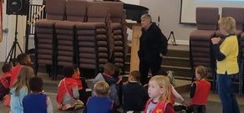
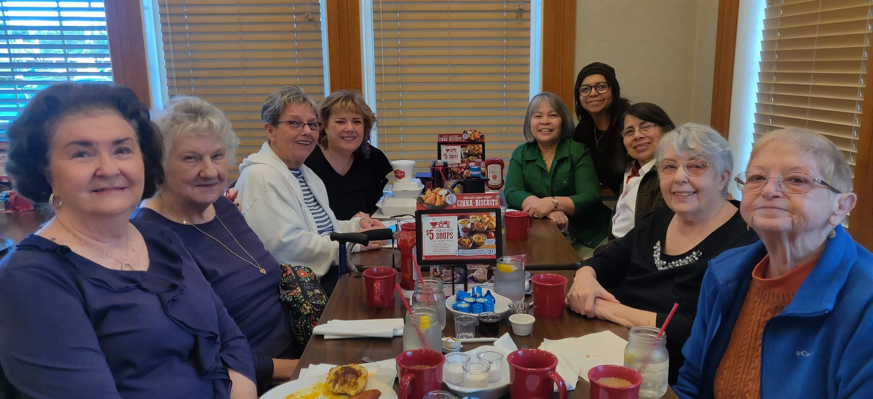
3. Pardon for sin and a peace that endureth,
Thine own dear presence to cheer and to guide;
Strength for today and bright hope for tomorrow,
Blessings all mine, with ten thousand beside!
Great is Thy faithfulness! Great is Thy faithfulness!
Morning by morning new mercies I see;
All I have needed Thy hand hath provided—
Great is Thy faithfulness, Lord, unto me!

Slide 4
Hosea – Introduction (1:1), Body (1:2-14:8), and Conclusion (14:9)
Hosea
Part 1) Hosea’s Unfaithful Wife (Gomer, Romans 15:4) 1-3
Lesson 1 Judgment 1:2-9 Hosea’s family & the blood/valley of Jezreel (2 Kings 9-10)
Salvation 1:10-11 Day of Jezreel - blood of Naboth avenged (1 Kings 21:19)
Lesson 2 Judgment 2:1-13 Gomer’s unfaithfulness (parable of the prodigal wife)
Salvation 2:14-3:5 The Valley of Achor and hearing Jezreel
Part 2) God’s Unfaithful Wife (Israel has 3 strikes) 4-14
Strike 1 Judgment 4-5 Israel ‘s willful ignorance led by the Levite priests
Salvation 6:1-3 Israel returns to the LORD and is spiritually healed
Strike 2 Judgment 6:4-11:7 Israel’s rebellion “A Cake Not Turned”
Salvation 11:8-12
Strike 3 Judgment 12-13 Israel’s unfaithfulness
Salvation 14

Slide 5
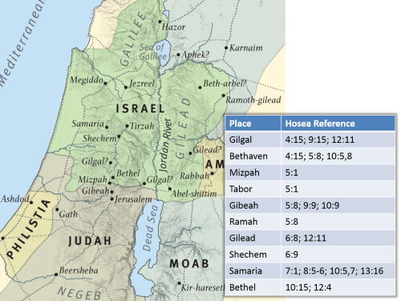
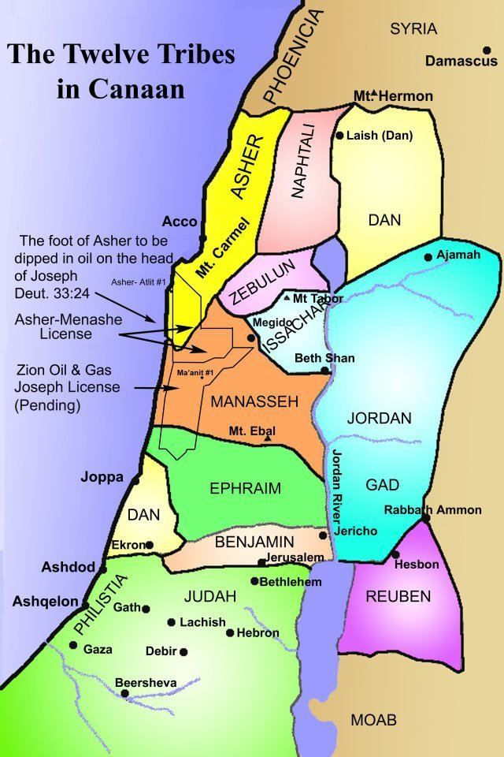
Jezreel is specified in 4 ways in Hosea 1-2
Lachish is 25 miles
south-west of
Jerusalem in Benjamin
(Hos 5:8-10)

Slide 6
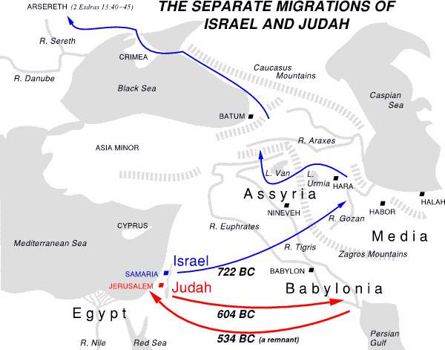
2 Chronicles 11:15
Jeroboam ordained priests
for the high places, and for
the devils, and for the calves which he had made. 16 And after them out of all the
tribes of Israel such as set their hearts to seek the
LORD God of Israel came to Jerusalem, to sacrifice unto the LORD God of their
fathers. 17 So they strengthened the kingdom
of Judah, and made Rehoboam the son of Solomon strong, 3 years: for
3 years they walked in the way of David & Solomon.

Slide 7
Hosea 4:1-6:3 (strike 1 of 3)
JUDGEMENT
4:1-3 The Crime and the Sentence by the Supreme Judge of the World
4: 4:19 The Priests Cause the People to Fall
5:1-7 Israel Fails to Hear God and shall Fall Suddenly
5:8-14 Warning of the coming Judgment by the Assyrians (40 years later)
SALVATION
6:1-3 During the 70th week of Daniel 9:24-27 (2000 years after Jesus is Crucified)
2021 Challenge: How can I warn others of coming judgment? Hebrews 10:24-25
Next Sunday: Hosea 6:4-11:12 (strike 2 of 3)

