Slide 1
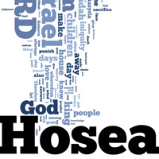
Adult Sunday School Fellowship Church January 24, 2021
Hymn: Onward Christian Soldiers
Hosea 6:4-11:12 (Strike 2 of 3)
Parrallels with the U.S.A. Today and in the Near Future
EasyWorship Background - 5 Minutes Countdown Timer - Bing video
Tibits on Hosea
Read Hosea in 30 minutes
Most common word is “return” used 15 times
Only Hosea and Jeremiah use the word “backsliding”
Read the 12 minor prophets or Isaiah in 4 hours
Book: “Notes on Minor Prophets” by H.A. Ironside

Slide 2

Onward Christian soldiers Marching as to war With the cross of Jesus Going on before Christ the royal master Leads against the foe Forward into battle See his banners go Onward Christian soldiers Marching as to war With the cross of Jesus Going on before Onward Christian soldiers Marching as to war With the cross of Jesus Going on before

Slide 3

We are not divided All one body we One in hope and doctrine One in charity Onward Christian soldiers Marching as to war With the cross of Jesus Going on before With the cross of Jesus Going on before

Slide 4
Hosea – Introduction (1:1), Body (1:2-14:8), and Conclusion (14:9)
Part 1) Gomer’s Faithful Husband (Romans 15:4) 1-3
Lesson 1 Judgment 1:2-9 Hosea’s family
Salvation 1:10-11 Far future of Israel
Lesson 2 Judgment 2:1-13 Gomer’s unfaithfulness
Salvation 2:14-3:5 Far future of Israel
Part 2) Israel’s Faithful Husband (Israel’s and God’s baseball) 4-14
Strike 1 Judgment 4-5 Israel ‘s willful ignorance led by the Levite priests
Salvation 6:1-3 Far future of Israel
Strike 2 Judgment 6:4-11:7 Israel’s rebellion
Salvation 11:8-12 Ekklesia now and far future of Israel
Strike 3 Judgment 12-13 Israel’s unfaithfulness
Salvation 14 :1-8 Ekklesia now and far future of Israel
Israel is OUT when conquered by the Assyrians in 721 B.C.

Slide 5
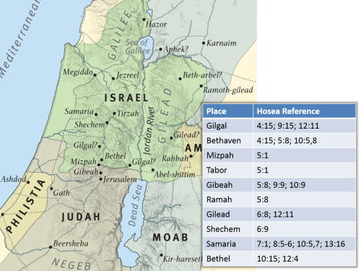
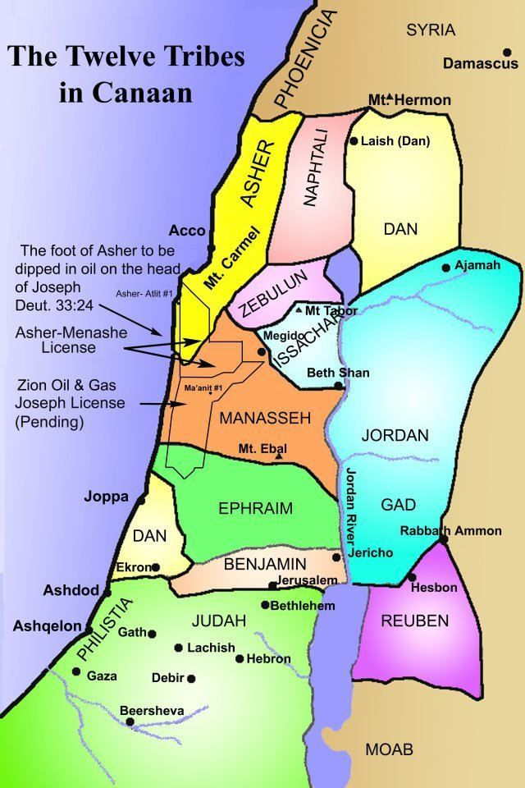
Bethel – house of God, worship a golden calf
Bethaven / Aven - house of wickedness
Gibeah – Gibeonite Lewdness (Judges 19)
Gilead – a Levite city, that works iniquity,
Gilgal – idol worship
Samaria – capital known for wickedness
Shechem – city of refuge

Slide 6
Hosea 6:4-11:12
JUDGEMENT (Strike 2 after 5 foul balls)
6:4-11 True Prophets and Lewd Priests
7:1-10 A Cake Not Turned 7:11-16 A Silly Dove without Heart, A Deceitful Bow
8:1-14 They have set up Kings & Princes, A Vessel Wherein is No Pleasure
9:1-9 Rejoice Not, a Fool & a Madman 9:10-10:8 Baal-Peor, An Empty Vine
Three-base Hit 10:9-15 (11-12) Break up Your Follow Ground: Time to Seek –
Until He Rain Righteousness (for the Ekklesia)
11:1-7 First Love (1-4), Own Counsel – Backsliding (5-7)
SALVATION
11:8-12 I will not (8-9, 4x), Judah yet Rules with God, and is Faithful with the Saints
2021 Challenge: Is the U.S.A. Like Ephraim, Israel, or Judah? What Would Jesus Do?
Next Sunday: Hosea 12-14 (out 3 of 3) Invite to prayer this Wednesday
“Turning our Laughter to Mourning”

