Slide 1
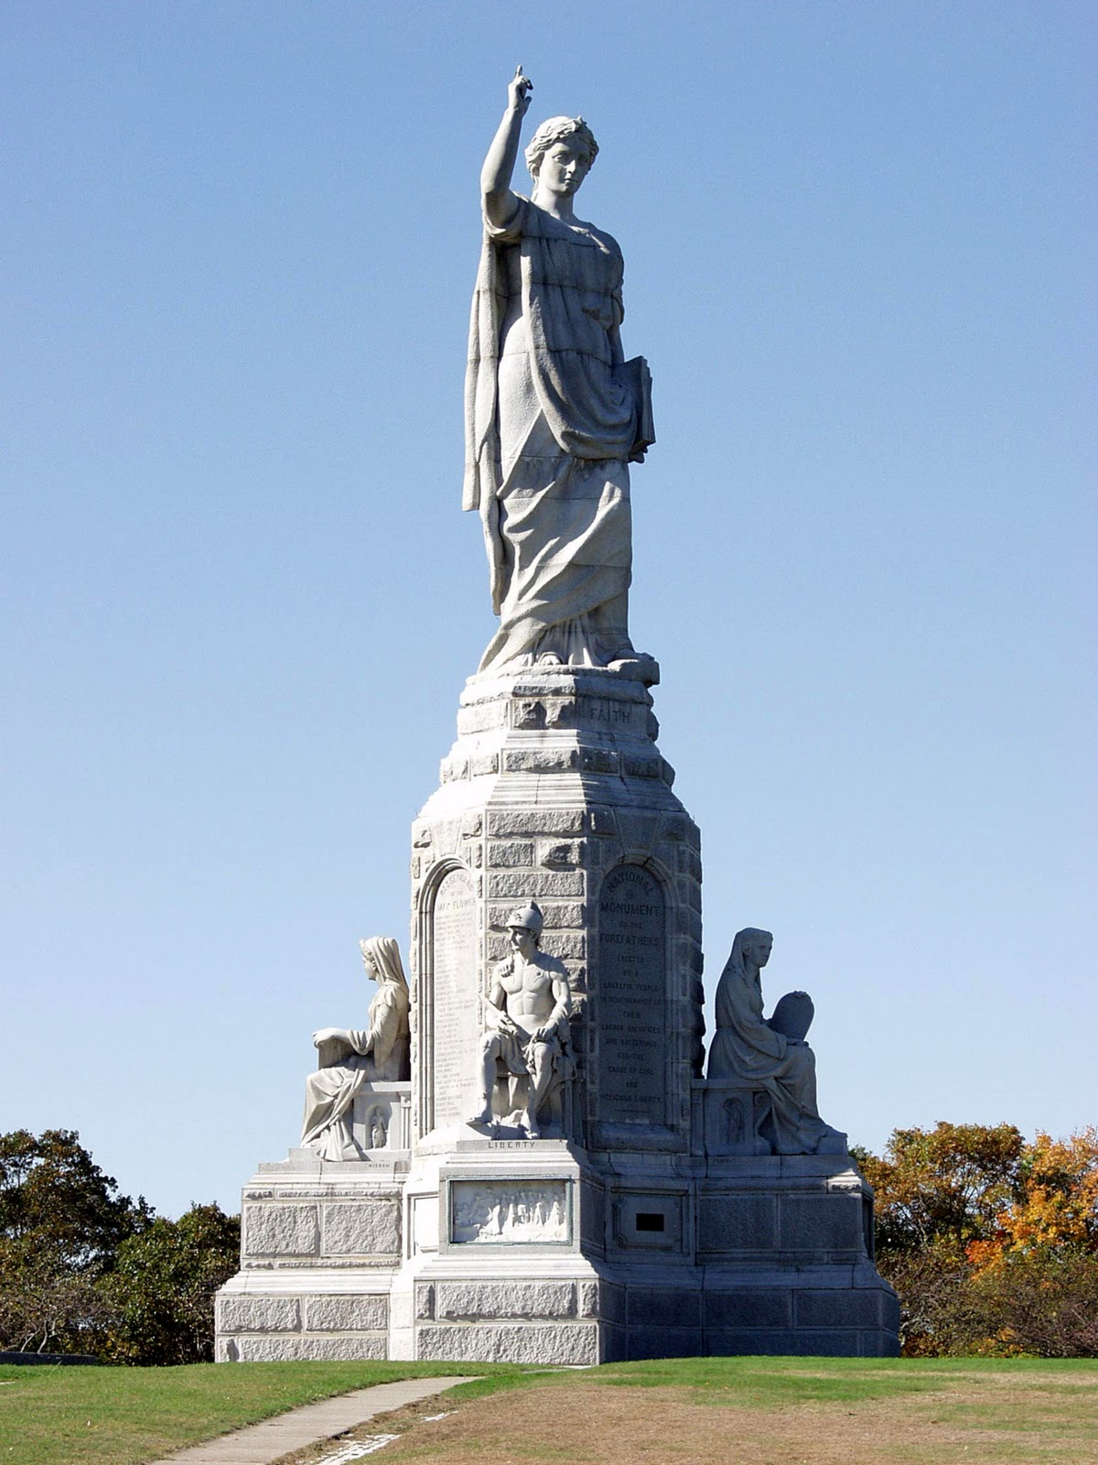
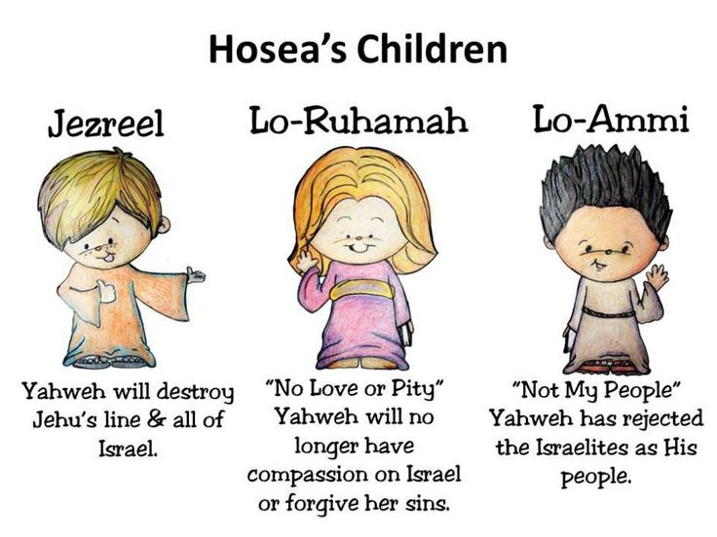
January 3, 2021
The Pilgrim Fathers
Foundations for our nation, the U.S.A.
Hymn: On Christ the Solid Rock
I Stand
and
Hosea (January 2021)
5-week study
Chapter 1 read-ahead
Introduction and Outline
New Jerusalem
Revelation 21-22
National Monument
to the Forefathers

Slide 2
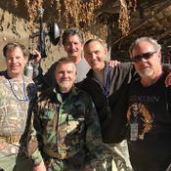
The Solid Rock by Edward Mote , ca.1834, One morning it came to his mind to write a hymn on the “Gracious Experience of a Christian.” He wrote >100 hymn texts, Matthew 7:24-27. Composed by William Bradbury, Public Domain.
My hope is built on nothing less Than Jesus’ blood and righteousness; I dare not trust the sweetest frame, But wholly lean on Jesus’ name.
Refrain: On Christ, the solid Rock, I stand; All other ground is sinking sand, All other ground is sinking sand.
When darkness veils His lovely face, I rest on His unchanging grace; In every high and stormy gale, My anchor holds within the veil.
Refrain: On Christ, the solid Rock, I stand; All other ground is sinking sand, All other ground is sinking sand.

Slide 3
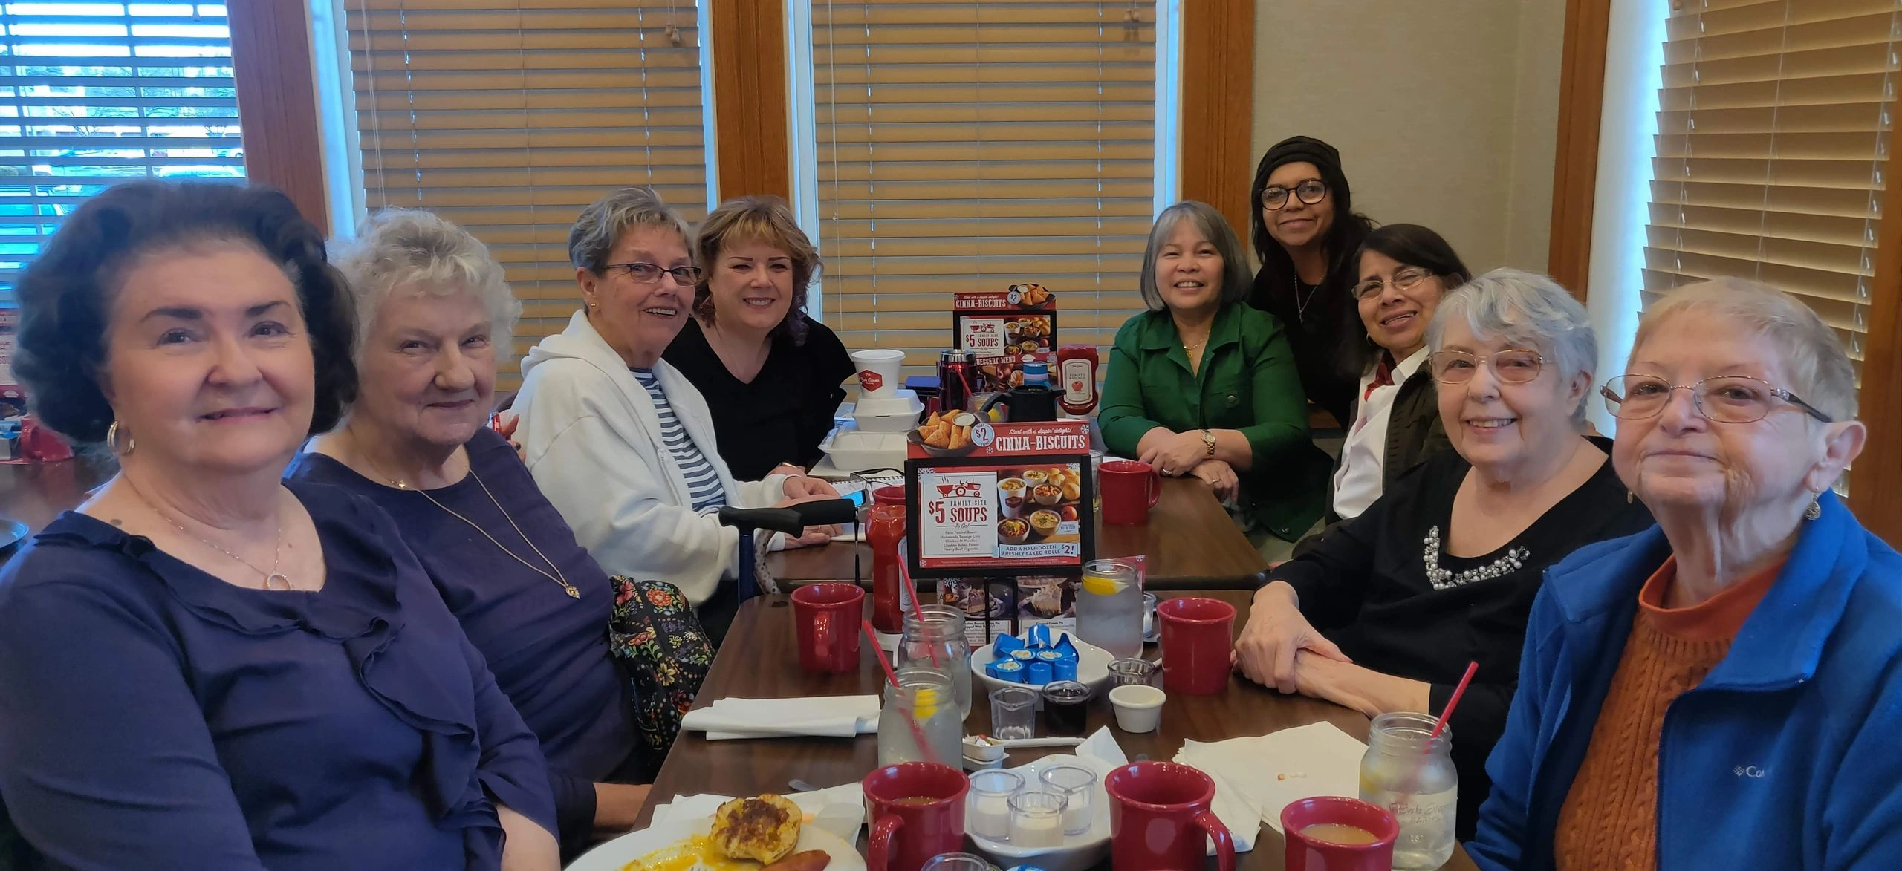
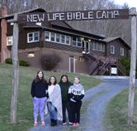
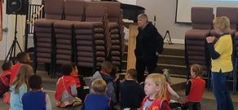
3. His oath, His covenant, His blood Support me in the whelming flood; When all around my soul gives way, He then is all my hope and stay.
Refrain: On Christ, the solid Rock, I stand; All other ground is sinking sand, All other ground is sinking sand.
4. When He shall come with trumpet sound, Oh, may I then in Him be found; Dressed in His righteousness alone, Faultless to stand before the throne.
Refrain: On Christ, the solid Rock, I stand; All other ground is sinking sand, All other ground is sinking sand.

Slide 4
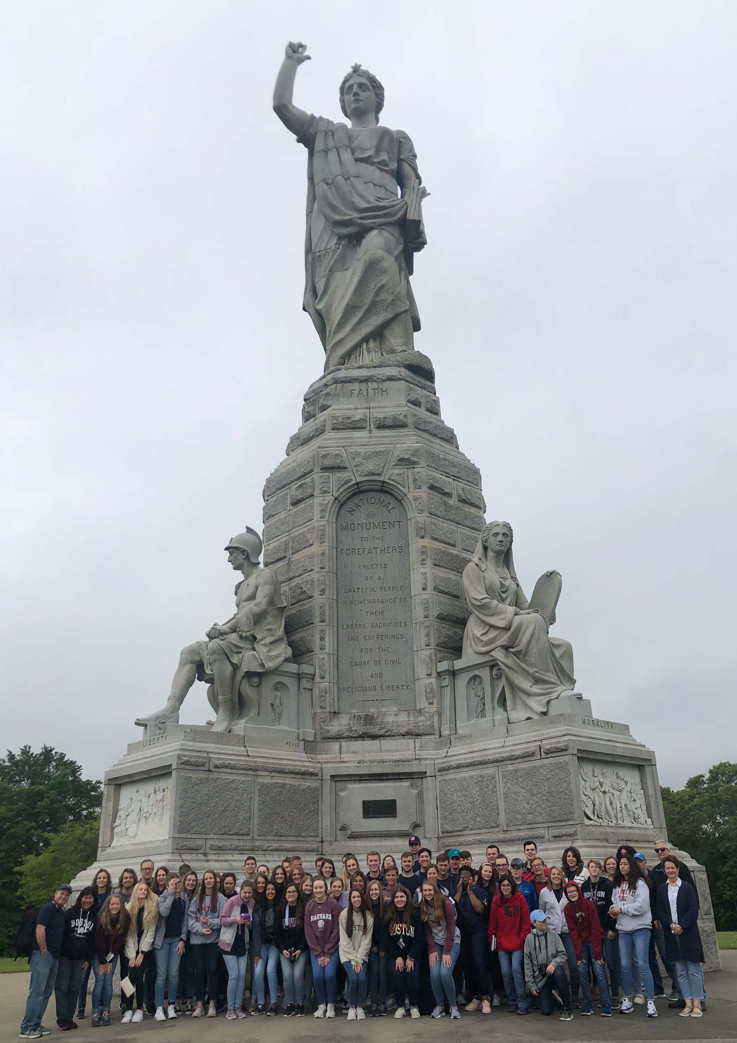
Plymouth Massachusetts
Granite, 188 feet tall, 80 tons

Slide 5
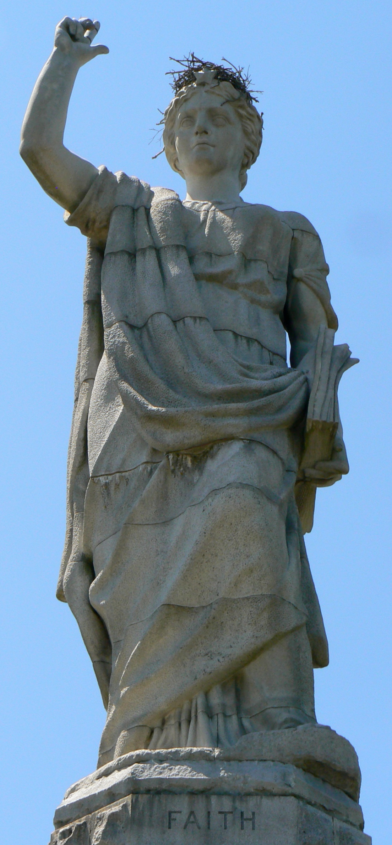
Hand points toward
heaven and one God.
Geneva Bible
is much used
FAITH
MORALITY >
LAW >
EDUCATION >
LIBERTY
FAITH

Slide 6
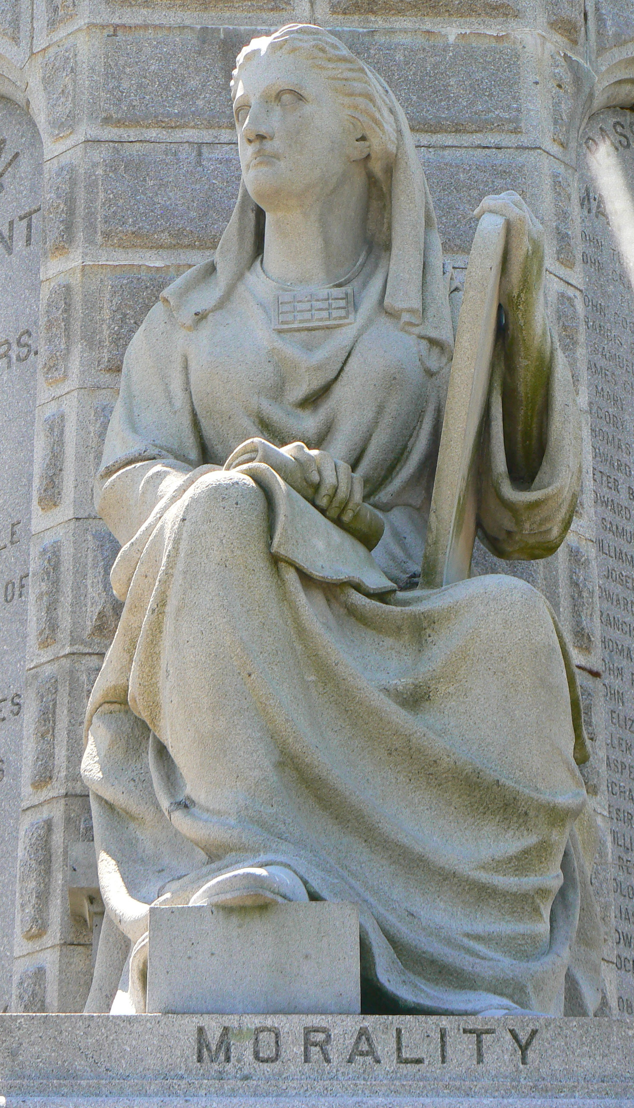
10 Commandments
Scroll of Revelation
Old Testament
Prophet
MORALITY
New Testament
Evangelist

Slide 7
Extended Hand
of Judgment
Statute of Law
Justice
Mercy
LAW

Slide 8
Book of Knowledge
Youth
Wisdom
EDUCATION

Slide 9
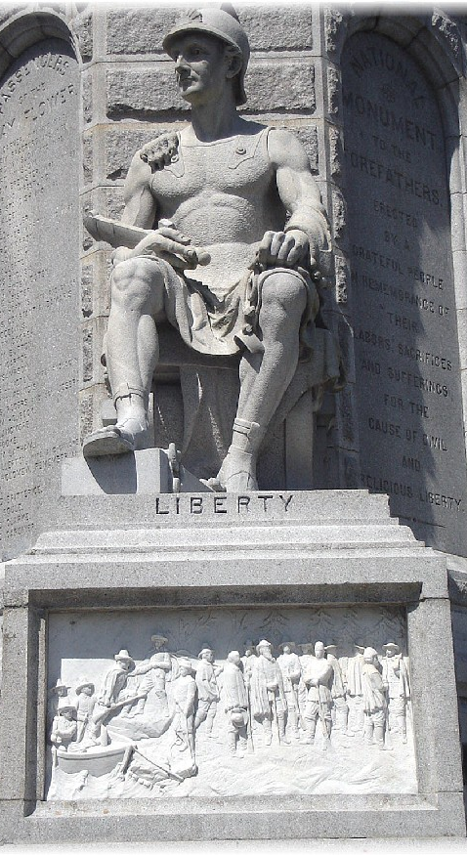
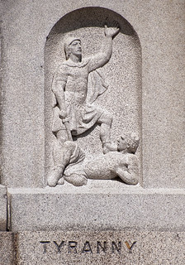
A strong soldier whole
his armor, Ephesians 6:10-20
Slain Lion
Paw & skin
Chains around
Hand & Ankles
Broken
Tyranny
LIBERTY
Peace

Slide 10
Hosea – Introduction (1:1), Body (1:2-14:8), and Conclusion (14:9)
Hosea
Part 1) Hosea’s Unfaithful Wife (Gomer) 1-3
Message 1 Judgment 1:2-9 Hosea’s family & the blood/valley of Jezreel (2 Kings 9-10)
Salvation 1:10-11 Day of Jezreel - blood of Naboth (1 Kings 21:19) avenged
Message 2 Judgment 2:1-13 Gomer’s unfaithfulness
Salvation 2:14-3:5 Valley of Achor (Joshua 7:24-26)
Part 2) God’s Unfaithful Wife (Israel) 4-14
Message 3 Judgment 4-5 Israel & Judah’s guilt
Salvation 6:1-3
Message 4 Judgment 6:4-11:7 Israel’s rebellion
Salvation 11:8-12
Message 5 Judgment 12-13 Israel’s unfaithfulness
Salvation 14

Slide 11
Hosea – chapter 1 (Hosea means salvation in Hebrew)
1:1 Time
1:2-9 Judgment: Hosea’s family
1:10-11 Salvation: Ahab & Jezebel > Naboth > Jehu > Israel
One king - this did not happen in the time of King Cyrus, but will occur when Israel appoints their “one head” who they rejected at his first coming (Romans 11).
Day of Jezreel - Judgment with justice when the vineyard of Naboth’s righteousness is restored
Next Sunday: Hosea 2:1-3:5
CHILDREN OF FAITHFUL HOSEA AND UNFAITHFUL GOMER
Name | Meaning | Purpose
Jezreel | God scatters | God will scatter His people
Lo-Ruhamah | No Mercy | God will show no more mercy to His people
Lo-Ammi | Not my people | God will not recognize Israel as His people

Slide 12
Hosea 1:4
“the blood of
Jezreel”
Jezreel in Hebrew
means “God
scatters or sows”
Like the parable
of the Sower,
the Seed,
and the Four Soils
See Matthew 13
Ahab & Jezebel’s
Summer Palace
2 Events
Blood by Ahab
Blood by Jehu
2 Places
City
Valley
2 Times
Near future
Far future
Saul and Jonathan
lose battle & die,
(1 Samuel 13)

Slide 13
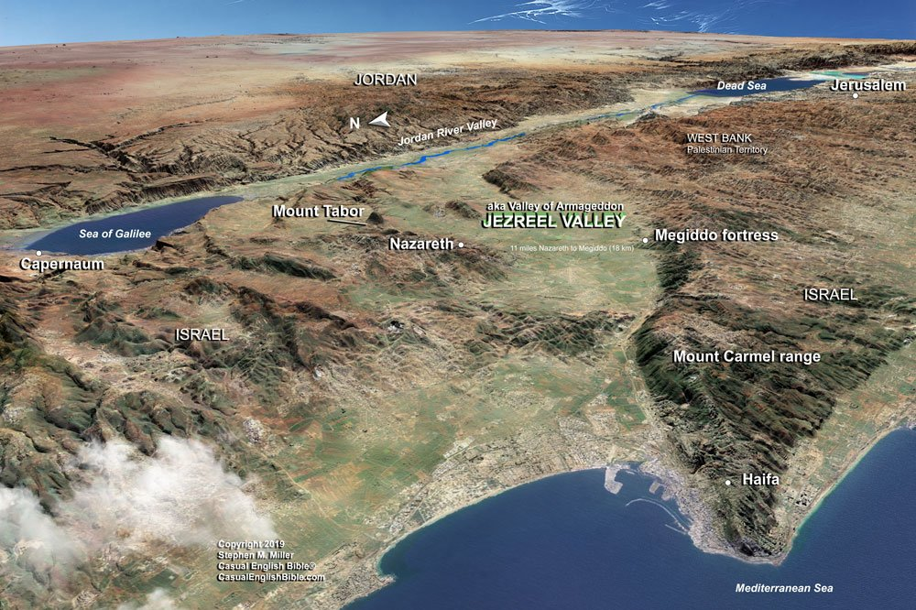
Hosea 1:5
“the Valley of
Jezreel”
Zechariah 14:2
the LORD will
smite all the
people that have
fought against
Jerusalem;
Revelation
16:14-16
the battle of that
great day of
God Almighty.
15 Behold,
I come as a thief.

Slide 14
The Valley of Jezreel today
In Hebrew Jezreel means God plants or sows
Hosea 1:11
“the day of
Jezreel”
What God sowed
In the seed of
righteous Naboth
was destroyed by
wicked Ahab &
Jezebel (Baal is
exalted), a strand
in a rope of truth
until the
“day of Jezreel”
or return of
Jesus Christ

Slide 15
The U.S.A. Supreme Court - Turning Point, Tip-over Point, Point of No Return – 1960s
Foundation Truth Lie Genesis
God Creator Young Earth - 7 days Old Earth – Intelligent Design 1
(Scopes Trial 1925, Public School System 1960s-sex & drugs, Evolutionary Creation)
Marriage & Family Man-Woman Man-man 2-3
(Institution of marriage & the family, Woman’s Rights 14th Amendment, Roe vs Wade 1973
Hate & Murder Religion Relation 4-5
Cain: Heart > Thought > Emotion > Anger > Words > Hate > Violence > Murder
Judgment of sin World-wide flood Local flood 6-8
(Amendment to the ERA – 2020 state of Virginia ratifies – 38 of 50 states 75%)
Government Bottom-up govt Top-down govt 9-11
Jesus Christ/Abraham Growing faith in God Faith in humanity 12
(Remove prayer then Bible 1962-1963 govt bldgs-public schools. 1789-Supreme Court Protestant, 2006-majority Catholic, since 2010-0 Protestant, today-6 Catholic & 3 Jewish.)

