Slide 1
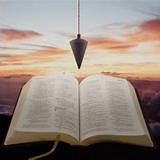
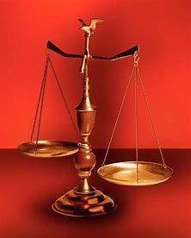
Fellowship Church, August 14, 2024 B. Heath
Straight and Balanced
(Luke 3:4-6)
Biblical characters (Hebrews 11:1-3, 6, 39-40)
#1 – Abel’s Faith & Innocent Blood (Heb 11:4, Gen 4)
#2 – Walking with God & with Enoch (Heb 11:5-6, Gen 5)
#3 – Secure on the Ark with Noah (Heb 11:7, Gen 6-11)
#4a – Faith with Abraham (Heb 11:8-19, Gen 12-23)
#4b – Faith with Sarah (Heb 11:11-12, 1 Peter 3:6)
#4c – OT & NT Strangers & Pilgrims (Heb 11:13-16, 1 Pe 2:11)
#5 – Your Faith & Laughter with Isaac (Heb 11:17-19, Gen 18-24)
#6 – Your Faith with Jacob-Israel (Heb 11:20-21, Gen 25-36)
#7 – Your Faith with Joseph (Heb 11:22, Gen 37- 50)
#8 – Your Faith with Moses (Heb 11:23-29, Exodus-Deut)
#9 – Your Faith with Joshua (Heb 11:30, Joshua)
#10 – Your Faith with Rahab (Heb 11:31, Joshua 6)
#11 – Your Faith with the Judges (Heb 11:32, Judges)
#12 – Your Faith with David (Heb 11:32, 2 Samuel, 1 Chr)
#13 – Your Faith with Samuel (Heb 11:32, 1 Samuel)
#14 – Your Faith with the Prophets (Heb 11:32-38, Is-Malachi)
#15 – Your Faith for All (Heb 11:39-40, Old Testament saints)
OT: Ps 5:8, Pr 4:25-27
Amos 7:7-8, Is 28:13, 17
NT: Mt 3:3, Acts 9:11
Hebrews 12:13, Jude 3
1 Cor 15:1-4, 2 Tim 3:10
John 7:16
OT: Deut 25:13-16
Pr 20:10, Dan 5:25-28
NT: Hebrews12:1
1 Cor 3:11-15,
Philippians 4:5,
James 3:17

Slide 2
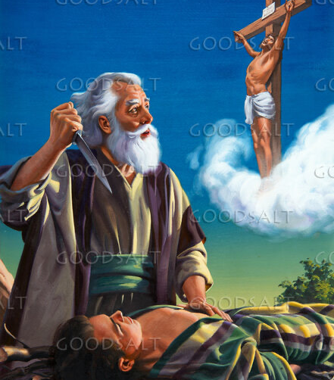
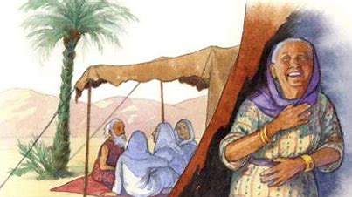
Your Faith and Laughter with Isaac (Hebrews 11:17-19)

Slide 3
Your Faith and Laughter with Isaac (Hebrews 11:17-19)
First: 1-2 minute testimonies on being strangers and pilgrims using 1 Peter 2:11
Text: 17 By faith Abraham, when he was tried, offered up Isaac: and he that had received the promises offered up his only begotten [son],
18 Of whom it was said, That in Isaac shall thy seed be called:
19 Accounting that God [was] able to raise [him] up, even from the dead; from whence also he received him in a figure. (Genesis 22:1-19)
Old Testament: Genesis 18:1-19 (also chapters 17-24 for more on the life of Isaac)
New Testament: Acts 7:1-8 by Stephen, Romans 9:1-11 by Paul
Straight and balanced truth: Understand Bible words - faith, laugh(ter), tried/trials,
promises/covenants to Israel, called, and figure/parable
Application: Christ-followers in local churches between Acts 2 and the rapture
Decision: Give sufficient daily time for the Bible and prayer
Pray for the speaker and message on August 28, brother Joshua

Slide 4
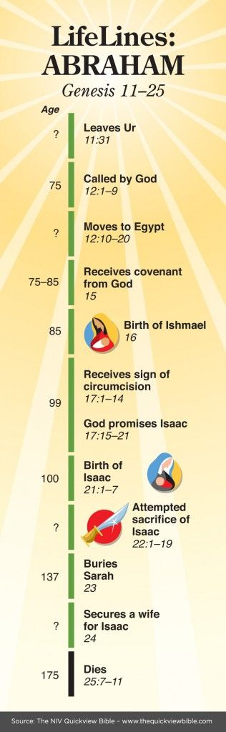
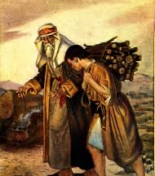
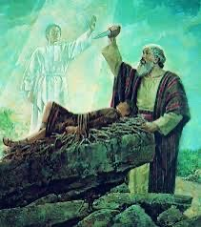
Your Faith and Laughter with Isaac
(Hebrews 11:17-19)
Focus on
Issac and Laughter (Genesis 18:1-19)

