Slide 1
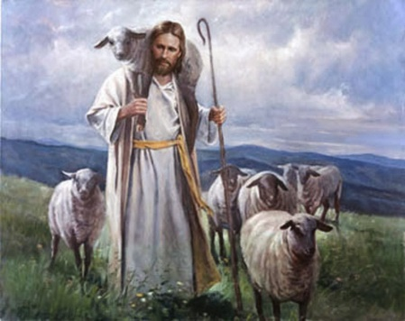
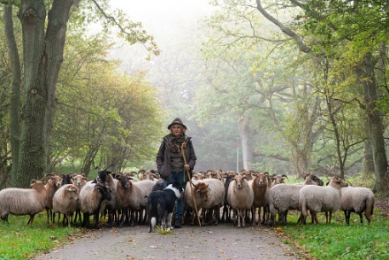
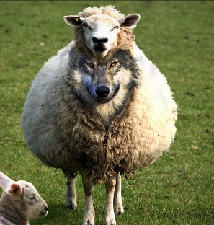
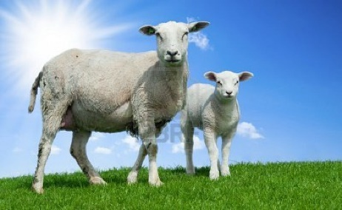
Fellowship church Sunday school November 21 John the apostle‘s “I AM” series I am the Door & the Good Shepherd John Chapter 10
Next Sunday, November 28
I am the resurrection & the life, John chapter 11-12

Slide 2
Jesus’s I AM Titles (8) John Jesus Date
(1-3)
1. I AM (the witness - foundation 4-5 Prophet Oct 31
2. I AM the Bread of Life 6-7 Prophet Nov 7
3. I AM the Light of the World 8-9 Prophet Nov 14
4. I AM the Door, and the Good Shepherd 10 Priest Nov 21
5. I AM the Resurrection and the Life 11-12 Priest Nov 28
6. I AM the Way, the Truth, and the Life 13-14 Priest Dec 5
7. I AM the True Vine/I AM the Vine 15-17 Priest Dec 12
(18-21)
8. I AM Alpha and Omega Revelation 1, 21-22 King Dec 19
9. I AM Christmas and New Year John’s 5 books Dec 26

Slide 3
John 10 – I AM the Door and The Good Shepherd
(7:1-10:21 two days in Jesus’ life)
10:1-10 I AM the Door of the Sheep (2, 7, 8)
Sheepfold – Thief & Robber - Hear Shepherd’s Voice
10:11-21 I AM the Good Shepherd of the Sheep (11, 14)
Gives His life (6x, God is Love) – Hireling/Wolf – Other Sheep
10:22-30 My Sheep Hear My Voice and Follow Me (2-3 months later)
Believed not – Eternal life/Security (5x, God is Holy)
10:31-42 The Jews Attempt to Stone Jesus (31, 39)
John the Baptist – many Believe

