Slide 1
Fellowship church Sunday school November 28 John the apostle‘s “I AM” series I am the resurrection and the life John Chapters 11-12
Next Sunday, December 5
I am the way, the truth & the life, John chapters 13-14

Slide 2
Jesus’s I AM Titles (8) John Jesus Date
the beginning – the foundation (1-3)
1. I AM (the witness) 4-5 Prophet Oct 31
2. I AM the Bread of Life 6-7 Prophet Nov 7
3. I AM the Light of the World 8-9 Prophet Nov 14
4. I AM the Door, I AM the Good Shepherd 10 Priest Nov 21
5. I AM the Resurrection and the Life 11-12 Priest Nov 28
6. I AM the Way, the Truth, and the Life 13-14 Priest Dec 5
7. I AM the True Vine, I AM the Vine 15-17 Priest Dec 12 the ending – the cross (18-21)
8. I AM Alpha and Omega Revelation 1, 21-22 King Dec 19
9. I AM Christmas and New Year John’s 5 books Dec 26

Slide 3
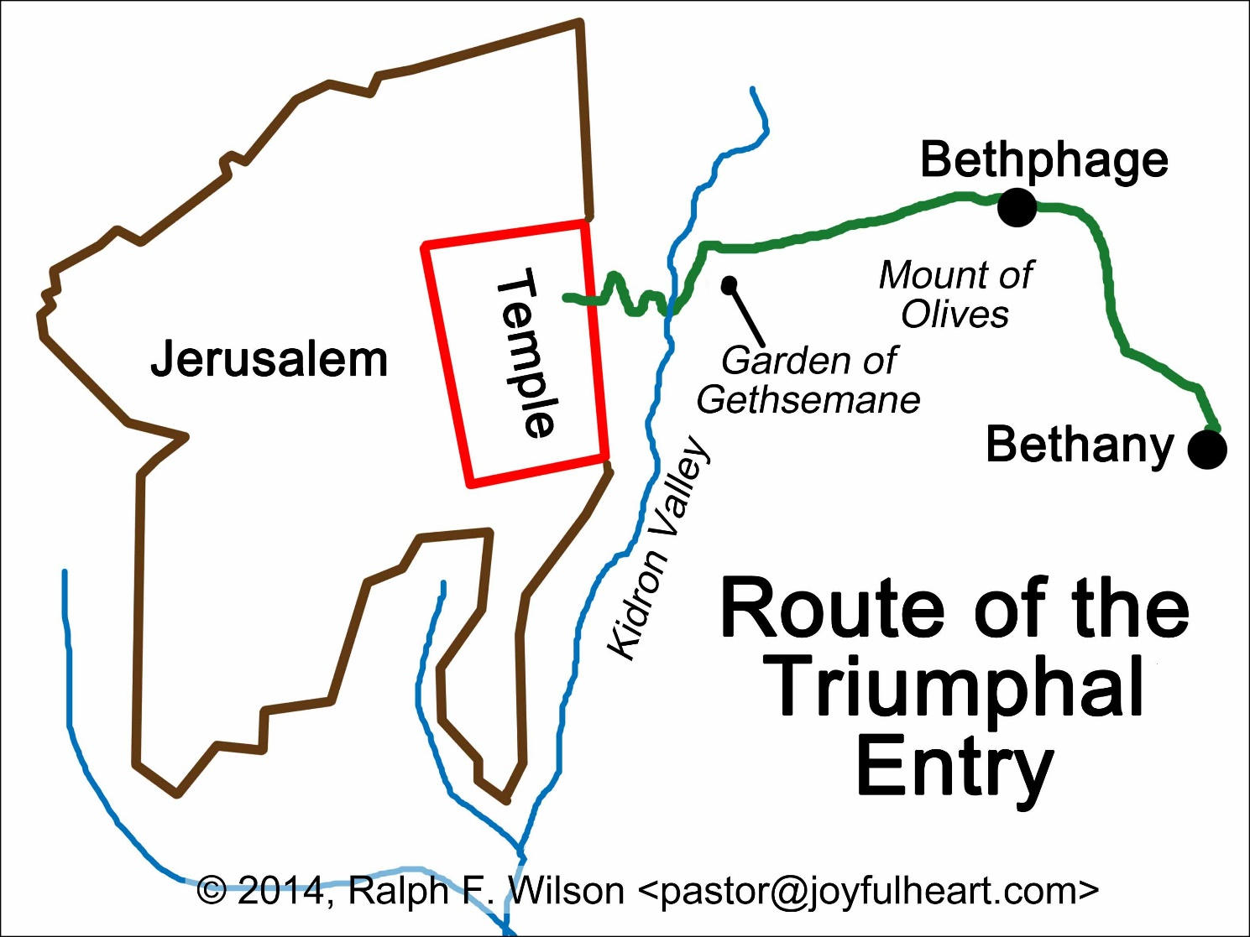
Times and Places
11:1 Bethany
11:54 Ephraim and other places
(a few months)
12:1 Bethany
Saturday
(6 days before Passover)
12:12 Jerusalem
Palm Sunday
12:20 Greeks and Parable - Tuesday

Slide 4
John 11-12, I AM the Resurrection and the Life - Overview
11:1-45 I AM the Resurrection and the Life (11:25)
The Family of Lazarus, Mary and Martha at Bethany (Love)
11:46-57 The Political Climate of Jerusalem the capital (Hate)
12:1-11 Mary Worships and Judas a Thief (6 days before Passover)
Actions of Love (belief) and Hate (unbelief)
12:12-26 Palm Sunday and the Greeks (the next day)
12:27-36 Believe in the Light to be Children of Light
12:37-50 Isaiah and Jesus’ Words Judge Individuals (in the last day)

Slide 5
John Paragraph Title Details
11:1-16 Lazarus Dies at Bethany &
Thomas is Confused
11:17-27 I am the Resurrection and Life
11:28-37 Jesus Wept with Others
11:38-45 Jesus Raises Lazarus from the Dead
11:46-54 The Political Climate &
the High Priest’s Prophecy

Slide 6
John Paragraph Title Details
12:1-11 Mary (sister of Lazarus) Worships Jesus
with Precious Ointment (Saturday)
12:12-19 The Triumphant Entry into Jerusalem
(Palm Sunday)
12:20-26 The Corn of Wheat Must Fall to the Ground and
Die to Bring Forth Fruit (Tuesday)
12:27-36 Believe and Walk in the Light to be
the Children of Light
12:37-41 Three of Isaiah’s Prophecies Fulfilled
12:42-50 Pharisees Love the Praise of Men &
The Words of Jesus and the Father are One

