Slide 1

Fellowship church Sunday school
December 12
John the apostle‘s “I AM” series
I am the Vine
John Chapters 15-17
Next Sunday, December 19
I am Alpha and Omega, Revelation 1, 21-22

Slide 2
Jesus’s I AM Titles (8) John Jesus Date
the beginning – the foundation (1-3)
1. I AM (the witness) 4-5 Prophet Oct 31
2. I AM the Bread of Life 6-7 Prophet Nov 7
3. I AM the Light of the World 8-9 Prophet Nov 14
4. I AM the Door, I AM the Good Shepherd 10 Priest Nov 21
5. I AM the Resurrection and the Life 11-12 Priest Nov 28
6. I AM the Way, the Truth, and the Life 13-14 Priest Dec 5
7. I AM the True Vine, I AM the Vine 15-17 Priest Dec 12 the ending – the cross (18-21)
8. I AM Alpha and Omega Revelation 1, 21-22 King Dec 19
9. I AM Christmas and New Year John’s 5 books Dec 26

Slide 3
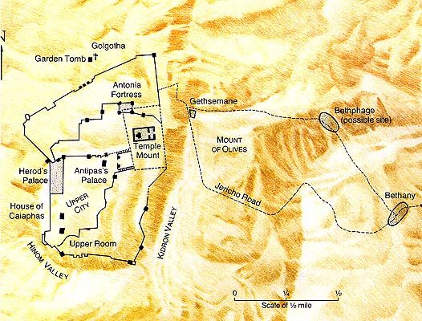
Times and Places
Thursday Evening
Depart Upper Room to the Mount of Olives
14:31 Arise, let us
go from here
Depart Mount of Olives to the Garden of Gethsemane
18:1 He went forth with His disciples … where was a garden

Slide 5
John 15-17, I AM the Vine
Overview
15:1 FOUNDATION: I AM the True Vine, and My Father is the Husbandman
15:2-17 Abide in Me, and I in you: Abide, Fruit, Love, & Friends
15:18-16:4 Jesus Predicts Why the World will Hate Christ followers
Doctrine Build–up
1st Fruit (vs 2)
2nd more fruit (vs 2)
3rd much fruit (vs 8)
4th fruit that remains (vs 16)
Doctrine Build–up
1st Branches receive (vs 5)
2nd Disciples follow (vs 8)
3rd Friends fellowship (vs 15)

Slide 6
John 16-17, I AM the Vine
Overview
16:5-15 The Holy Spirit’s Work (reprove sin-righteousness-judgment)
16:16-22 Trials (Here Comes Trouble) will Turn our Sorrow into Joy
16:23-33 The 11 Apostles will pray directly to the Father
Jesus’ Great High Priestly Prayer to His Father in Heaven
17:1-5 1st for His Work (works – Heb 10:24-25, Rev 2-3)
17:6-19 2nd for His 11 Apostles Sanctification (why the world hates them)
17:20-26 3rd for all future Believers in the Church, Ephesians 3:14-21

