Slide 1
Fellowship church Sunday school November 7 John the apostle‘s “I AM” series I am the bread of life, John Chapters 6-7
Next Sunday, November 14
I am the light of the world, John chapters 8-9

Slide 2
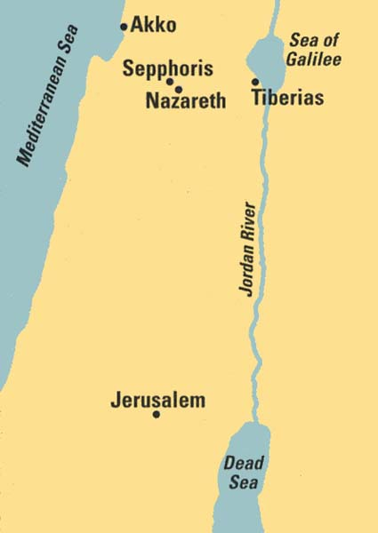
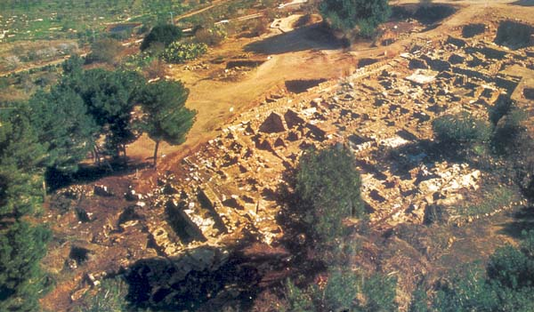
1. Background/Setting
Archeological remains of Sepphoris
4 miles NW from Nazareth
Herod Antipas Rules Galilee
from Sepphoris from 4-20 AD
then from Tiberias from 20-39 AD

Slide 3
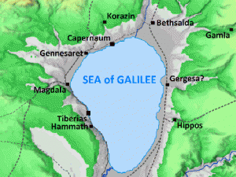
The Travel of Jesus in John 6
4
1
3
2

Slide 4
Jesus’s I AM Titles (8) John (1-3)
1. I AM (the witness - foundation 4-5
2. I AM the Bread of Life 6-7
3. I AM the Light of the World 8-9
4. I AM the Door, and the Good Shepherd 10
5. I AM the Resurrection and the Life 11-12
6. I AM the Way, the Truth, and the Life 13-14
7. I AM the True Vine/I AM the Vine 15-17
(18-21)
8. I AM the Alpha and Omega Revelation 1, 21, 22

Slide 5
John 1-3 | Beginning: Light 1:4-5, 7-9, 3:19-21. Life 5x, Not life 1x. John 1-21 Believe 92x (John 20:31) 1 John 5:13 |  | John 8-12 Light, 13-17 Love, 18-21 Life 1 John 1:1-2:11 Light, 2:5-5:3 Love, 5:6-19 Life Revelation 1-18 Light, 19-20 Love, 21-22 Life
 | I AM (John 21x) + (Rev 4x) = (25x) |  | Who | When (appx) | Where
John 4-5 | I AM (the witness - foundation) (4:26) | living water, Never thirst 4:10-11, 13-15 Light 5:35 | Woman at the Well /Lame man | 6 to 9 months ? Sabbath | Judea, Samaria Galilee, Jerusalem
John 6-7 | I AM the Bread of Life (6:35, 6:41, 6:48, 6:57) | (7:1-53) Thirst, Rivers of living water | Fed Multitude Heal 1, Taught | Passover Feast Feast of Taber | Galilee, Jerusalem
John 8-9 | I AM the Light of the World (8:12, 9:5) | I AM (8:28, 9:9) | Blind man healed | 3 years Same day Sabbath | Mount of Olives
John 10 | I AM the Door of the Sheep (10:7, 10:9) | I AM the Good Shepherd of the Sheep (10:11, 14) | My Sheep hear my Voice |  | Beyond Jordon 10:40
John 11-12 | I AM the Resurrection & the Life (11:25) | the Light of this World (11:9, 12:35, 12:49) | A family of friends - funeral | 3 yr, 5 mo , Jn 12:1 | Bethany 11:1 Ephraim, Bethany
John 13-14 | I AM the Way, the Truth, and the Life (14:6) | I AM (13:19) | Judas left, 13:31 11 disciples | Thursday night before Jesus is crucified | Jerusalem Passover Supper
John 15-17 | I AM the True Vine (15:1) I AM the Vine (15:5) | Abide 8x Abide not 1x. Fruit 6x, No fruit 1x. World-Hate 15:18-25 |  |  | Mount of Olives
John 18-21 | Ending I AM (18:5, 18:6, 18:8) | John 4-17 Life 30x Not life 1x | Disciples, Jews, Romans, World | Betrayal, death 40 days, 33 AD | Gethsemane Golgotha
Revel ation | I AM the Alpha & Omega, Beginning & the Ending (1:8, 21:6) | I AM the Alpha & Omega, First & the Last (1:11) + Beginning & End (22:13) | John, Jesus, Angels, 4 beasts 24 elders | 90 AD 1 John 90 AD? | Island of Patmos World

