Slide 1

Fellowship church Sunday school
December 26
John the apostle‘s “I AM” series
I am the Christmas and the new year
John, revelation, & 1-2-3 john
January 2, 2022
Acts Chapter 1

Slide 2
Jesus’s I AM Titles (8) John Jesus Date
the beginning – the foundation (1-3)
1. I AM (the witness) 4-5 Prophet Oct 31
2. I AM the Bread of Life 6-7 Prophet Nov 7
3. I AM the Light of the World 8-9 Prophet Nov 14
4. I AM the Door, I AM the Good Shepherd 10 Priest Nov 21
5. I AM the Resurrection and the Life 11-12 Priest Nov 28
6. I AM the Way, the Truth, and the Life 13-14 Priest Dec 5
7. I AM the True Vine, I AM the Vine 15-17 Priest Dec 12 the ending – the cross (18-21)
8. I AM Alpha and Omega Revelation 1, 21-22 King Dec 19
9. I AM the Christmas and the New Year John’s 5 books Dec 26

Slide 3


Slide 5
Jesus is the Christmas in 2022
I will give my mind, heart, soul, and strength
to our God daily in my Time, Talents, and Treasure
To be led by the Holy Spirit to do His will, His way,
and in His time (Romans 12:1-2)
As the wise men gave gifts to Jesus,
I desire to give gifts of eternal value to others
(Matthew 2:11)

Slide 6
2022
Fellowship
Church
Jesus is the
New Year
of Daily
Bible
and
Prayer
2022

Slide 7
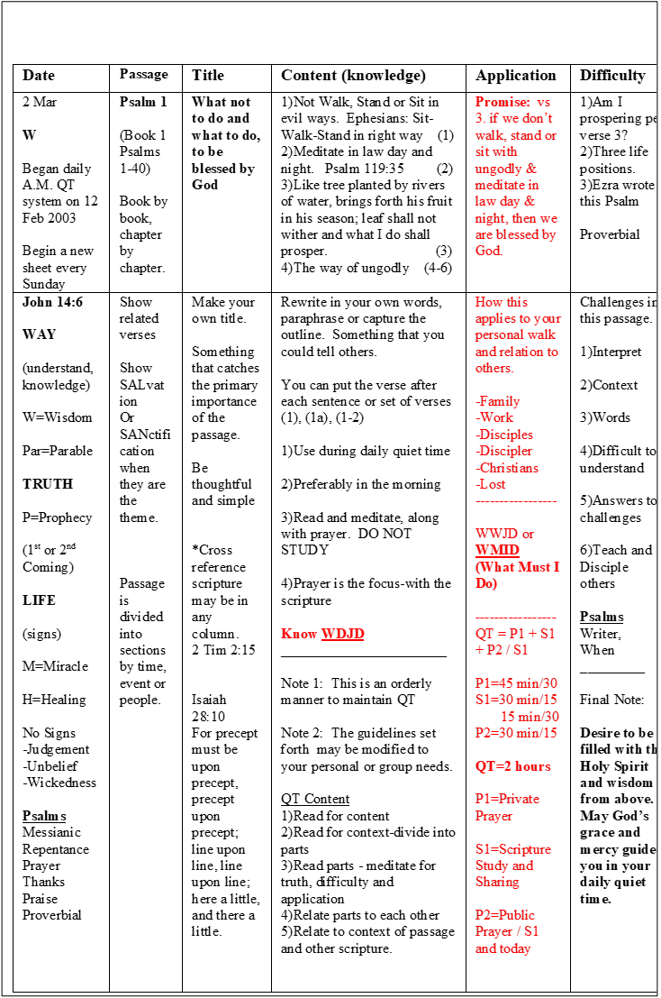
Date | Passage | (4) Title | (1) Contents | (2) Complexity | (3) Application
Sun
Mon
Tue
Wed
Thu
Fri
Sat

