Slide 1
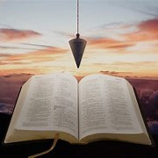
Straight and Balanced
(Luke 3:4-6)
Biblical characters (Hebrews 11:32)
Barak the Battle Winner
#1 – Honor or dishonor in battle (Judges 5:12-23)
#2 – Jael severed from the past to win a battle (Judges 4-5)
#3 – Deborah: wife & mother, prophetess & judge (Judges 4-5)
#4 – General Barak honored by God (Judges 4-5, Heb 11:32)
#5 – How to win a major battle like Barak (Judges 4-5)
Samson the Carnal Strongman
#6 – Samson is chosen & gifted (Judges13)
Samson rejects parents & Scripture authority (Judges 14)
#7 – Samson is angry & alone (Judges 15)
#8 – Samson is shelved & saved (Judges 16, Heb 11:32)
#9 – Jephthah’s past, vow & victories (Judges 11:1-12:7)
#10 – Gideon (Judges 7)
#11 – Gideon (Judges 8)
#12 – Gideon (Judges 9)
OT: Ps 5:8, Pr 4:25-27
Amos 7:7-8, Is 28:13, 17
NT: Mt 3:3, Acts 9:11
Hebrews 12:13
OT: Deut 25:13-16
Pr 20:10, Dan 5:25-28
NT: Hebrews12:1
1 Cor 3:11-15
Fellowship Church, January 6, 2024, by Bill Heath

Slide 2
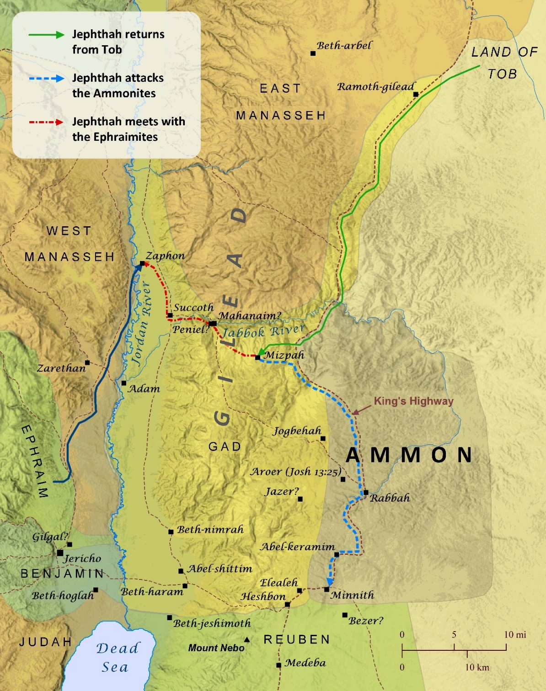
(Hebrews 11:32 Gideon, Barak, Samson, and Jephthah;) Jephthah’s Past, Vow & Victories (Judges 11:1-12:7) . 11:1-11 Jephthah Rejected, then Leads Rejects 11:12-40 Jephthah ‘s External Enemy & Victory Just war won 300 years ago – History revisionist Jephthah’s Rash Vow - Doctrine of Vows 12:1-7 Jephthah’s Internal Enemy & Victory Ephraim is one of the two sons of Joseph Decision: Bring your past to the Lord for his land (your mind, body, and soul) and victory over His enemies.

