Slide 1
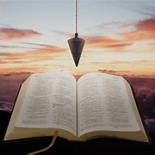
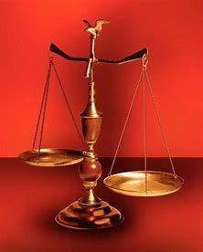
Straight and Balanced
(Luke 3:4-6)
Biblical characters
#1 – Simeon & Anna seek, see, & speak (Luke 2:22-40)
#2 – No guile Nathanael (John 1:43-51)
#3 – Here a little, there a little (Isaiah 28:1-29)
Barak the Battle Winner
#4 – Honor or dishonor in battle (Judges 5:12-23)
#5 – Jael severed from the past to win a battle (Judges 4-5)
#6 – Deborah: wife & mother, prophetess & judge (Judges 4-5)
#7 – General Barak honored by God (Judges 4-5, Heb 11:32)
#8 – How to win a major battle like Barak (Judges 4-5)
Samson the Carnal Strongman
#9 – Samson is Chosen & Gifted (Judges13)
Samson rejects parents & Scripture authority (Judges 14)
#10 – Samson is Angry & Alone (Judges 15)
#11 – Samson is Shelved, & Saved (Judges 16, Heb 11:32)
OT: Ps 5:8, Pr 4:25-27
Amos 7:7-8, Is 28:13, 17
NT: Mt 3:3, Acts 9:11
Hebrews 12:13
OT: Deut 25:13-16
Pr 20:10, Dan 5:25-28
NT: Hebrews12:1
1 Cor 3:11-15
Fellowship Church, December 13, 2023, by Bill Heath

Slide 2
Times: Every man did what was right in his own eyes
(Judges 21:25)
Old Testament: And the times of ignorance God winked at; but now commands all men everywhere to repent (Acts 17:30)
New Testament: The chosen have the best gift, the indwelling Holy Spirit, the perfect example, Jesus Christ, completed Scripture, and the body of Christ (Romans 12)

Slide 3
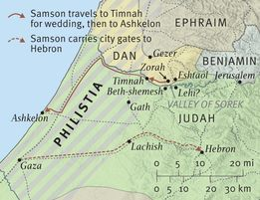
Time & place: Judges 13-16, Philistine rule, 40 years (13:1)
Samson of Dan, Judge of Israel, 20 years, 1085-1065 AD (15:20, 16:31)
1. Zorah – parents & birth (13:2-24)
2. Zorah & Eshtaol – youth (13:25)
3. Timnah – wife, 7 days. (14:1-18)
4. Ashkelon – 30 garments (14:19a)
5. Zorah – parents (14:19b-20)
6. Timnah – 300 foxes (14:20-15:8)
7. Lehi – 3,000 Judah/1000 bone (15:9-20)
8. Gaza – harlot (16:1-3a)
9. Hebron - gate (16:3b)
10. Valley of Sorek – Deliah (16:4-20)
11. Gaza – temple, 3000 (16:21-30)
12. Zorah & Eshtaol – burial (16:31)
1, 2, 5, 12
3, 6
7
10
4
9
8, 11

Slide 4
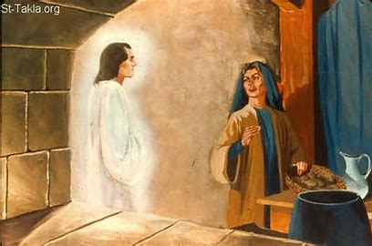
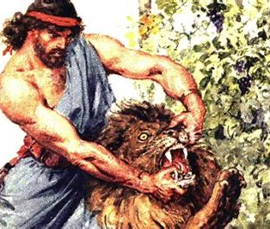
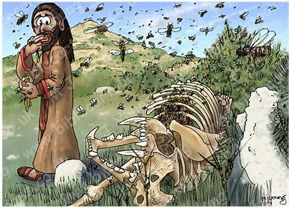
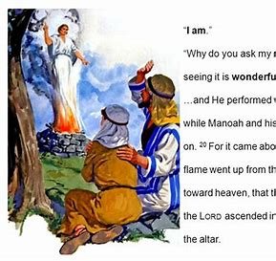
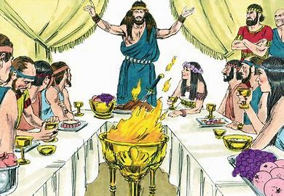
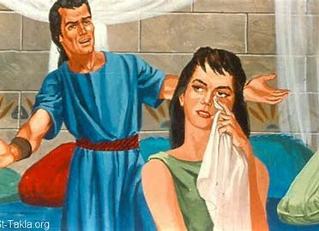
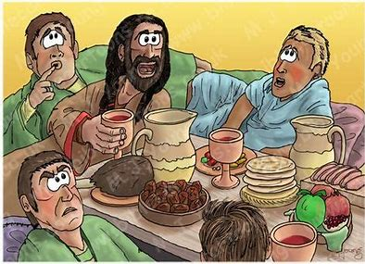
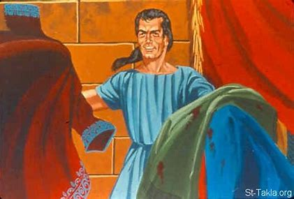
3a. Timnath. Lion in vineyard. 14:1-7
(Nazarite law breaker – Numbers 6)
3b. Timnath. Dead lion and honey. 14:8-9
(Parental & Nazarite law breaker)
1. Zoriah. Angel visits Manoah’s wife 2x. She gets husband. 13:1-23
2. Zoriah. Samson ‘s birth, and youth - Zoriah & Eshtaol. 13:24-25
Judges 13-14
Judges 13-16, 25 action scenes
3c. Timnath. 7-day marriage feast. False friends / $.
Proverbs 27:12. Riddle of the lion and honey. 14:10-14
4. Ashkelon. Slays 30 men for 30 garments.
14:19a
5. Zoriah. Returns to parents. 14:19b-20
3d. Timnath. Wife, tears-hate-love Death threat. by the Philistines 14:15-18

Slide 5
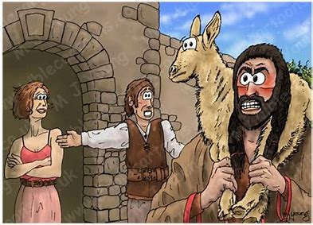
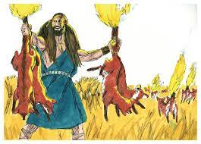
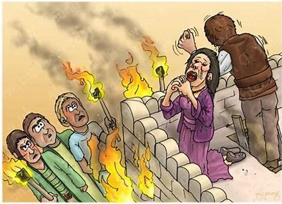
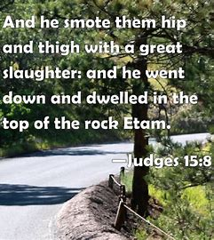
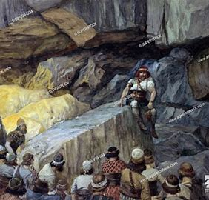
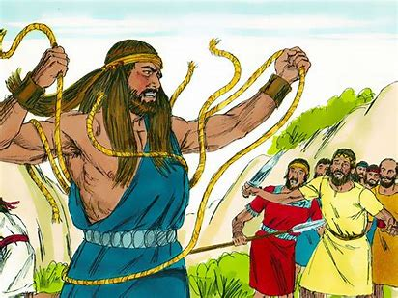
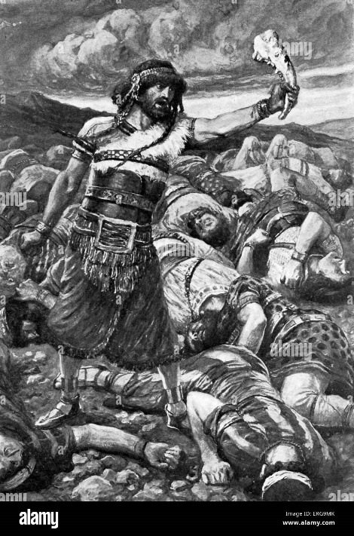
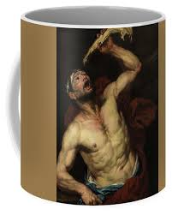
6a. Timnah. Brings marriage gift.
Father gave wife to friend. 15:1-2
Proverbs 16:32, 25:28 self-control
6b. Timnah. 300 fox tails tied. Destroyed fall crop. 15:3-5
6c. Timnah. Philistines burn Samson’s wife and her father to death. 15:6
6d. Timnah. Samson slaughters many Philistines 15:7-8a
Judges 15
7b. Lehi. Men of Judah tied Samson.
He broke the new rope. 15:12-14
7a. Lehi-Etam. 3,000 men of Judah fear the Philistines. 15:8b-11
7c. Lehi. Samson slays 1000
Philistines with Jawbone. 15:15-17
7d. Lehi. Deadly thirst. Miracle of
water out of jawbone. 15:18-20

Slide 6
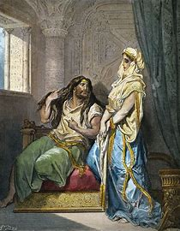
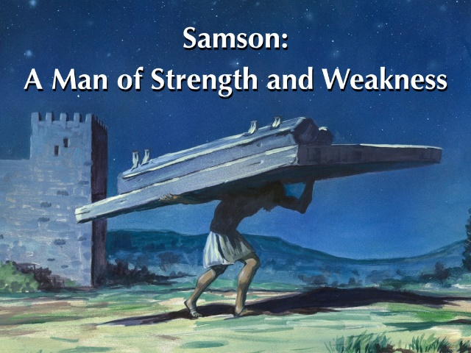
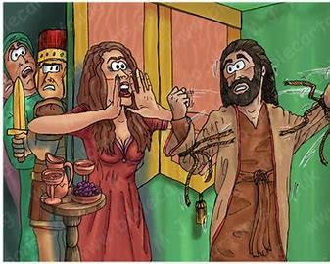
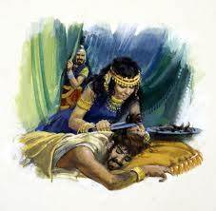
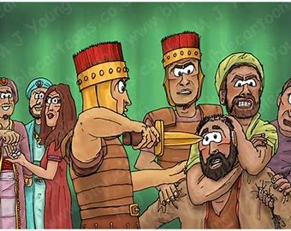
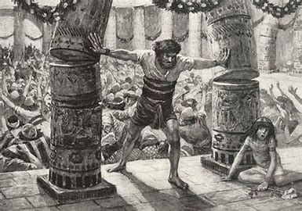
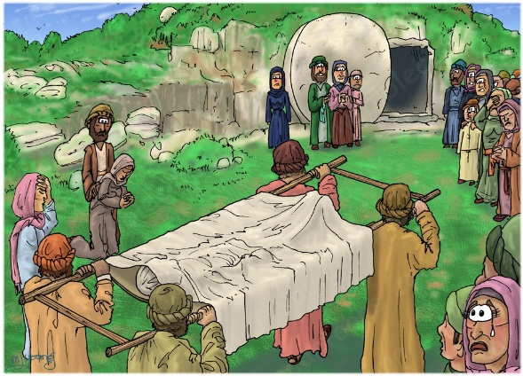
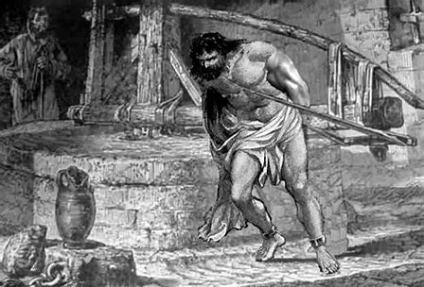
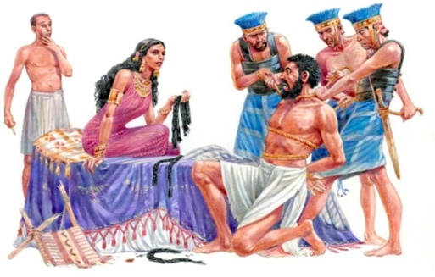
8. Gaza. Stays evening. 16:1-3a
Proverbs 5-7,, 31:3. Ecc 7:28. 1 Tim 2:9-15.
9. Hebron. Midnight. Carries city gate 30 miles. Brag-showoff-pride. 16:3b
Proverbs 27:2
10a. Valley of Sorek. Lies to Deliah 3x. Green rope, new rope, hair locks. 16:4-14
Proverb 27:2 , 27:20.
Judges 16
11b. Gaza. Temple of Dagon. Prayer, 3000 Philistine leaders die. 16:23-30
Prayer. self - I/me/my.
No repentance.
10b. Valley of Sorek. Deliah vexed his soul.
Samson told her his heart. Shaved hair. $/eyes.
Proverbs 27:15 6:15-21a
11a. Gaza. Chained and grinding in
prison. Hair grows. 16:21b-22
Zorah & Eshtaol. Burial. 16:31
Ecc 3:14. Samson-last judge in Judges, Judges 21:25. 1 Samuel – Eli and Samuel.

Slide 7
(Hebrews 11:32 Gideon, Barak, Samson, and Jephthah;)
Title: Samson the Carnal Strongman (Judges 13-16)
.
1. God separates Samson at conception. When and how did God separate you?
.
2. How do you seek and listen to God-given authority?
3. Think about it. Who in the New Testament is like Samson?
.
Application: I am admonished not to spiral downward as Samson did (1 Corinthians 10:11)
.
Decision: Have I consecrated myself unto God? When, where, and how? If not, why?

