Slide 1


Straight and Balanced
(Luke 3:4-6)
#1 – Simeon & Anna seek, see, & speak (Luke 2:22-40)
#2 – No guile Nathanael (John 1:43-51)
#3 – Here a little, there a little (Isaiah 28:1-29)
#4 – Honor or dishonor in battle (Judges 5:12-23)
#5 – Jael severed from the past to win a battle (Judges 4-5)
#6 – Deborah: wife & mother, prophetess & judge (Judges 4-5)
#7 – General Barak honored by God (Judges 4-5, Heb 11:32)
OT: Ps 5:8, Pr 4:25-27
Amos 7:7-8, Is 28:13, 17
NT: Mt 3:3, Acts 9:11
Hebrews 12:13
OT: Deut 25:13-16
Daniel 5:25-28
NT: Hebrews12:1
1 Cor 3:11-15
Fellowship Church, September 27, 2023, by Bill Heath

Slide 2
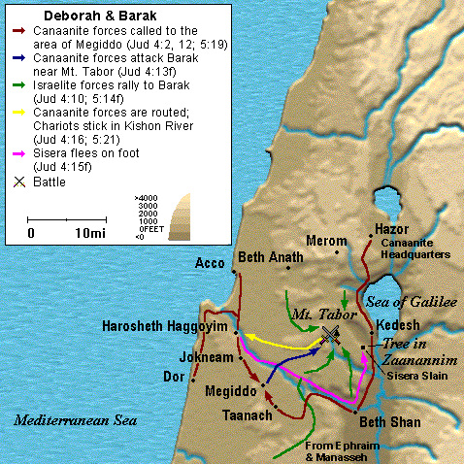
Straight & Balanced
Romans 15:4 things written before are for our learning, that we through patience and comfort of the Scriptures might have hope.
1 Corinthians 10:11 these things are written (1 Cor 10) for our admonition, upon whom the ends of the world are come.
Context: Judges 21:25, In those days there was no king in Israel: every man did that which was right in his own eyes.
Time: 12 judges from Othniel to Samson, 1450-1050 BC.
Four Messages from Judges 4-5
1. Honor or dishonor in battle
2. Jael severed from the past to win a battle
3. Deborah: wife & mother, prophetess & judge
4. General Barak honored by God (Hebrews 11:32)
Deborah, 1204-1144 BC
(Merneptah Stele, 1206 BC Pharoah, 1213-1203 BC
King Jabin’s oppression, Judges 4:3, 5:6-8)
Kishon River

Slide 3
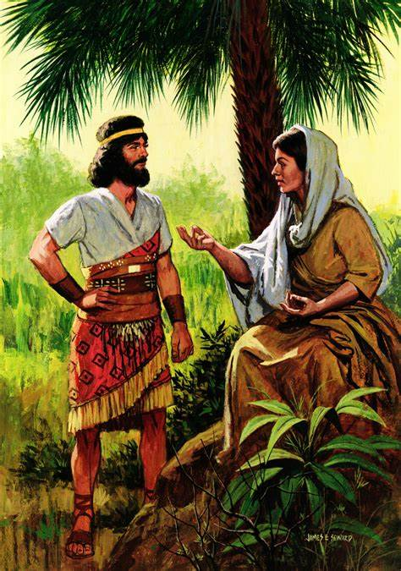
Deborah: wife & mother, prophetess & judge
4:1-3a. Evil > Bondage > Repent > Delivered
4:3b. 20 years of mighty oppression by King Jabin
4:4 WIFE OF LAPIDOTH (5:24) Proverbs 31
Male and female, leave and cleave. Gen 1:27, Mt 19:4-6, Eph 5:22-33
5:6-8 MOTHER (5:28-30) Proverbs 31
Eve = life, Rebekah, Hannah, Naomi & Ruth, Elizabeth & Mary, Lydia
4:4 PROPHETESS (4:6-7, 9, 14, 23; 5:20-23, 25-27)
Role limited to a specific local time and events.
4:4-5 JUDGE (5:2, 9-11, 12b-13, 15b, 18-19, 31)
Anomaly due to weak and fearful men in the times of Judges
Conclusion: 5:31. Love God first, then comes strength
Decision: Honor God’s roles for wives, mothers, & widows
Image of Deborah under the palm tree

